Slide 1
Hall D Beam Commissioning Schedule GlueX Collaboration Meeting
Todd Satogata
Hall D APEL
Jefferson Lab/Old Dominion University
satogata@jlab.org
Thursday Feb 21, 2013
(With thanks to Mike McCaughan, Hall D Operations Group Liason, and Mike Spata, Arne Freyberger)

Slide 2
12 GeV Commissioning Planning
Mike Spata (CASA) is in charge of 12 GeV beam commissioning
Several teams working to develop detailed commissioning plans
Accelerator groups involved include
Beam transport team (broad, leads effort)
High level applications
Controls
Operations
Director’s review of commissioning plan: late spring 2013
Training and review activities ramp-up to beam commissioning
Commissioning plan/goals are aimed at
Meeting 12 GeV project CD4 milestones (CD4A: Dec 2014)
Establishing research-quality beam delivery to all halls

Slide 3
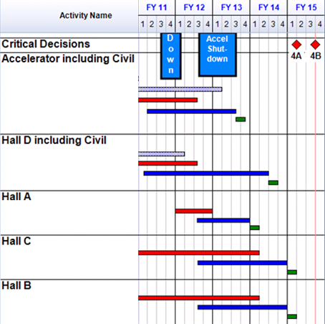
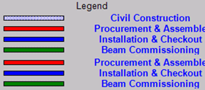
Commissioning Overview After FY12/13 Down
1Q12: End of FY11 down
3Q12-3Q13: FY12/13 down to complete installation
3Q13: Accelerator commissioning
FY14-15: Accelerator provides beam for commissioning Halls

Slide 4
First Accelerator Commissioning Run
Goal:
Establish 1-pass beam at 2.2 GeV/pass
6+ weeks of operations 1QFY14
Injector recovery and new beamline commissioning
Commission 8 new C100 cryomodules with beam
First look at new Spreaders and Recombiners
Get 2.2 GeV/pass beam to 2R
New Hardware:
R100 Cryomodule in the injector*
Injector Spectrometer
Injector Chicane
1S, 1A, 1R, 2S beamlines
8 new and 2 slightly used C100 cryomodules
* R100 not strictly needed until we try to recirculate beam for multiple passes
Notes:
I think this needs some setup.
Might be good to add a top bullet about “start up and commissioning goes smoother when the operations staff knows what changes they’re dealing with.

Slide 5
Second Accelerator Commissioning Run
Goals:
Establish 3 pass beam to Hall-A (magnetic separation)
Establish 5-1/2 pass beam through Hall-D transport line
13 weeks of operations 2QFY14
Injector recovery
Commission Spreaders and Recombiners
Extract third pass beam to Hall A
Get beam to Hall D Tagger Dump
New Hardware:
All of the remaining Spreaders and Recombiners, Arc 3, Arc 10, Hall D Transport
6T Transport Channel and Recombiner for 3rd pass to Hall A
6th beam in the North Linac
Notes:
I think this needs some setup.
Might be good to add a top bullet about “start up and commissioning goes smoother when the operations staff knows what changes they’re dealing with.

Slide 6
High Level Schedule of First Three Runs
Hall D first beam, Accelerator Period II: ~April-May 2014
Beam energy 6 GeV or greater
Mainly depends on C100 RF commissioning, stability
Predominantly tune beam (but CW when available)
Accelerator Period III: ~1QFY15 (October-December 2014)
Push beam energy above 10 GeV
Hall D detector and physics development scheduled
Notes:
I think this needs some setup.
Might be good to add a top bullet about “start up and commissioning goes smoother when the operations staff knows what changes they’re dealing with.

Slide 7
Hall D APEL and Operations Liason
Hall D APEL: Todd Satogata (satogata@jlab.org)
Hall D Operations Liason: Mike McCaughan (michaelm@jlab.org)
Accelerator Physicist Endstation Liason
Serve as primary accelerator division contact on Hall D beam physics issues
Establish robust ties to hall experiment program and staff
Explore beam optics configurations for new proposed experiments
Identify needs for new diagnostics/software required by new beam requirements
Develop beam startup plans and procedures with Operations Liason
Own process of establishing and maintaining physics quality beam to hall D

