Slide 1
USPAS Accelerator Physics 2015 Old Dominion University Colliders, Luminosity, & Crabbing
Todd Satogata (Jefferson Lab) / satogata@jlab.org
Vasiliy Morozov (Jefferson Lab) / morozov@jlab.org
Alex Castilla (ODU) / acast020@odu.edu
http://www.toddsatogata.net/2015-USPAS

Slide 2
Outline
Colliders
Why and where?
Issues
Accelerator Physics of Colliders
Event rate
Luminosity
Looking at the luminosity
Fixed target
Colliders: Gaussian bunches, head-on
Optimization knobs and complications
Hourglass effect
Crossing angle
Crabbing

Slide 3
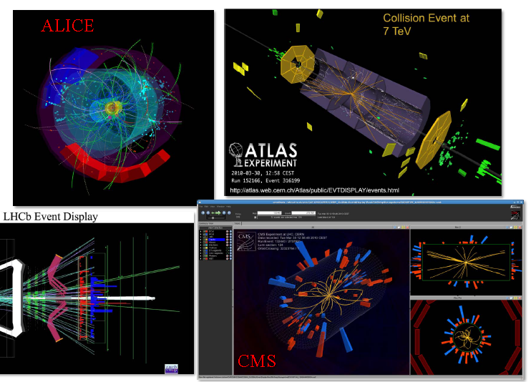
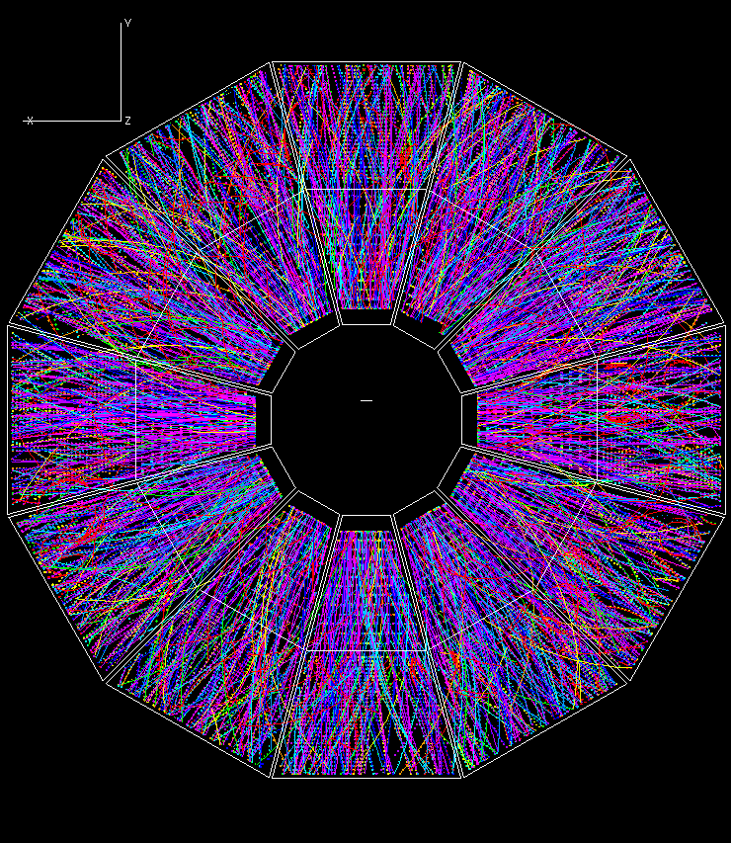
Colliders
Where?
STAR detector at RHIC,
J.G. Cramer UW Colloquium 2002.
Butchered slide from Steve Myers IPAC2012 New Orleans.

Slide 4
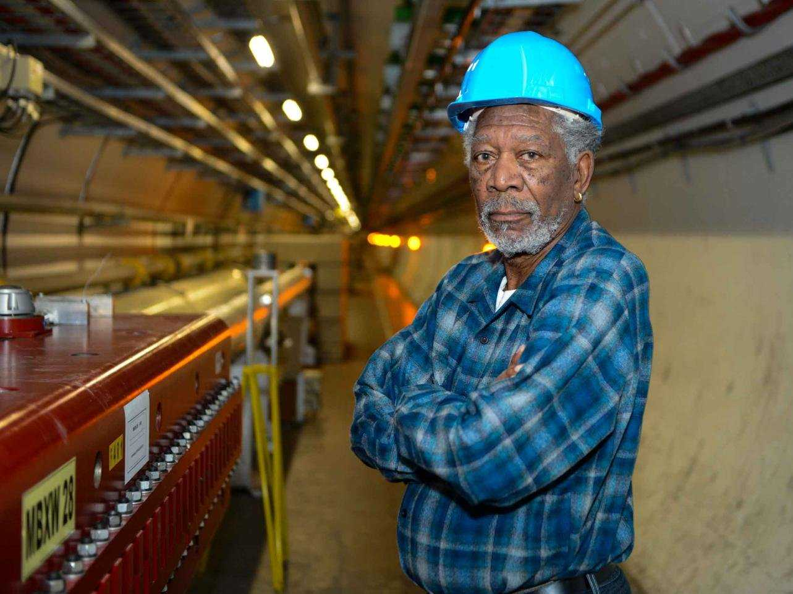
Colliders (2)
Because they are super cool!
Why?
www.businessinsider.com Laurent Egli.
True! But also:
$$E_{cm}=\sqrt{{\left(E_{1}+E_{2}\right)}^{2}+{\left(p_{1}+p_{2}\right)}^{2}}$$
$$E_{cm}=E_{1}+E_{2}$$
$$E_{cm}=\sqrt{2m^{2}+2E_{1}m}$$
Fixed target
$${(p}_{2}=0)$$
Colliding beams
$${(p}_{1}=−p_{2})$$

Slide 5
Probing “small things”
Higher energy → higher resolution
$$λ=\frac{h}{p}$$
??
SUSY??
Weak nuclear force
Proton and neutron
Quarks, muon
Nuclear states transitions
Electron
Transitions in the inner-shell atomic states
Atomic states transitions
Lattice vibration in solids (phonons)
1 $TeV$
≈125 $GeV$
1 $GeV$
1 $MeV$
1 $keV$
1 $eV$
1 $meV$

Slide 6
Accelerator Basics of Colliders
More events in time → better statistic/resolution of the processes.
$$\frac{dR}{dt}=𝓛×σ_{p}$$
$\frac{dR}{dt}$ interactions per second,
$σ_{p}$ interaction cross section (machine independent),
$𝓛$ luminosity, relativistic invariant, independent of the interaction and –very important- measurable.

Slide 7
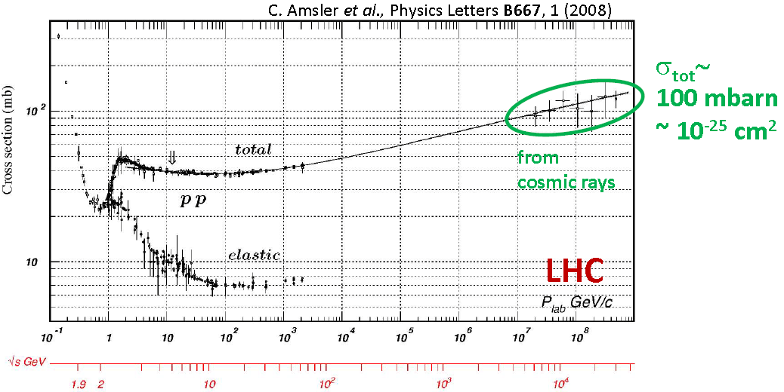
Accelerator Basics of Colliders (2)
*F. Zimmermann, SLAC Summer Institute (2012).

Slide 8
Shining Beam on a Fixed Target
The interaction rate will be a function of:
$$\frac{dR}{dt}=(φρ_{T}l)×σ_{p}$$
$σ_{p}$ interaction cross section.
$φ$ beam particles flux.
$ρ_{T}$ target density.
$l$ target size.
$$ρ_{T}=const$$
$$φ$$
$𝓛$
$$l=const$$

Slide 9
Shining Beam on a Beam (Collider)
The interaction rate will be a function of:
$$\frac{dR}{dt}=(φρ_{T}l)×σ_{p}$$
Then:
$$𝓛∝fn_{1}n_{2}/a$$
$f$ bunch frequency.
$n_{i}$ number of particles per bunch.
$a$ beam transverse profile.
$ℒ$
$$ρ_{T}=const$$
$$l$$
target =
moving beam!

Slide 10
Collider Luminosity
$$n_{1}$$
$$n_{2}$$
Per bunch crossing:
$$ℒ=K∙n_{1}n_{2}∙$$
$\iiint_{−∞}^{∞}{dxdydsds_{0}[}ρ_{1}\left(x,y,s,−s_{0}\right){∙ρ}_{2}\left(x,y,s,s_{0}\right)$]
Where $s_{0}=ct$.
And $K$ is the kinematic factor $\sqrt{{\left({\vec{v}}_{1}−{\vec{v}}_{2}\right)}^{2}−{{\left({\vec{v}}_{1}×{\vec{v}}_{2}\right)}^{2}}/{c^{2}}}$.
Head-on collisions (${\vec{v}}_{1}=−{\vec{v}}_{2}$), then $K=2$.
For uncorrelated distributions:
$$ρ\left(x,y,s,s_{0}\right)=ρ_{x}\left(x\right)ρ_{y}\left(y\right)ρ_{s}\left(s±s_{0}\right)$$
$$s_{0}$$

Slide 11
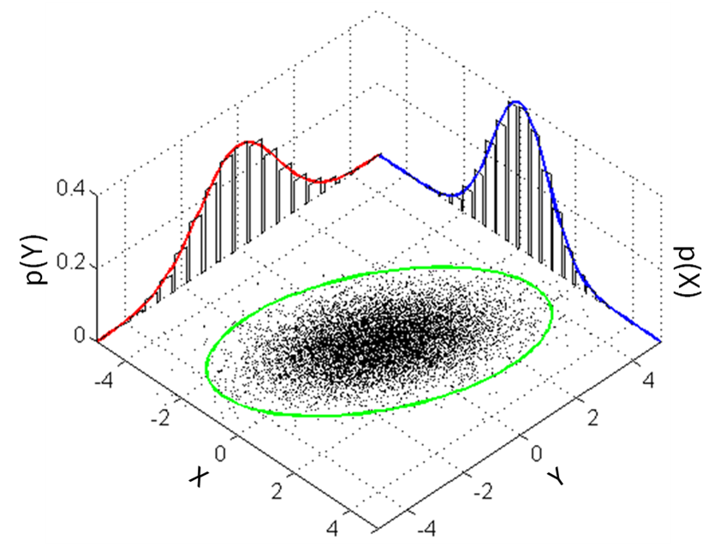
Luminosity of Gaussian Bunches
For two bunches with $n_{1}$ and $n_{2}$ particles respectively:
$$n_{1}$$
$$n_{2}$$
$$s_{0}$$
$$t=1/f$$
Where $σ_{x/y}$ are the rms horizontal/vertical beam sizes.
No offset and head-on collision.
https://en.wikipedia.org/wiki/Multivariate_normal_distribution

Slide 12
Luminosity of Gaussian Bunches (2)
For two beams:
$$ℒ=2∙n_{1}n_{2}∙f∙N_{b}∙\iiint_{−∞}^{∞}{dxdydsds_{0}[}$$
$ρ_{1x}\left(x\right)ρ_{1y}\left(y\right){ρ_{1s}\left(s−s_{0}\right)∙ρ}_{2x}\left(x\right)ρ_{2y}\left(y\right)ρ_{2s}\left(s+s_{0}\right)$]
The Gaussian distributions can be written:
$ρ_{iu}\left(u\right)=\frac{1}{σ_{iu}\sqrt{2π}}e^{(−\frac{u^{2}}{{2σ_{iu}}^{2}})}$, $ρ_{s}\left(s±s_{0}\right)=\frac{1}{σ_{s}\sqrt{2π}}e^{(−\frac{{(s±s_{0})}^{2}}{{2σ_{s}}^{2}})}$ ;
where $u=x,y$ and $i=1,2$ indicates the bunch number.

Slide 13
Luminosity of Gaussian Bunches (3)
Normal distributions are 0K for bunches in equilibrium.
Not Gaussian? → (most likely) numerical integration.
Simplest case: Identical bunches:
$σ_{1x}=σ_{2x}$, $σ_{1y}=σ_{2y}$, and $σ_{1s}=σ_{2s}$
Even $σ_{1x}≠σ_{2x}$ and $σ_{1y}≠σ_{2y}$ can be easily calculated (we will keep $σ_{1s}≈σ_{2s}$).
We will also consider no dispersion at the collision point.
Let’s try a bit of real-time math!

Slide 14
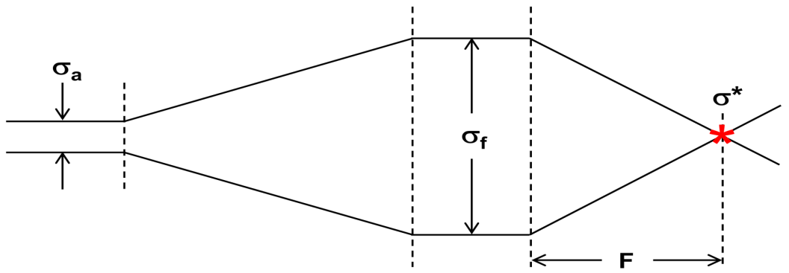
Luminosity of Gaussian Bunches (4)
$$n_{1}$$
$$n_{2}$$
What happens to the bunch’s shape here?
$$t=1/f$$
Where at the IP:
$β_{x,y}^{∗}=\frac{σ_{x,y}^{2}}{ε}$ and $ϵ=\frac{γ}{ε_{N}}$
$$∴ℒ=\frac{n_{1}n_{2}fN_{b}}{4π\sqrt{β_{x}^{∗}β_{y}^{∗}}}$$
Is this “optimizable”?
Again, for identical beams, no crossing angle, no dispersion, no off-set.
Then $ℒ=\frac{n_{1}n_{2}fN_{b}}{4πσ_{x}σ_{y}}$

Slide 15
Turning Knobs for Luminosity
Not head-on collisions (crossing angle $θ_{c}$).
Beam deformations at IP (hour-glass effects).
Desired or non-desired offsets.
Dispersion at IP.
Strong coupling, etc.
$$ℒ=\frac{1}{4π}\left(nfN_{b}\right)∙\frac{n}{ε_{N}}∙\frac{γ}{β_{}^{∗}}∙R(θ_{c},ε,β_{}^{∗},σ_{s})$$
injector and beam-beam
More a complication rather than a knob?
Reduction factor:
hourglass effect,
crossing angle…
total beam current
energy and $β_{}^{∗}$

Slide 16
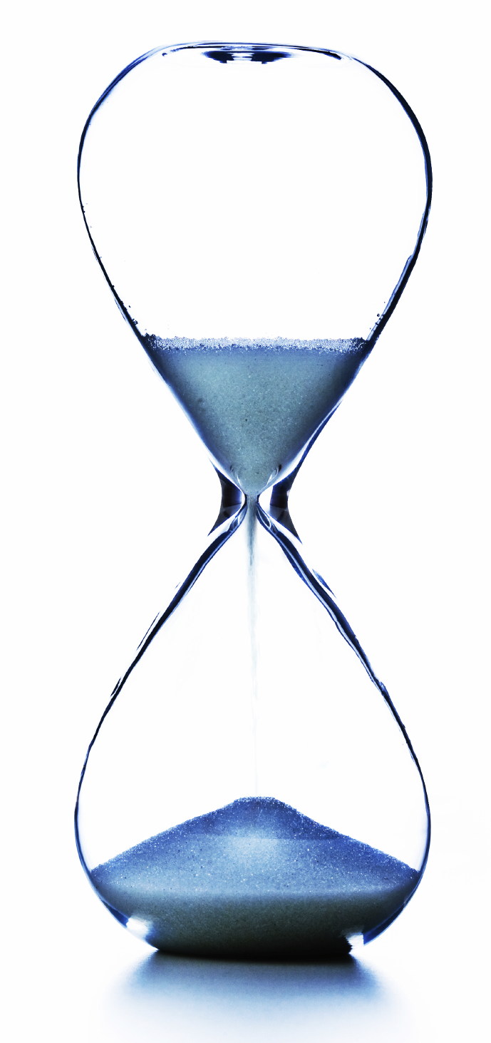
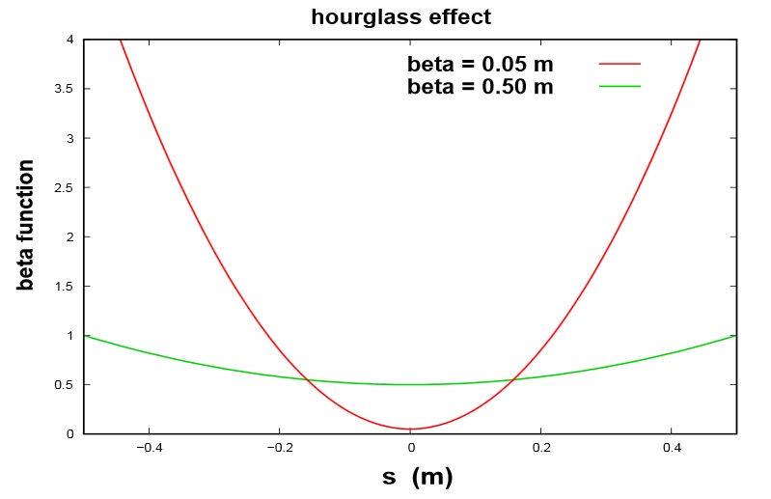
Hourglass Effect
$β$-functions dependent on $s$, usually:
$$β(s)≈β^{∗}\left(1+{\left(\frac{s}{β^{∗}}\right)}^{2}\right)$$
Then $σ≠constant=σ\left(s\right)$:
$σ(s)≈σ^{∗}\sqrt{1+{\left(\frac{s}{β^{∗}}\right)}^{2}}$
Results important if $σ_{s}≥β^{∗}$.
*Werner Herr, CAS-Lectures, Bulgaria (2010).

Slide 17
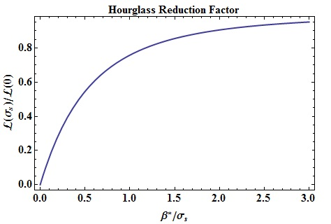
Hourglass Effect (2)
So the luminosity reduction factor:
$$\frac{ℒ\left(σ_{s}\right)}{ℒ\left(0\right)}=\sqrt{π}\frac{β^{∗}}{σ_{s}}e^{{\left(\frac{β^{∗}}{σ_{s}}\right)}^{2}}erfc\left(\frac{β^{∗}}{σ_{s}}\right)$$
$$ℒ\left(σ_{s}\right)=ℒ\left(0\right)∙R_{H} (θ_{c},ε,β_{}^{∗},σ_{s})$$
“Enigmatic” dependency mentioned before!

Slide 18
A Bit More Interesting Case (Crossing Angle)
x
s
$$n_{2}$$
$$n_{1}$$
$$\frac{θ_{c}}{2}$$
$$\frac{θ_{c}}{2}$$
Reduce parasitic collisions.
Physical space for magnets.
Better detector resolution.

Slide 19
Rotating Reference Frames (for each bunch)
x
$$x_{1}$$
s
$$\frac{θ_{c}}{2}$$
$$\frac{θ_{c}}{2}$$
$$s_{1}$$
$$s_{2}$$
$$x_{2}$$
$x_{1}=x\cos{\frac{θ_{c}}{2}}+s\sin{\frac{θ_{c}}{2}}$ , $s_{1}=s\cos{\frac{θ_{c}}{2}}−x\sin{\frac{θ_{c}}{2}}$ .
$x_{2}=−x\cos{\frac{θ_{c}}{2}}+s\sin{\frac{θ_{c}}{2}}$ , $s_{2}=−s\cos{\frac{θ_{c}}{2}}−x\sin{\frac{θ_{c}}{2}}$ .

Slide 20
For the Distributions in the New Systems
For two beams:
$$ℒ=2∙n_{1}n_{2}∙f∙N_{b}∙\iiint_{−∞}^{∞}{dxdydsds_{0}[}$$
$ρ_{1x}\left(x_{1}\right)ρ_{1y}\left(y_{1}\right){ρ_{1s}\left(s_{1}−s_{0}\right)∙ρ}_{2x}\left(x_{2}\right)ρ_{2y}\left(y_{2}\right)ρ_{2s}\left(s_{2}+s_{0}\right)$]
Now we will use:
$$\int_{−∞}^{∞}{dte^{−\left(at^{2}+bt+c\right)}}=\sqrt{\frac{π}{a}}∙e^{\frac{b^{2}−ac}{a}}$$
With some approximations: ${θ_{c}}/2$ fairly small (mrad ~${10}^{−2}$deg), then:
$$\sin{{θ_{c}}/2}\sim \tan{{θ_{c}}/2}\sim {θ_{c}}/2$$

Slide 21
For the Distributions in the New Systems (2)
Some more approximations since ${θ_{c}}/2$ is small:
$$\sin{{θ_{c}}/2}\sim \tan{{θ_{c}}/2}\sim {θ_{c}}/2;$$
discarding $\left\{\begin{aligned}{σ_{x}}^{k}\sin^{l}{{θ_{c}}/2} \\ x^{k}\sin^{l}{{θ_{c}}/2}\end{aligned}\right. ; ∀ k+l≥4$
And so the result is slightly different:
is $σ_{x}≪σ_{s}$?
$\tan{{θ_{c}}/2}→{θ_{c}}/2$.
$ℒ=\frac{n_{1}n_{2}fN_{b}}{4πε\sqrt{β_{x}^{∗}β_{y}^{∗}}}∙$ $\frac{1}{\sqrt{1+{\left(\frac{σ_{s}}{σ_{x}}\tan{\frac{θ_{c}}{2}}\right)}^{2}}}$
$$R(θ_{c},ε,β_{}^{∗},σ_{s})$$

Slide 22
Crossing Angle w/o Correction
$$θ_{c}$$
IP

Slide 23
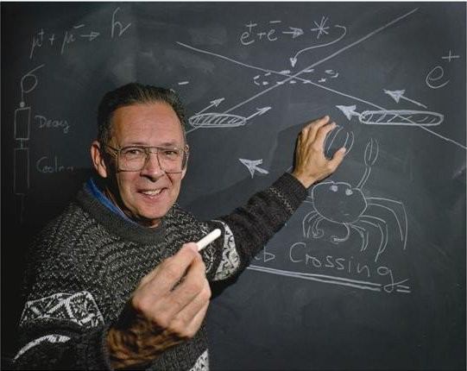
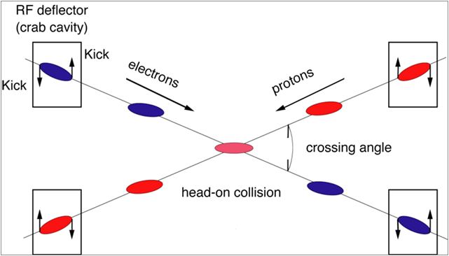
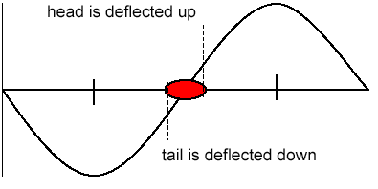
The Crabbing Concept
electrons
protons
*R. Palmer, SLAC-PUB-4707 (1988).
.

Slide 24
RF Transverse Deflection
$$V_{T}=\int_{−∞}^{∞}{\left[E_{x}\left(z\right)\cos{\frac{ωz}{c}}+cB_{y}\left(z\right)\sin{\frac{ωz}{c}}\right]dz}$$
$$V_{T}$$
$$t$$

Slide 25
RF Transverse Deflection (special case)
$$V_{T}=\int_{−∞}^{∞}{\left[E_{x}\left(z\right)\cos{\frac{ωz}{c}}+cB_{y}\left(z\right)\sin{\frac{ωz}{c}}\right]dz}$$
$$V_{T}$$
$$t$$

Slide 26
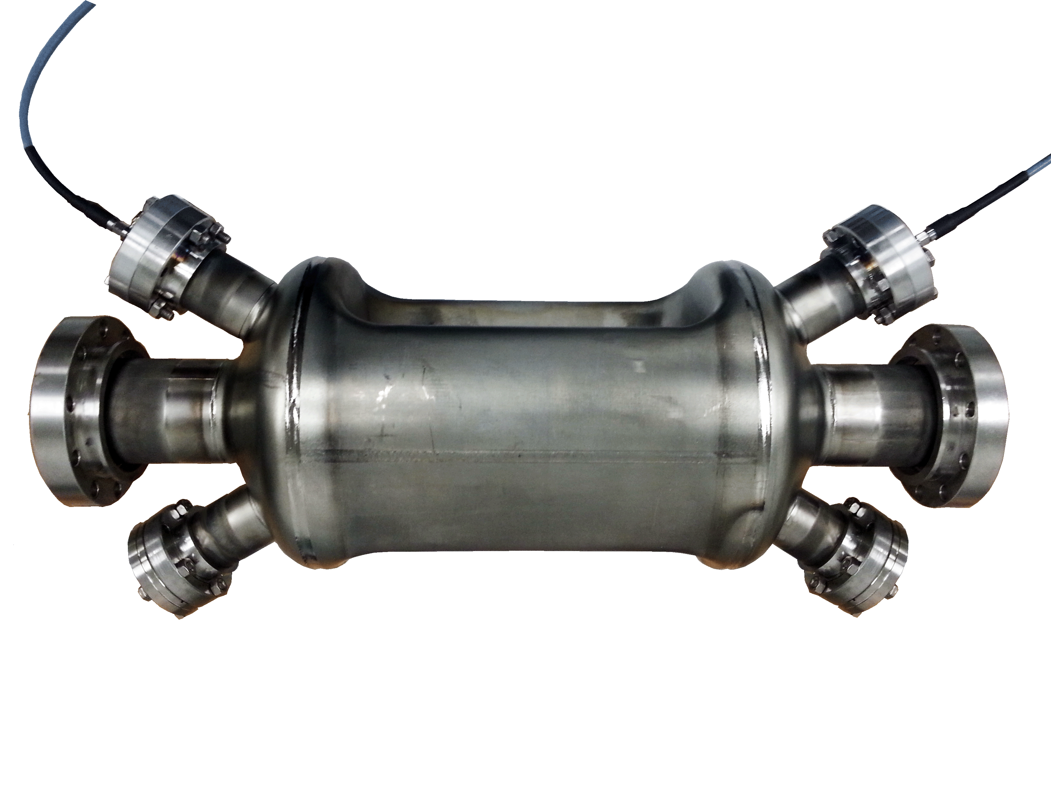
Local Crab Crossing Correction
$$θ_{c}$$
IP

Slide 27
Jefferson Lab’s Medium Energy Electron-Ion Collider

Slide 28
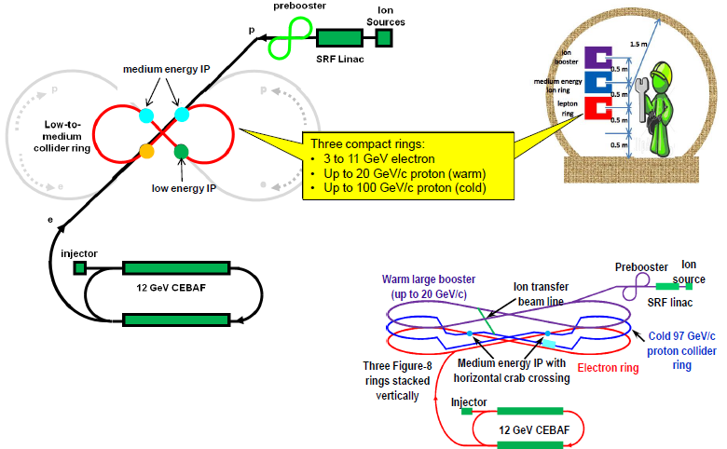
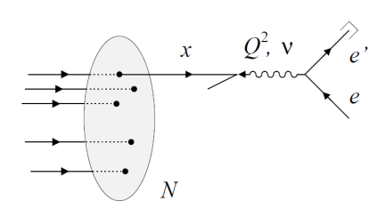
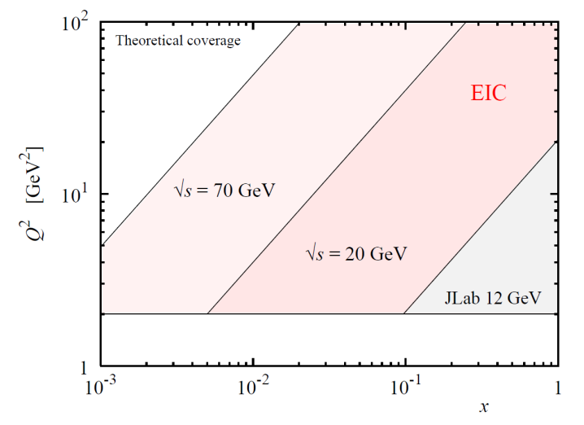
The MEIC at JLab
Deep inelastic ${ep}/{eA}$ scattering.
Y. Zhang, et al. arXiv:1209.0757v2 (2012).
A. Accardi, et al. arXiv:1110.1031v1 (2011).
($\sqrt{s}=20−70 GeV$) and $\sim {10}^{34} {cm}^{−2}s^{−1}$ luminosity.

Slide 29
The MEIC Layout
$ℒ=\frac{N_{1}N_{2}fn_{b}}{4πε\sqrt{β_{x}^{∗}β_{y}^{∗}}}∙$ $\frac{1}{\sqrt{1+{\left(\frac{σ_{s}}{σ_{x}}\tan{\frac{θ_{c}}{2}}\right)}^{2}}}$
Ions
IP
Electrons
Electrons
Ions
IP’s
V. S. Morozov , MEIC study group (2013).

Slide 30
The MEIC Luminosity Approach
Short bunches for both species.
Small transverse emittance.
Ultrahigh collision frequency CW beams.
Staged electron cooling.
Small final focusing $β^{∗}$.
Large beam-beam tune shift.
Crab crossing.

Slide 31
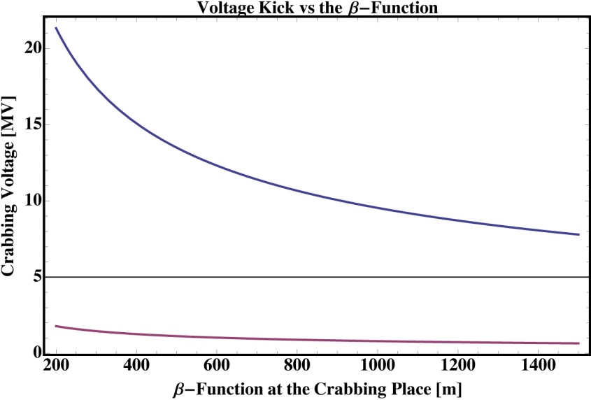
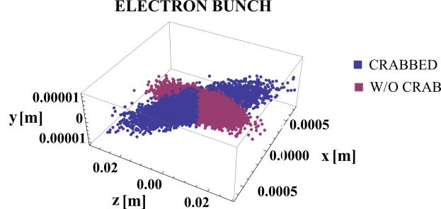
MEIC Crabbing Requirements
High repetition.
Big crossing angle.
$$p$$
$$V_{T}=\frac{cE_{b}\tan{\frac{θ_{c}}{2}}}{ω_{rf}\sqrt{β_{x}^{∗}β_{x}^{c}}}$$
$$e^{−}$$
Parameter | Units | Electron | Proton
Beam energy $E_{b}$ | GeV | 5 | 60
Bunch frequency $n_{b}$ | MHz | 750.0
Crossing angle $φ_{c}$ | mrad | 50
Betatron function at the IP $β_{x}^{∗}$ | cm | 10
Betatron fn. at the crab cavity $β_{x}^{c}$ | m | 300 | 1400
Integrated kicking voltage $V_{T}$ | MV | 1.35 | 8

Slide 32
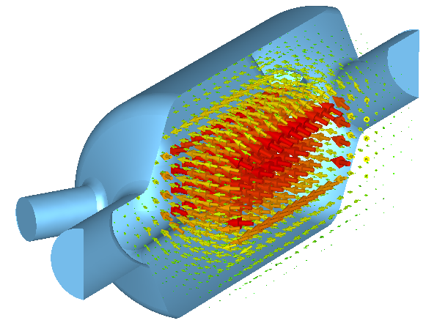
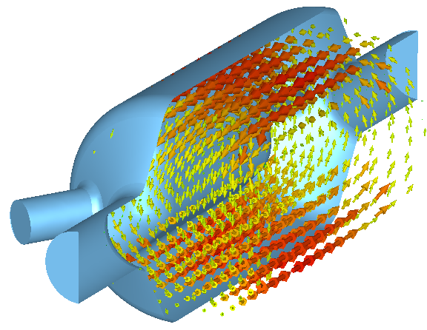
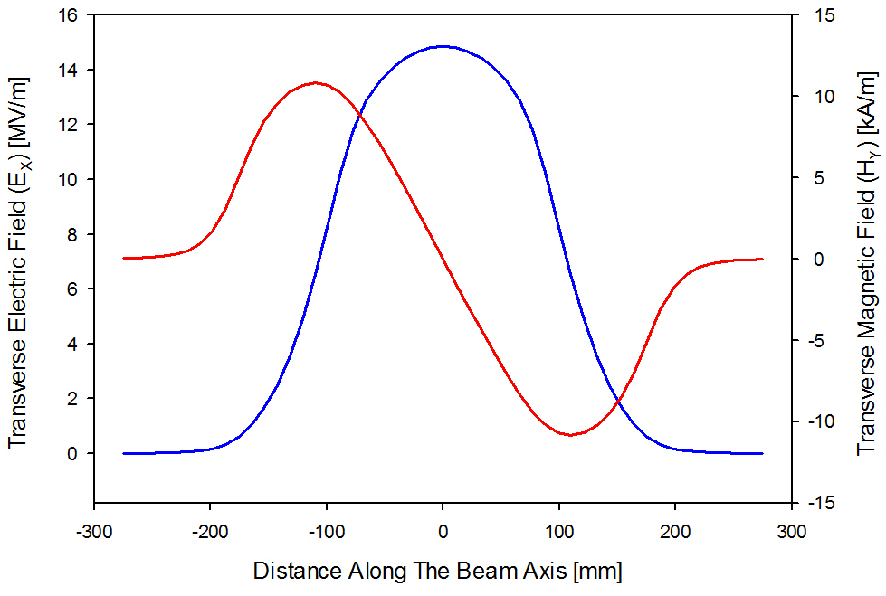
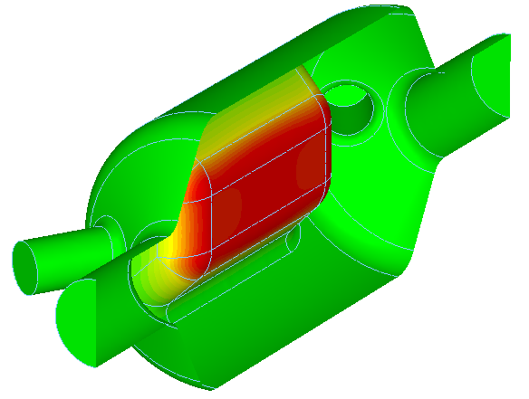
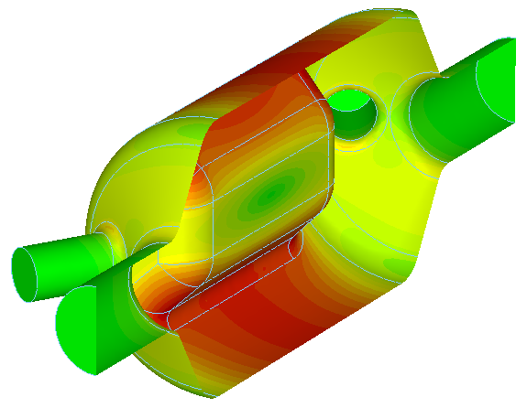
Transverse Kick (e.g. 750 MHz SRFD)
$$V_{T}=\int_{−∞}^{∞}{\left[E_{x}\left(z\right)\cos{\frac{ωz}{c}}+cB_{y}\left(z\right)\sin{\frac{ωz}{c}}\right]dz}$$
$$E_{T}=\frac{V_{T}}{λ/2}⇒V_{T}^{∗}=0.2 MV$$
Electric Field
Magnetic Field
$$E_{T}^{∗}=1{MV}/m$$
$$V_{T,H}^{∗}=−0.2 MV$$
$$V_{T,E}^{∗}=0.4 MV$$

Slide 33
Most of the Content Borrowed from
W. Herr “Concepts of luminosity for particle colliders” CAS-Lectures, Varna, Bulgaria 2010.
F. Zimmermann “LHC: The machine”, SLAC Summer Institute 2012.
J. G. Cramer “Surprises from RHIC” UW Phys. Dept. Colloquium 2002.
And many more…

