Slide 1
Manipulation of transverse beam distribution in circular accelerators: beam splitting by particles’ trapping into resonance islands
M. Giovannozzi
Summary:
Introduction
Present multi-turn extraction
New multi-turn extraction (MTE)
Other applications
Measurement results
Conclusions

Slide 2
Introduction - I
Three approaches are normally used to extract beam from a circular machine:
Fast Extraction (one turn)
A kicker (fast dipole) displaces the beam from nominal closed orbit.
A septum magnet deflects displaced beam towards transfer line.
This extraction can be used both to transfer beam towards a ring or an experimental area.
Slow Extraction (millions turns)
The separatix of the third-order resonance increases particles’ amplitude until they jump beyond the septum.
The tune is changed to shrink the stable region, thus pushing the particles towards larger amplitudes.
This extraction is used to transfer beam towards an experimental area.
Multi-turn!
What is in between?

Slide 3
Introduction - II
Multi-turn extraction
The beam has to be “manipulated” to increase the effective length beyond the machine circumference.
This extraction mode is used to transfer beam between circular machines.
AT CERN this mode is used to transfer the proton beam between PS and SPS. In the SPS the beam is used for
  Fixed Target physics (broad sense)
  Neutrino experiments (until 1998)
  CERN Neutrino to Gran Sasso (CNGS) (from 2006)
These beams are high-intensity (about 3×10¹³ p in the PS).

Slide 4
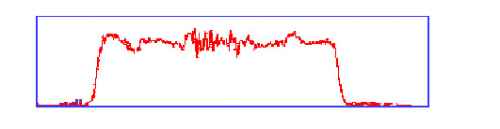
Present multi-turn extraction – I
C_{SPS} = 11 C_{PS}
PS
PS
SPS circumference
First PS batch
Second PS batch
Gap for kicker
Beam current transformer in the
PS/SPS transfer line
1 2 3 4 5 (total spill duration 0.010 ms)

Slide 5
Present multi-turn extraction – II
Electrostatic septum
(beam shaving)
Fifth turn
Kicker strength
Four turns
Slow bump
Kicker magnets used to generate a closed orbit bump around electrostatic septum
Length
E_{field}=0
X’
E_{field}≠0
2
3
5
1
Slow bump
X
4
Extraction line
Electrostatic septum blade
Extraction septum

Slide 6
Present multi-turn extraction –III
The main drawbacks of the present scheme are:
  Losses (about 15% of total intensity) are unavoidable due to the presence of the electrostatic septum used to slice the beam.
  The electrostatic septum is irradiated. This poses problems for hands-on maintenance.
  The phase space matching is not optimal (the various slices have “fancy shapes”), thus inducing betatronic mismatch in the receiving machine, i.e. emittance blow-up.
  The slices have different emittances and optical parameters.

Slide 7
Novel multi-turn extraction – I
The main ingredients of the novel extraction:
The beam splitting is not performed using a mechanical device, thus avoiding losses. Indeed, the beam is separated in the transverse phase space using
  Nonlinear magnetic elements (sextupoles ad octupoles) to create stable islands.
  Slow (adiabatic) tune-variation to cross an appropriate resonance.
This approach has the following beneficial effects:
  Losses are reduced (virtually to zero).
  The phase space matching is improved with respect to the present situation.
  The beamlets have the same emittance and optical parameters.

Slide 8
Model used in numerical simulations
Standard approach: nonlinear elements represented as a single kick at the same location in the ring (Hénon-like polynomial maps).
Vertical motion neglected.
Normalised (adimensional co-ordinates).
The linear tune is time-dependent
Quadrupoles
Sextupole
Octupole

Slide 9
Novel multi-turn extraction – II
Left: initial phase space topology. No islands.
Right: intermediate phase space topology. Islands are created near the centre.
Bottom: final phase space topology. Islands are separated to allow extraction.

Slide 10
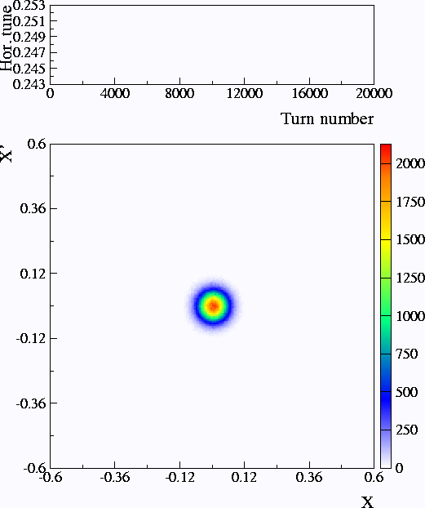
Novel multi-turn extraction - III
Simulation parameters:
Hénon-like map (i.e. 2D polynomial – degree 3 - mapping) representing a FODO cell with sextupole and octupole
Tune variation
Phase space portrait

Slide 11
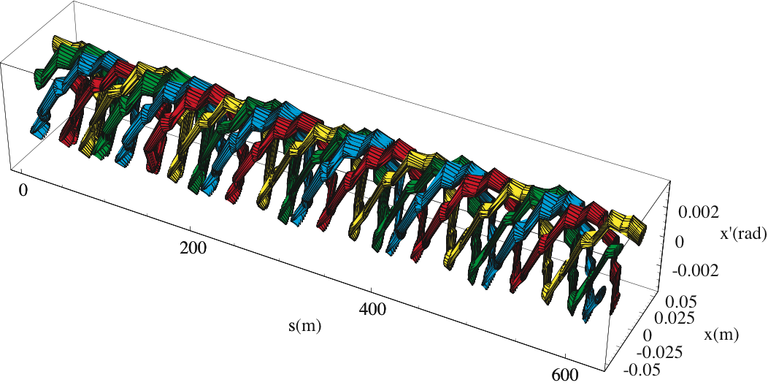
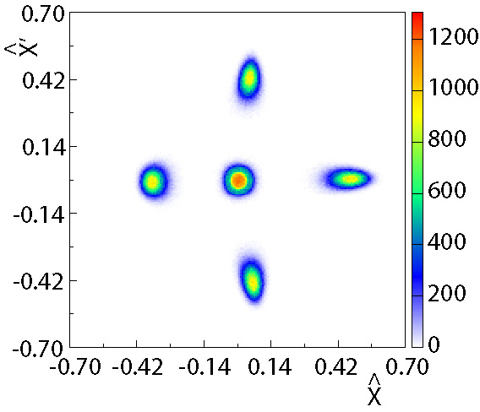
Novel multi-turn extraction – IV
Final stage after 20000 turns (about 42 ms for CERN PS)
At the septum location
B_{field} = 0
B_{field} ≠ 0
Slow (few thousand turns) bump first (closed distortion of the periodic orbit)
Fast (less than one turn) bump afterwards (closed distortion of periodic orbit)
About 6 cm in physical space

Slide 12
Novel multi-turn extraction - V
The original goal of this study was to find a replacement to the present Continuous Transfer used at CERN for the high-intensity proton beams. However the novel technique proved to be useful also in different context, e.g.
  The same approach can be applied for multi-turn injection (time-reversal property of the physics involved).
  multi-turn extraction over a different number of turns can be designed, provided the appropriate resonance is used.
  Multiple multi-turn extractions could be considered, e.g. to extract the beam remaining in the central part of phase space.

Slide 13
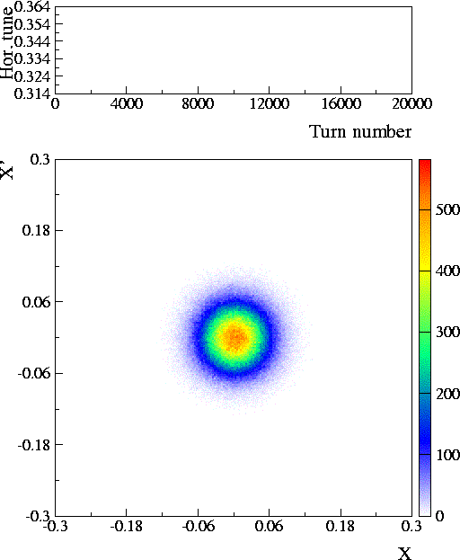

Novel multi-turn extraction with other resonances - I
Simulation parameters:
Hénon-like map with sextupole and octupole
The third-order resonance is used, thus giving a three-turn extraction
Tune variation
Phase space portrait

Slide 14
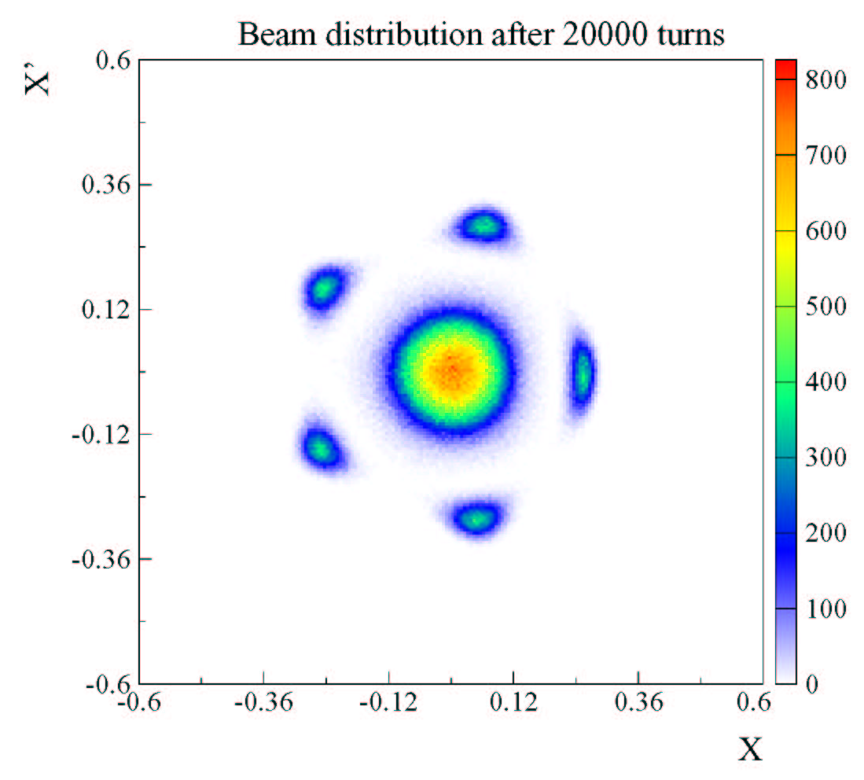
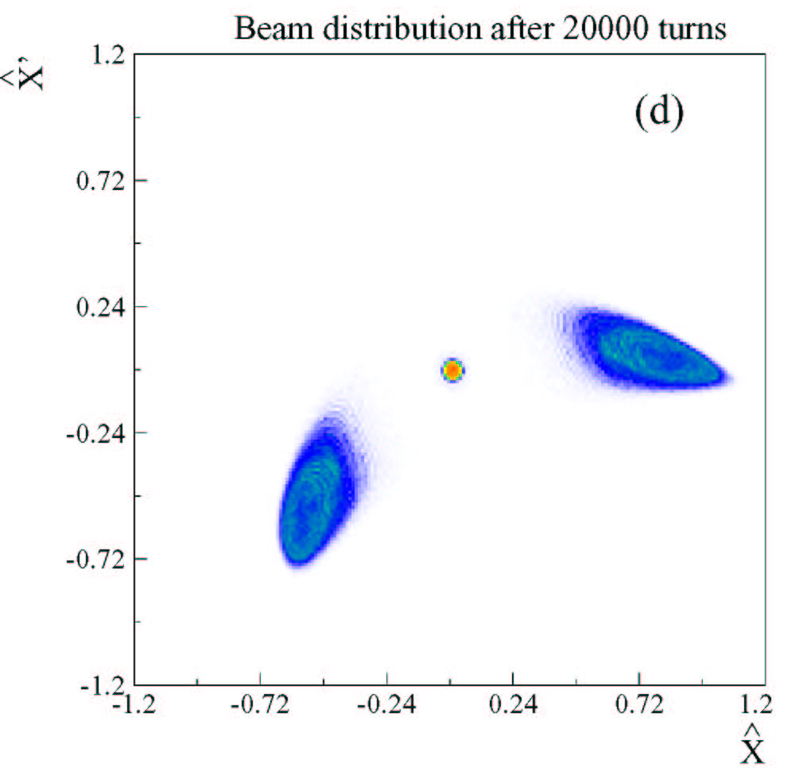
Novel multi-turn extraction with other resonances - II
The second-order resonance is used, thus giving a two-turn extraction
The fifth-order resonance is used, thus giving a six-turn extraction

Slide 15

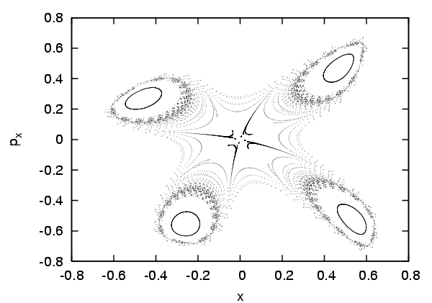
Novel multi-turn extraction: 4th order unstable resonance - new application!
Non-linear elements can be used to make the fourth-order resonance unstable by canceling the amplitude detuning.
Possible applications:
  Four-turn extraction.
  Deplete the core region to
  achieve a better intensity
  sharing.
Master thesis Diego Quatraro

Slide 16
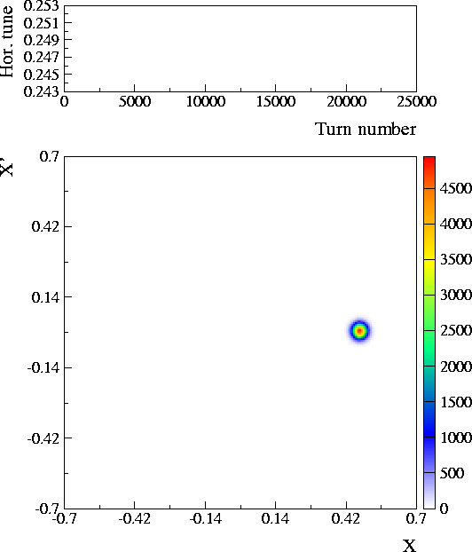
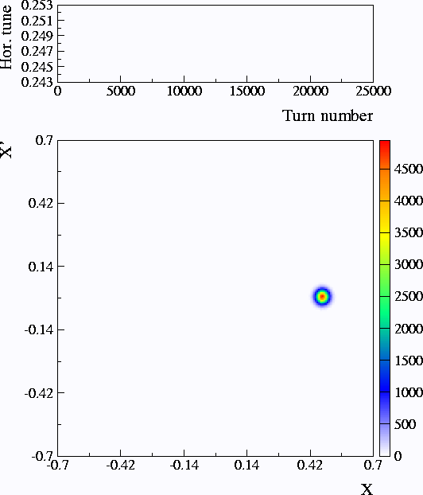
Novel multi-turn injection: new application!
Simulation parameters:
Third-order polynomial map representing a FODO cell with sextupole and octupole
The fourth-order resonance is used for a four-turn injection
Tune variation
Phase space portrait
Efficient method to generate hollow beams!

Slide 17
Novel multi-turn injection: new application!
Possible applications: transverse shaping of beam distribution.
Observation: the proposed method seems to be more efficient in generating smaller emittance beams than standard multi-turn injection!
“Flat” beam distribution obtained by injecting a fifth turn in the centre.
“Standard” hollow beam distribution
M. Giovannozzi, J. Morel, PRST-AB, 10, 034001 (2007)

Slide 18
The capture process - I
Quantitative analysis needed:
  To control sharing between core and beamlets.
  To control the emittance sharing.
Adiabatic theory is the key concept:
  Probability trapping is proportional to the speed of variation of the island’s surface.
  It is possible to account for the loss of adiabaticity close to the separatrix.
2D case seems under control.
The 4D case requires the usual conditions:
  weak coupling between the two degrees of freedom
  no low order resonances in the vertical plane

Slide 19
The capture process - II
Initial gaussian distribution
Particles in island 2
Particles in island 4
Particles in island 6
Particles in island 8
Particles in beam core

Slide 20
The capture process - III
Size of non-adiabatic region
Under these conditions:
  Scaling law for the size of the adiabatic region is well-reproduced.
  Trapping probability is well-described.
Hénon-like model
Pendulum-like model

Slide 21
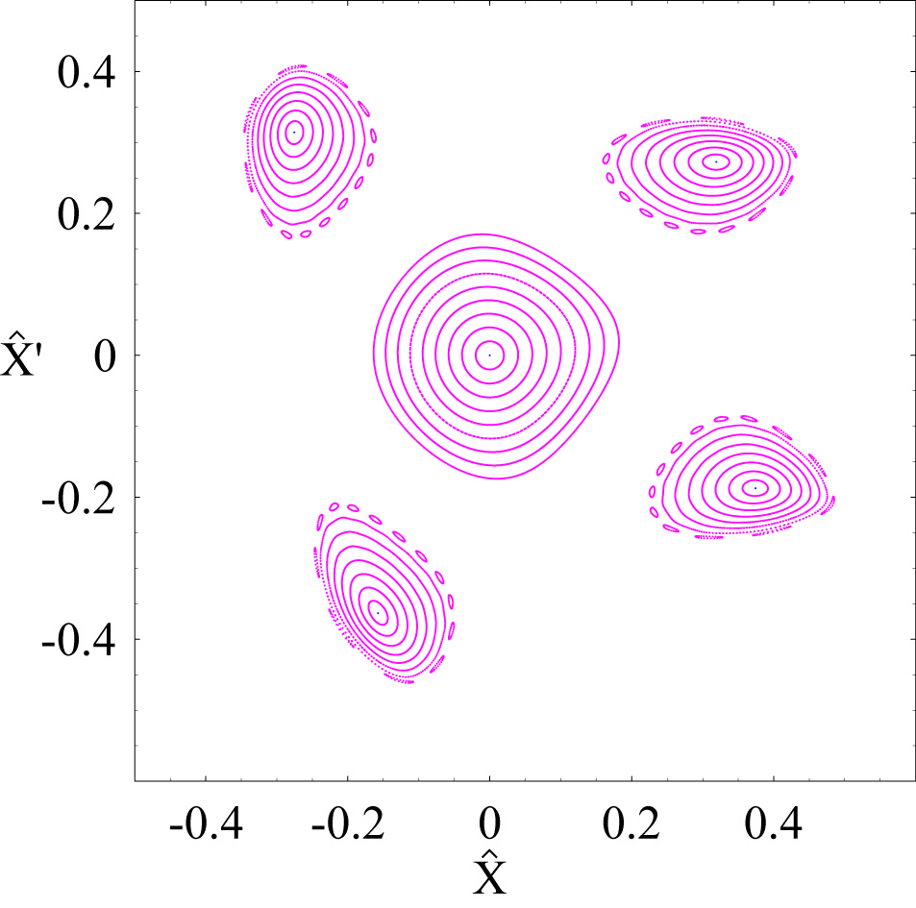
Analytical computation of island’s parameters
Using perturbative theory (normal forms) it is possible to derive analytical estimate of island’s parameters.
Normalised phase space
Distance from resonance
Distance of fixed points from origin of phase space
Secondary frequency
Island’s surface
Distance between separatices

Slide 22
Operational implementation - I
Sextupoles and octupoles are used to
Generate stable islands
Control size/position of islands
Control linear chromaticity
Control non-linear coupling (using an additional set of octupoles, normally used to combat instabilities)
h_{2,0} -> detuning with amplitude (H-plane) -> ∝ β_{x}² K₃
h_{1,1} -> non-linear coupling -> ∝ β_{x}β_{y} K₃
h_{0,2} -> detuning with amplitude (V-plane) -> ∝ β_{y}² K₃

Slide 23
Operational implementation - II
Extraction: 0.835 s
Injection: 0.170 s

Slide 24
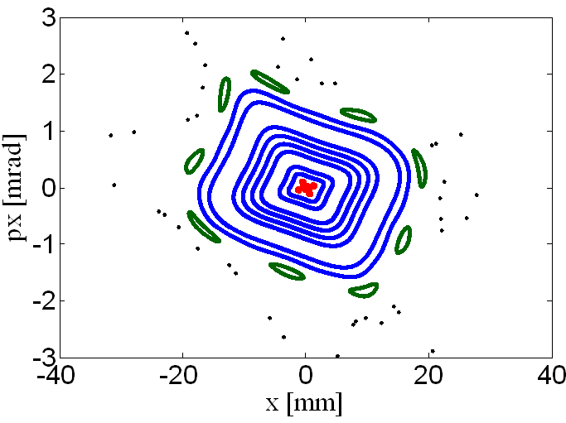
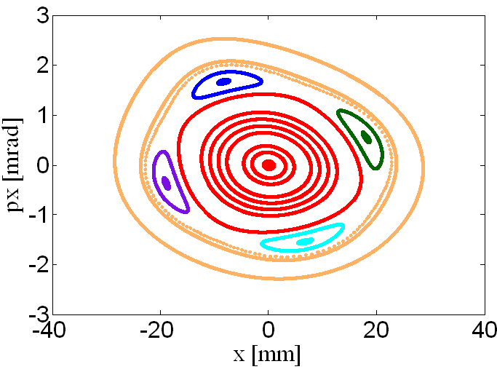
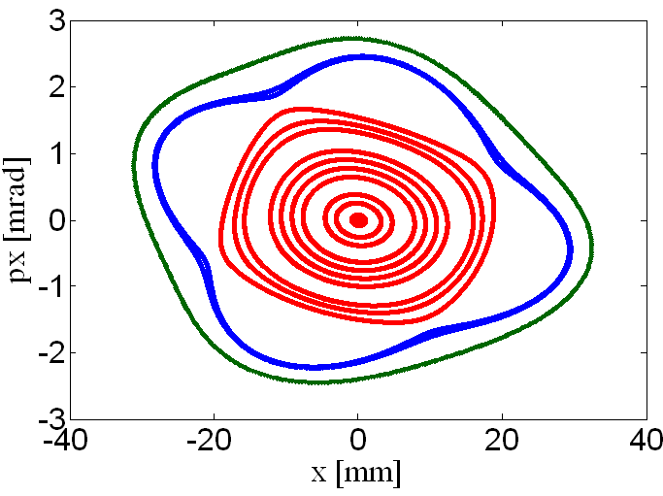
Transverse dynamics - III
Phase space at septum

Slide 25
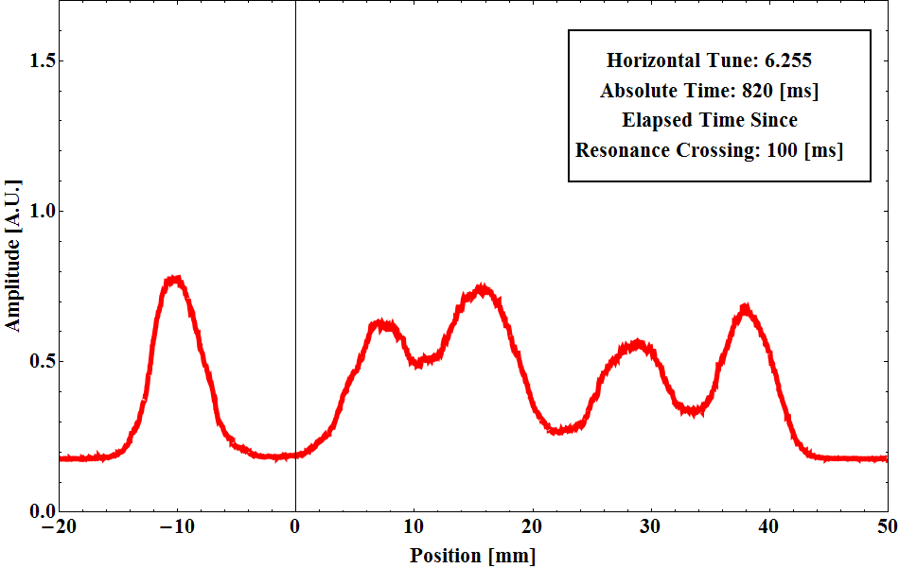
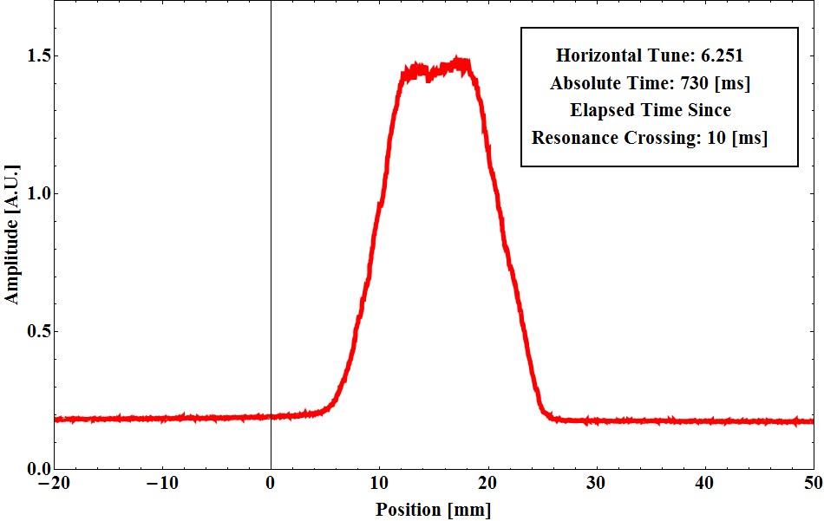
Evolution of beam distribution
Horizontal beam profiles in section 54 have been taken during the capture process (total intensity ~2.1×10¹³).

Slide 26
Trapping performance
20% trapping
18% trapping
5 PS turns

Slide 27
Extraction efficiency
Regular fluctuations in the extraction efficiency are also observed and seem well correlated to spill fluctuations.
CT extraction efficiency is about 93%
Distribution of extraction efficiency is peaked at about 98% (NB: the beam is debunched at extraction! Unavoidable beam losses are estimated at about 1-2%)

Slide 28
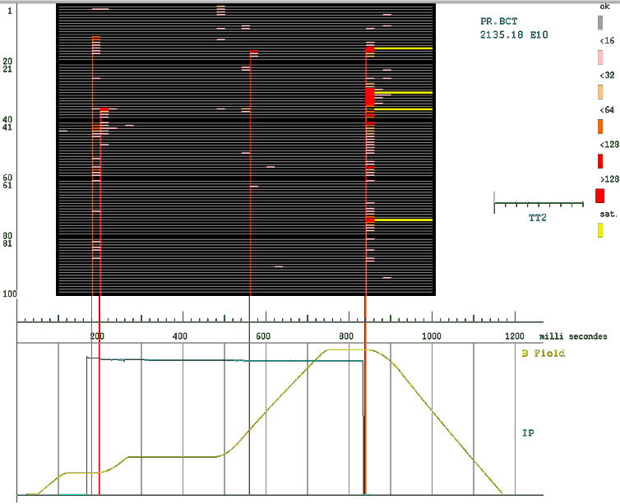
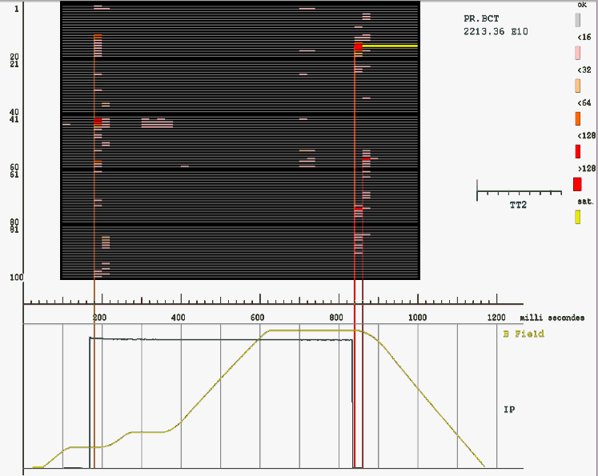
CT vs. MTE: extraction losses
CT
MTE
  For the same extracted intensity, the CT features more losses, about the double, compared to MTE.
  The CT losses are spread around the ring whereas for MTE the losses are more concentrated on the extraction septum as anticipated in the MTE Design Report.

Slide 29
First observations of intensity-dependent effects - I
Usual process for trapping the beam into stable islands.
Varying parameter: total beam intensity.
Beamlets are moving with intensity!

Slide 30
First observations of intensity-dependent effects - II
No change in beamlets size
The observed effect can be explained with an intensity-dependent shift of the single particle tune.
Possible sources:
  Image currents.
  Direct effects (interaction between beamlets).
Consider projection effect

Slide 31
Summary and Outlook - I
A novel multi-turn extraction is studied since a few years: it allows manipulating transverse emittances in a synchrotron!
First MTE beam delivered to the SPS by mid-September 2009 (about 1.5×10¹³ p/extraction).
Equal sharing for islands/core achieved by the end of 2009.
In February 2010 the commissioning was resumed.
High intensity beam was extracted (about 2.1×10¹³ p/extraction) with record intensity 2.6×10¹³ p/extraction.
2010 physics run at SPS was started using MTE beam.
Open issues:
  Variation of the fraction of particles trapped in islands.
  Activation of extraction septum due to the longitudinal structure of the beam (de-bunched as needed by the SPS).
New optimised extraction scheme to avoid losses on extraction septum -> beam commissioning in 2014.

Slide 32
Summary and Outlook - II
The same principle can be used for injection.
Transverse shaping is possible, i.e. generation of hollow bunches.
Lines of research:
  Complete study of splitting process in 2D and extend to 4D.
  Study trapping in 4D, i.e., manipulations in x-y plane.
  Study intensity-dependent effects.
    And many more!

Slide 33
Selected references
S. Gilardoni, M. Giovannozzi, C. Hernalsteens (2013). “First observations of intensity-dependent effects for transversely split beams during multiturn extraction studies at the CERN Proton Synchrotron”, Phys. Rev. ST Accel. Beams .
M. Giovannozzi, D. Quatraro, G. Turchetti, (2009). “Generating unstable resonances for extraction schemes based on transverse splitting”, Phys. Rev. ST Accel. Beams 12 024003.
A. Franchi, S. Gilardoni, M. Giovannozzi, (2009). “Progresses in the studies of adiabatic splitting of charged particle beams by crossing nonlinear resonances”, Phys. Rev. ST Accel. Beams 12 014001.
M. Giovannozzi and J. Morel, (2007). “Principle and analysis of multiturn injection using stable islands of transverse phase space”, Phys. Rev. ST Accel. Beams 10 034001.
S. Gilardoni, M. Giovannozzi, M. Martini, E. Métral, P. Scaramuzzi, R. Steerenberg, A.-S. Müller, (2006). “Experimental evidence of adiabatic splitting of charged particle beams using stable islands of transverse phase space”, Phys. Rev. ST Accel. Beams 9 104001.
R. Cappi, M. Giovannozzi, (2003). “Multi-turn Extraction and Injection by Means of Adiabatic Capture in Stable Islands of Phase Space”, Phys. Rev. ST Accel. Beams 7 024001.
R. Cappi, M. Giovannozzi, (2002). “Novel Method for Multi-Turn Extraction: Trapping Charged Particles in Islands of Phase Space”, Phys. Rev. Lett. 88 104801. The same principle can be used for injection.

