Slide 1
Hall D APEL Update
Hall D Commissioning (Elton Smith)
Tagger/Hall on same PSS (Kelly Mahoney, email Nov 1)
Substantial effort to SCMB, change req to next ARR
Hall D/Tagger enclosure PSS functional ~Jan 2014
Todd will review Hall D ops procedures with Mike McCaughan
RF signals to hall (Tomasz Plawski)
7/8” heliax from MCC to hall (cable cost ~$4200)
Questions about alternate clocking for separator upgrade
Alex has requested steering angles/pos ranges at radiator
Todd evaluating beamline optics
Schedule:
Todd walking beamline weekly to evaluate installation progress
Acc-I, II, III commissioning schedules on next slides

Slide 2
Acc-I
Objectives
CW beam to inline dump (injector), tune beam (<8uA) to 2R
Beam through all C100s, rebuilt 1A/2A arcs
Check out hardware, optics tools, model, applications, etc
Schedule has shifted a bit (cryo delays)
130 keV beam commissioned in injector as of Nov 11
Downshift to hot checkout, RF commissioning to Dec 2
New Acc-I Schedule
Operations: Dec 2 to Dec 16, Jan 10 to Feb 7
Holiday break: Dec 16 to Jan 10

Slide 3
Acc-II
Objectives
3-pass spin-up, optics checkout to BSY
Hall A checkout
5.5-pass spin-up, optics checkout to Hall D if feasible
Hall D Transport Review: Jan 16
Acc-II Accelerator Readiness Review (ARR): Jan 28
Acc-II Schedule
3-pass, Hall A: Feb 28-Apr 18, SAD-II: Apr 18-24
5.5-pass spin-up, Hall D initial beam: Apr 24-June 7
Serious concerns about higher arc box PS delivery schedule
Elton et al investigating split PSS of tagger enclosure, hall

Slide 4
Box Supplies and Other Issues
FY14 budget may not support 20 weeks of FY14 ops
There is some possibility that first Hall D beam gets moved to Acc-III (Fall 2014)
Even in the most optimistic scenario (Freyberger)
~1 uA tune mode beam to Hall D tagger dump in spring
Transport line hardware, optics checkout

Slide 5
Acc-III
Objectives
Full energy checkout with two halls, initial operations
Initial Hall D radiator, detector checkout
Acc-III Accelerator Readiness Review (ARR): March 1 (?)
Acc-III Schedule
Sep 22-Dec 19 2014
Hall D beam: Nov 3-Dec 5
May include deferred Acc-II activities
Hall and tagger enclosure presumably secured

Slide 6
Beamline Installation
All magnets in place
LCW, electrical hookups in progress
Vacuum pipe installed
Through CEBAF NL, after first vertical bends to shield wall upstream of radiator
Instrumentation in place
SEE BPMs on beamline but not cabled yet
nA BPM hardware on schedule for Acc-III
Overall beamline installation on schedule
Not driving schedule compared to, e.g., box supply delivery

Slide 7
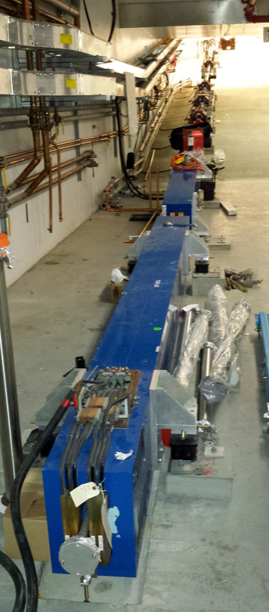
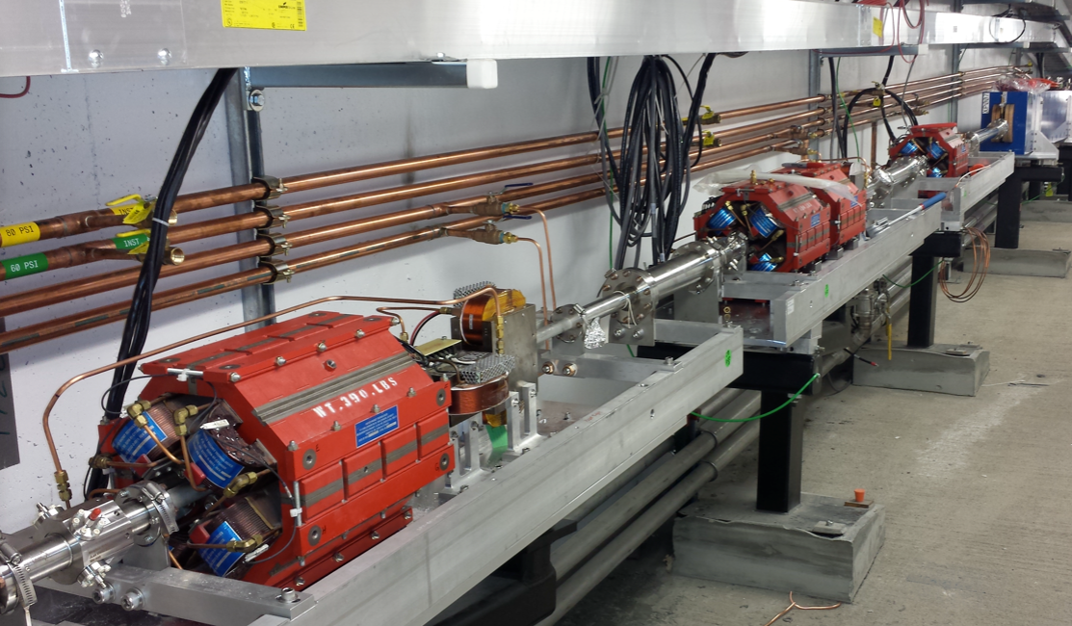
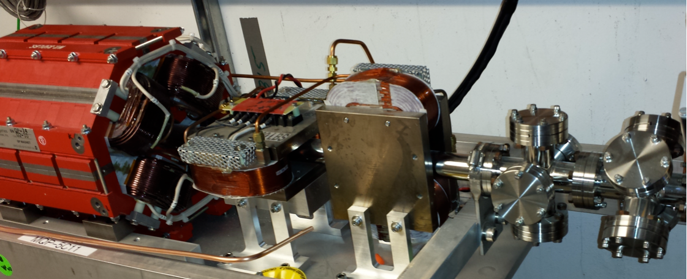
Hall D Beamline Photos

Slide 8
Tagger Magnet Mapping

