Slide 1
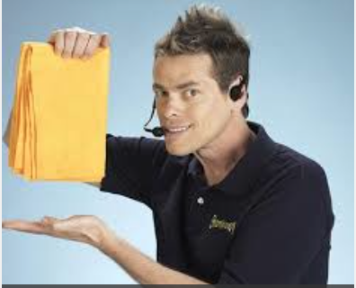
What is JACoW and What Do We Offer To Your Conference?
Todd Satogata
Jefferson Lab and Old Dominion University
JACoW Team Meeting 2016
Vancouver, Canada
5 November 2016

Slide 2
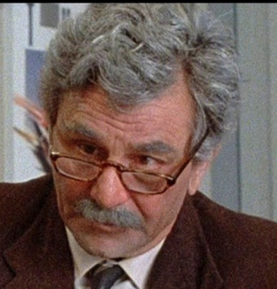
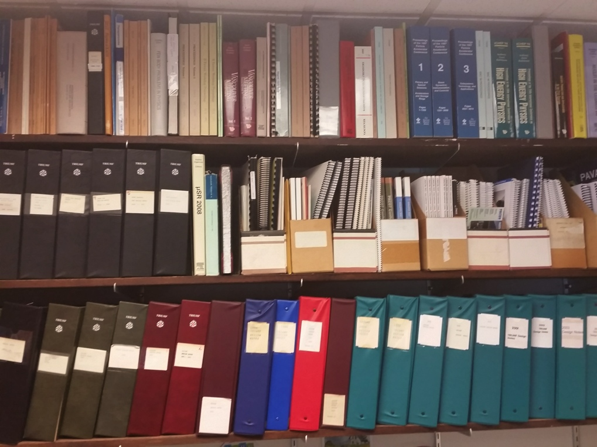
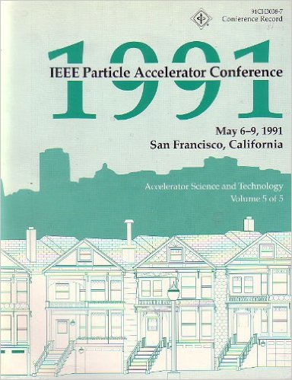
When I was your age…
…television was called “books”!
Conferences once printed all their proceedings
(Nearly) all the delegates got a printed, shipped copy
We’d send people to conferences to get proceedings!

Slide 3
A Confluence of Technologies
And an exaltation of larks
Not to be confused with the larch
1990-1: World Wide Web (CERN)
1993: PDF and Acroread made free (Adobe)
1993: Commercialization of Linux (redhat)
1994: 100 MHz PC processors (Intel)
1995-2000: Dot Com Boom
Internet usage/access grows 25x: 15M to 350M
1995: Release of Windows ’95
PAC’95 (Dallas): Camera-ready publication
EPAC’96 (Sitges): Electronic publication (CERN)
Templates, on-site editing, dot board (author “education”)
PAC’97 (Vancouver!): The birth of JACoW
Founded by APAC’98, EPAC’98, PAC’99

Slide 4
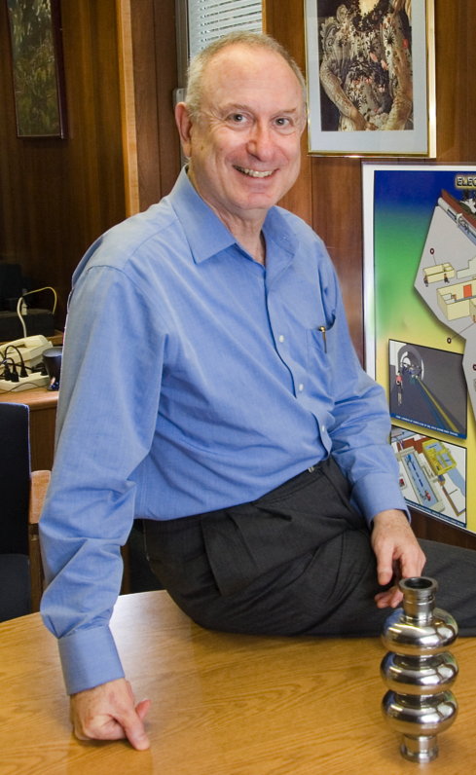
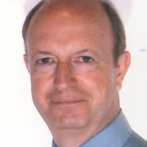
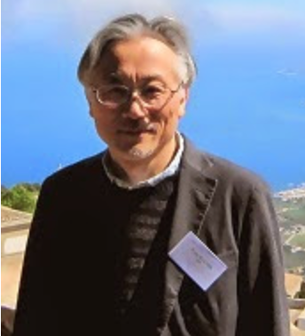
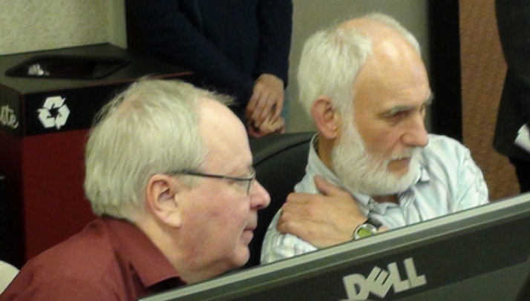
A Confluence of Personalities

Slide 5
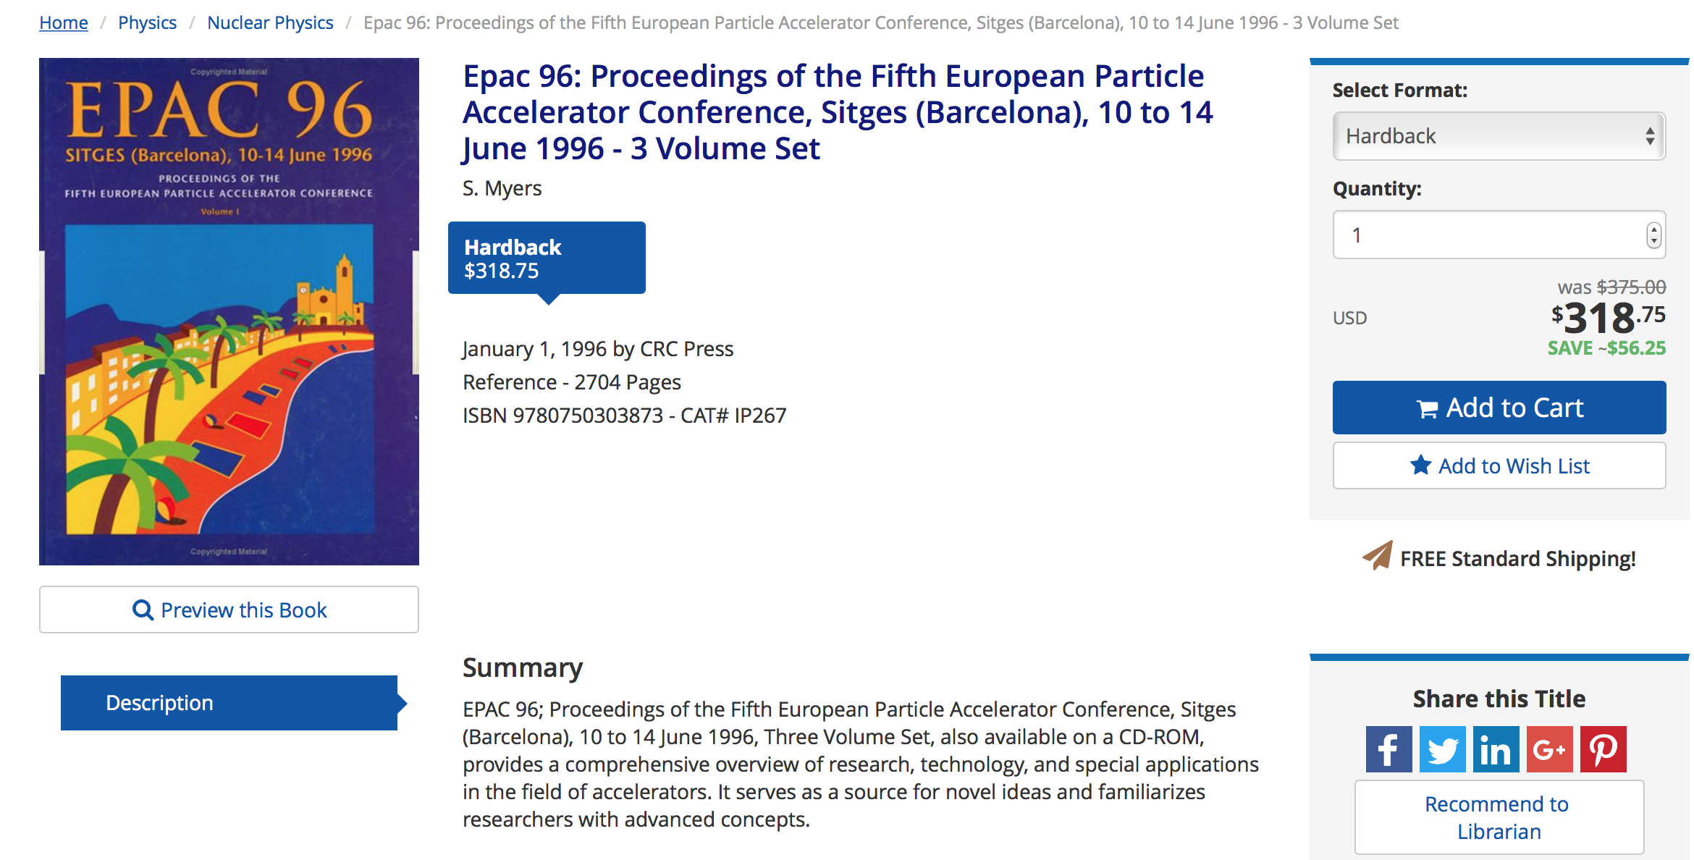
What a Deal!

Slide 6
What are the Goals of JACoW?
http://www.jacow.org/About/Goals
Publish high-quality sets of proceedings with access through the custom interface.
Provide long-term archival storage to ensure longevity and access to publication data.
Publish conference metadata for open archives.
Train and educate authors and editors.
Maintain a repository of user profiles for accelerator conferences.
Provide support for conference organisers.
Consistent core goals since the founding of JACoW

Slide 7
What are the Requirements of JACoW?
http://www.jacow.org/About/PoliciesRequirementsForPublishingOnJACoW
CC-BY 3.0: https://creativecommons.org/licenses/by/3.0/
Editor/IT participation in Team Meetings (3yr cycle)
Technical paper requirements
PDFs: proper metadata / margins / paper size / font embedding / version compatibility
SPMS use not required
But use of SPMS and repository requires agreement on data privacy, quality, integrity
Discussion within BoD about editorial support MOU draft with member conferences

Slide 8
The JACoW Charter
http://www.jacow.org/About/Charter
JACoW operates according to the rules and policies of the JACoW Charter, documented on jacow.org
The charter defines less what JACoW does, and more how JACoW operates.
Board of Directors composition, elections, responsibility and authority
Annual Team Meeting
Annual Stakeholder’s Meeting
“The existence of the JACoW site does not detract from the rights of individual conference organisers to publish their proceedings on other web sites, storage media or hard copies of their choice.”
http://www.jacow.org/Main/Contacts

Slide 9
What is JACoW? A Website (or more)
Joint Accelerator Conferences Website(s)
Proceedings hosted by CERN and KEK
JACoW wiki/website hosted by Elettra
SPMS servers hosted by FNAL, CERN, KEK
Upload/download servers hosted by PSI, Jefferson Lab
Source code, request tracking hosted by sourceforge
With investment in a functionality merge with InDiCo
We cannot achieve our goals without the resources (hardware and time) provided by the support of national labs and conference series

Slide 10
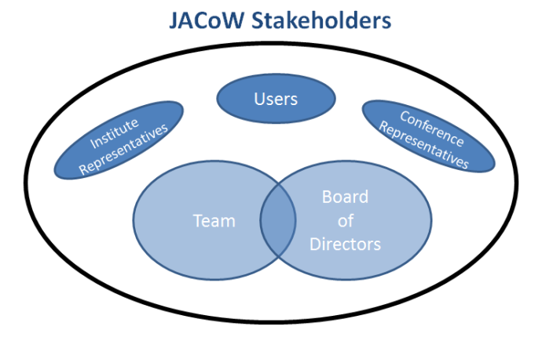
What Is JACoW? A Collaboration
http://www.jacow.org/About/TheCollaboration
JACoW is an international collaboration
Dedicated to prompt high-quality publication of accelerator science conference proceedings
http://www.jacow.org/StakeHolders/ListOfStakeholders

Slide 11
IPAC’16 JACoW Team (Busan)
http://www.jacow.org/About/TeamMembersRoles
All of us are members of the JACoW team
Producing excellent, prompt proceedings for international conferences in good cameraderie
Coordinating support for proceedings production
Author reception, IT, presentation management, etc

Slide 12
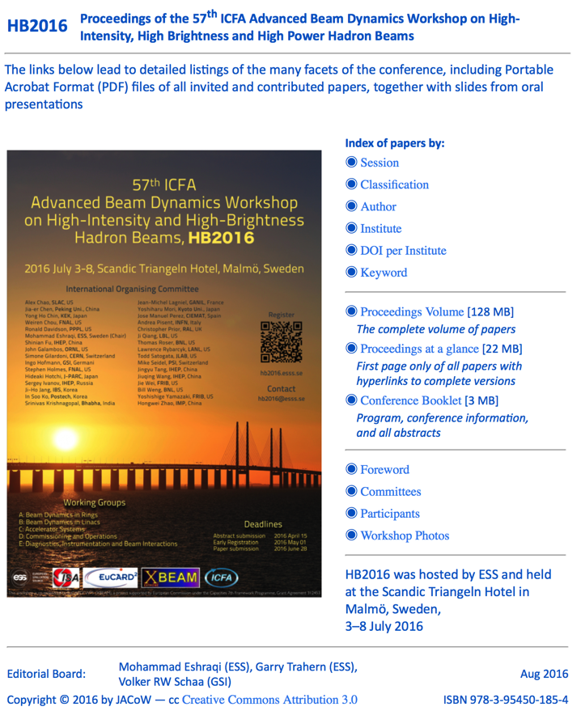
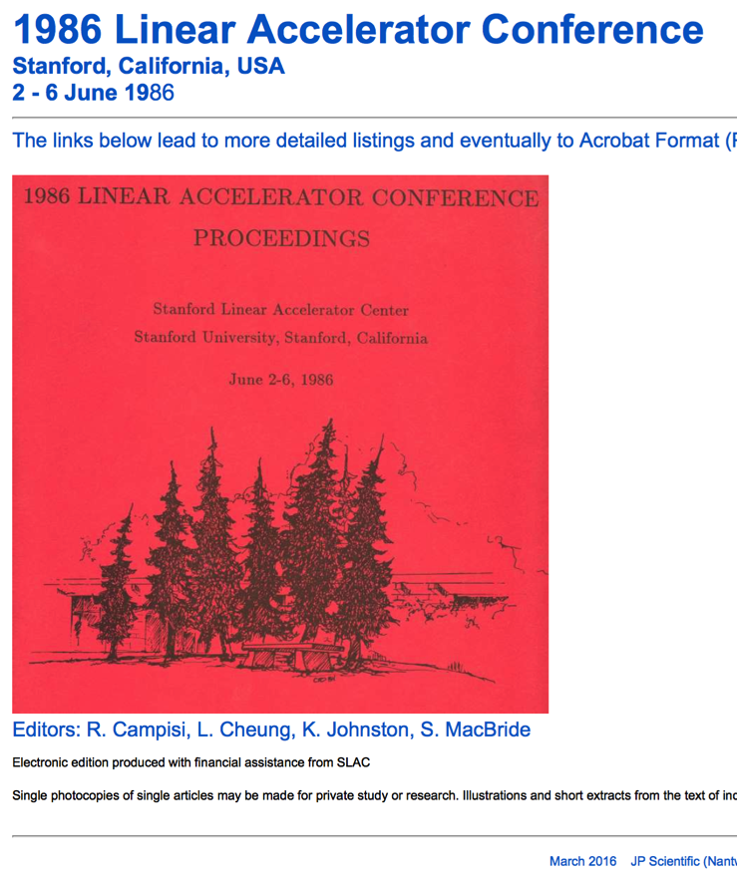
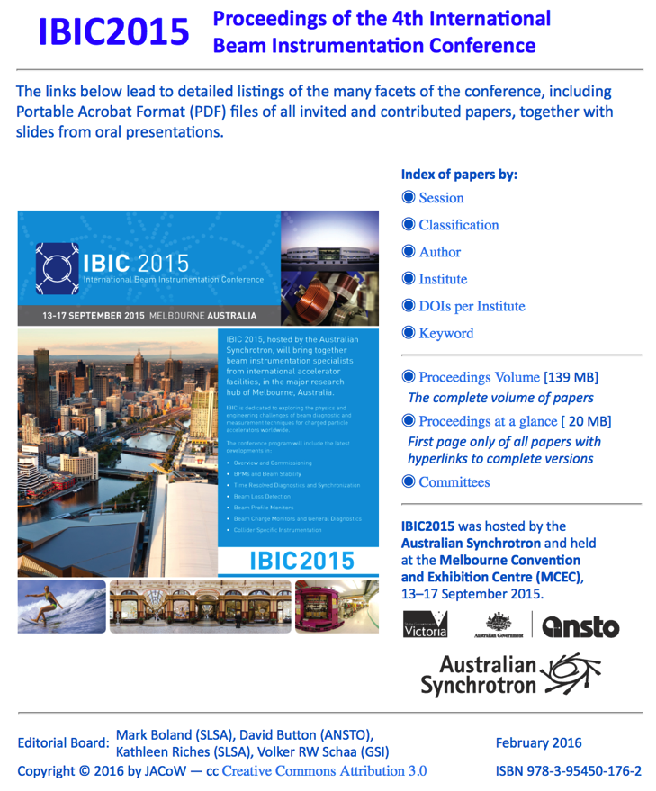
JACoW: Producing Excellent Proceedings
179 conferences
and workshops
as of this writing

Slide 13
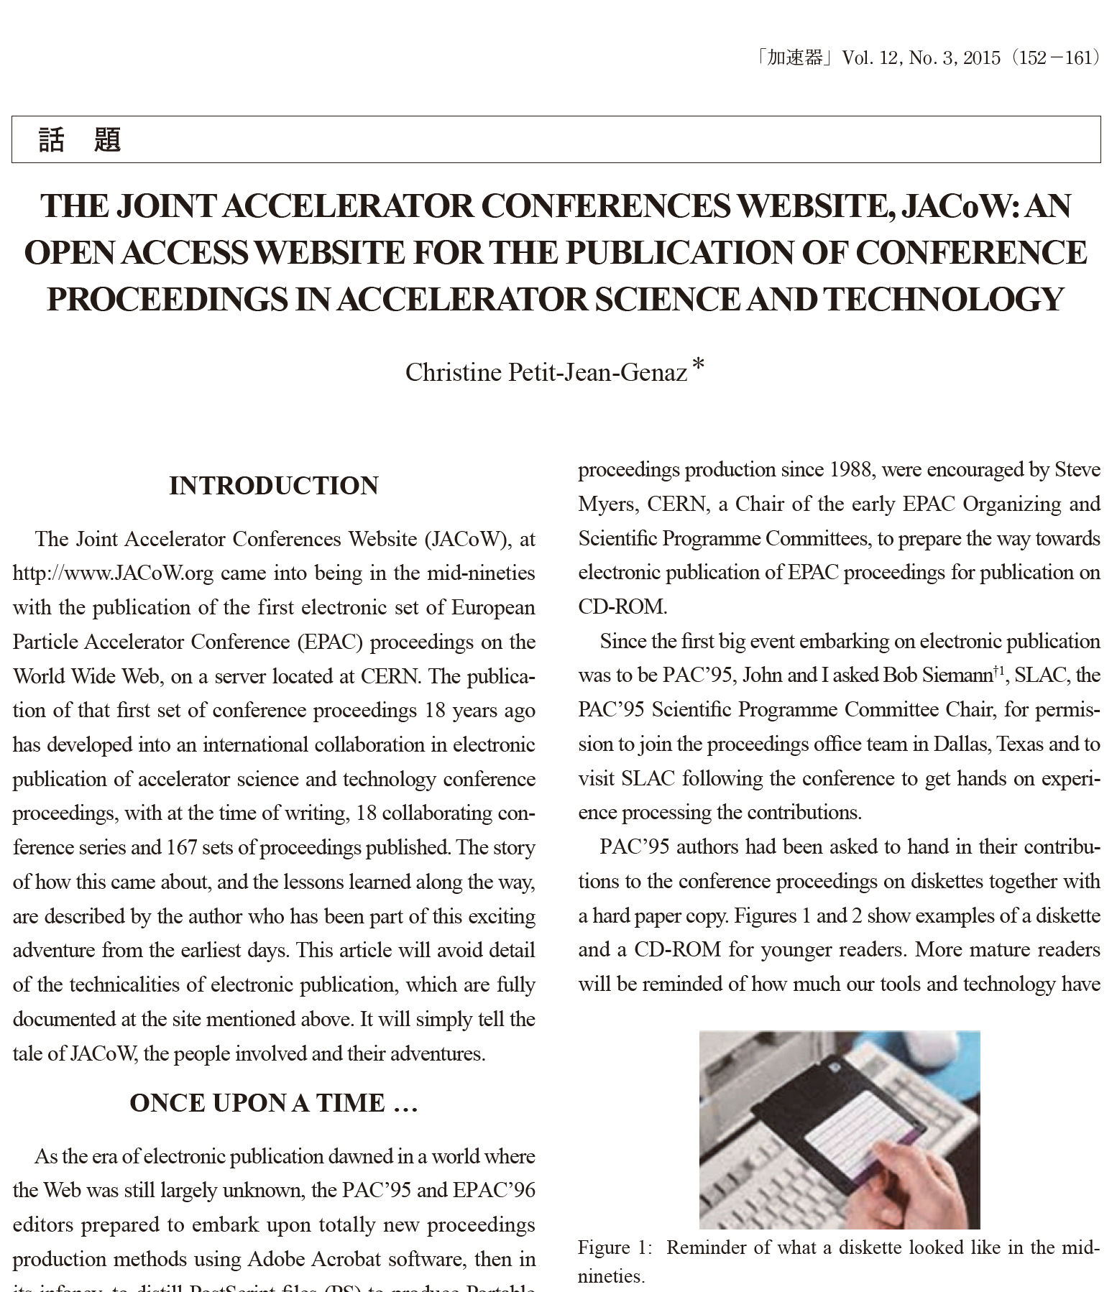
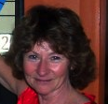
Recommended Reading
http://www.jacow.org/uploads/About/Article_KASOKUKI.pdf
http://epaper.kek.jp/jacow/TM_2003_Trieste/slides/Seminar-JP.pdf

