Slide 1
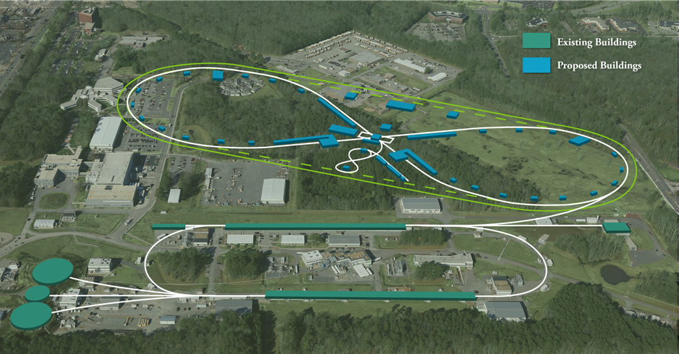
Title Slide [~20+5]
Plans for the JLEIC pre-CDR
Todd Satogata

Slide 2
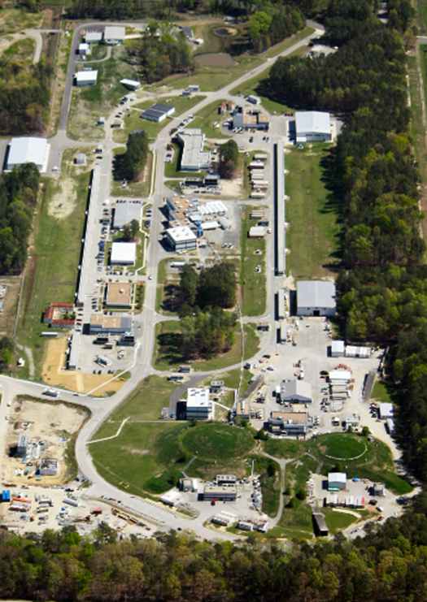
Outline
Need and Schedule
pCDR Strategy
History
2012 Design Report
2015 Design Summary
2016 JLAAC Committee
Latest Activities
Project and 2014 WBS
Documentation and DocDB
JeDi and Lattice Management
Plans and Summary
Notes:
Pre-Project Planning (rather than Project Management)
No Baseline
Rik Fulvia Bob Alison Mike
Need to fulfill white paper requirements

Slide 3
Need and Schedule
NAS report expected ~summer 2018 (18 months)
One of our esteemed AAC committee members likely just participated in the latest NAS committee meeting in Woods Hole
A positive NAS review will likely trigger the DOE CD process
CD0 (acceptance and critical need for science): mid-late CY18?
“alternative concepts based on user requirements, risks, costs and other constraints are analyzed to arrive at a recommended alternative”
Conceptual design report and review are prerequisites to CD1 (various DOE 413.3 sections)
CD0 does not immediately require CDR but does put it on horizon and timetable (~1 year)
Timeline of CDR need: mid-late CY19
JLEIC pCDR: mid-late CY18 (align with CD0 as much as possible)
Note: next DOE NP LRP is “due” in range of 2020-2022
Notes:
Timelines consistent with Deshpande, Hallman, Surrow comments at EIC UG meeting in Trieste
NAS project empaneled ~Dec 2016/Jan 2017 with 18 month timeline
LRP comment is to emphasize that DOE will likely not await next LRP for decision on whether to move forward on CD process
CD1 also typically requires CTE TRL of >=4, with plans for >=6 (https://www.directives.doe.gov/directives-documents/400-series/0413.3-EGuide-09/@@images/file)

Slide 4
pCDR Strategy
Given short timetables, pCDR must be as complete as possible
e.g. incorporate existing civil, rad safety, and costing
JLEIC organization includes pCDR/documentation (Satogata/Yoshida)
Initial process is three-fold
Start from existing significant JLEIC design summary/update
2012 Conceptual Design Report
2015 Design Summary
Ensure parameter self-consistency
Survey other recent pCDRs/CDRs as prototypes
Be cautious of scope -- 12 GeV pCDR (2004) was 48pp
Ensure completeness of process before CDR clock
Coordinate structure with pre-project planning
Ensure alignment with DOE 413.3 requirements
Establish coordination with WBS structure
CEBAF 12 GeV project management resources coming available

Slide 5
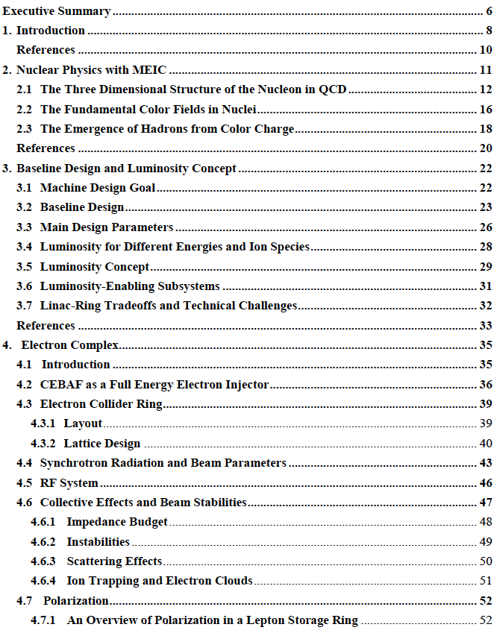
2012 Conceptual Design Report
160 pages
5 Sep 2012
arXiv:1209.0757v2
Edited by Y. Zhang and J. Bisognano
Includes comprehensive layout and structure suitable for pCDR
Requires
Integration of latest design and R&D work
Self-consistency of all parameters
Addition of DOE 413.3 scope
e.g. civil, costing

Slide 6
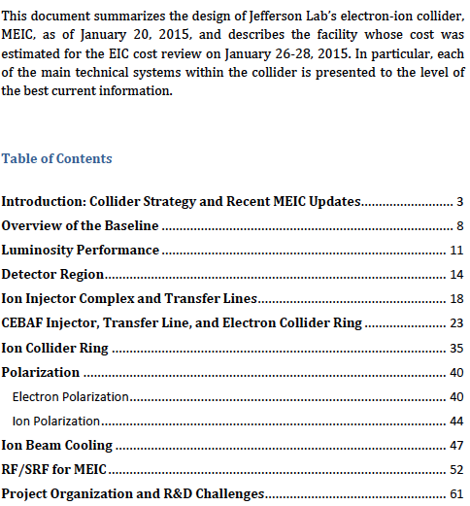
2015 Design Summary
65 pages
29 April 2015
arXiv:1504.07961
Mainly a design summary document aligned with January 2015 cost review
Consistent with 2014 WBS
Includes updates from 2012 design report, but not a comprehensive rewrite or reintegration
Fundamental luminosity concepts remain consistent with 2012 design report

Slide 7
2016 JLAAC Committee
2016 JLAAC Committee review included early pCDR outline review
Report included concerns about completeness of pCDR outline, connection to DOE CD timeline and 413.3 requirements
Recommendation: Ensure that the pCDR document outline is complete
DOE CD timeline and 413.3 requirements
Engagement of experienced personnel for pre-project planning
Natural timing of resource availability post-12 GeV project
Completeness
Comparative pCDR/CDR survey
Alignment with updated WBS

Slide 8
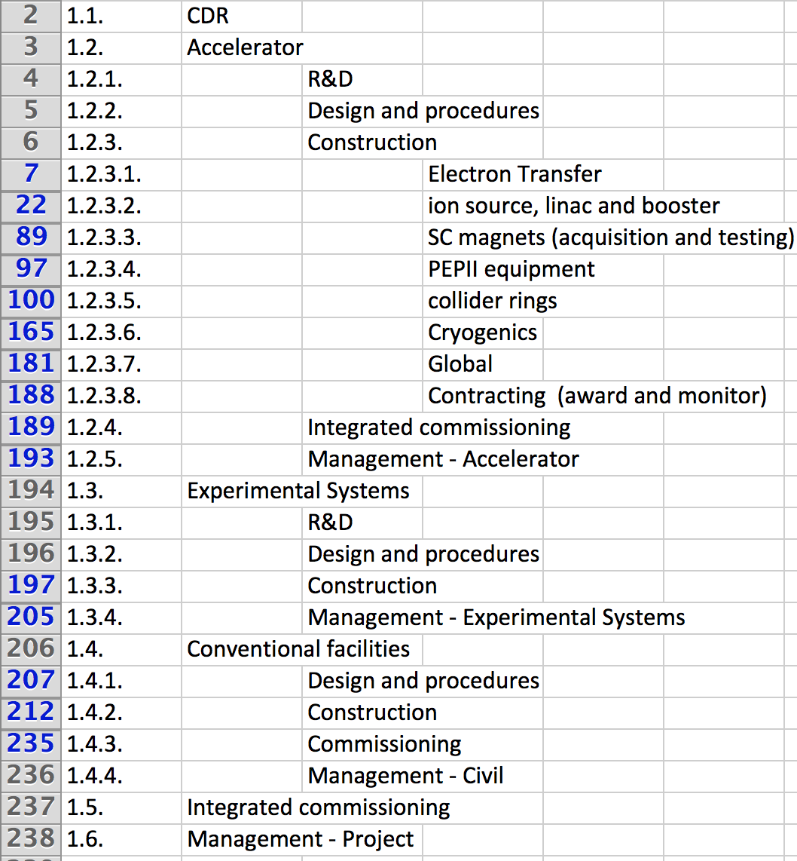
Project and 2014 WBS
WBS developed in 2014
Follows standard WBS rules
Framework for pre-project planning
Orthogonal basis set for planning and costing
Structured by machine segments
Review and revise as necessary over next few months
Incorporate as controlled document in DocDB
Notes:
Pre-Project Planning (rather than Project Management)
No Baseline
Rik Fulvia Bob Alison Mike
Need to fulfill white paper requirements

Slide 9
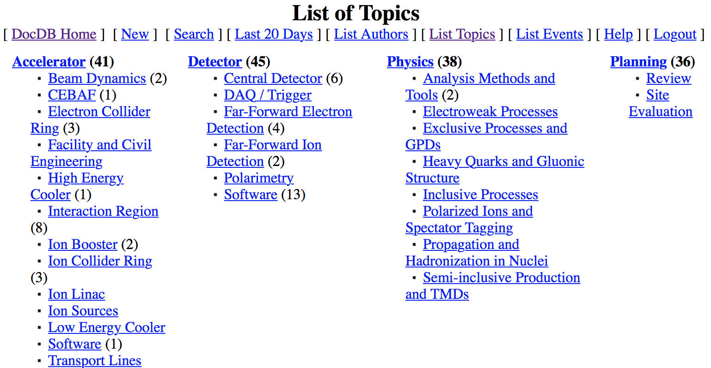
Documentation and DocDB
Pre-project planning and accelerator design documents
Located in JLab DocDB instance for all JLEIC work
Version controlled for tracking
Interface and machine definition parameter documents
Under development for all accelerator sections
Basis for relevant CDR machine sections
Standard format for parameter consistency
Initial documents for all accelerators by end CY17

Slide 10
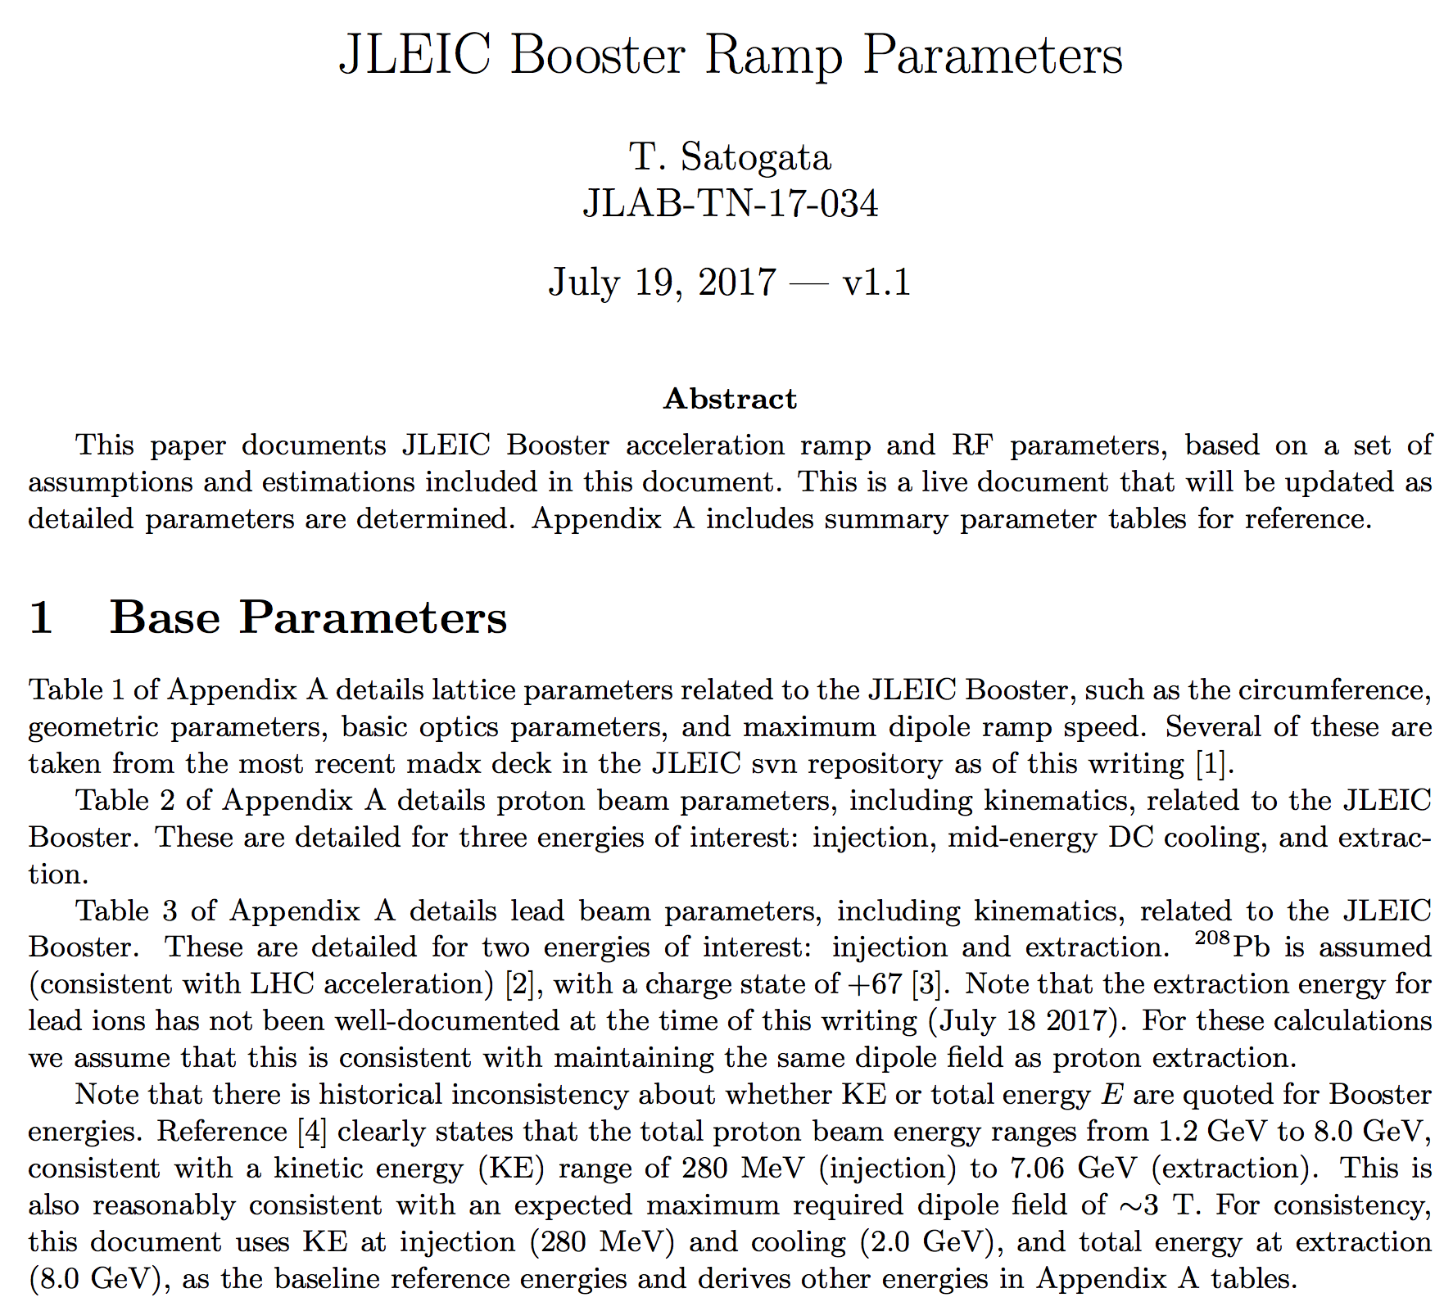
Document Example: Booster Parameters

Slide 11
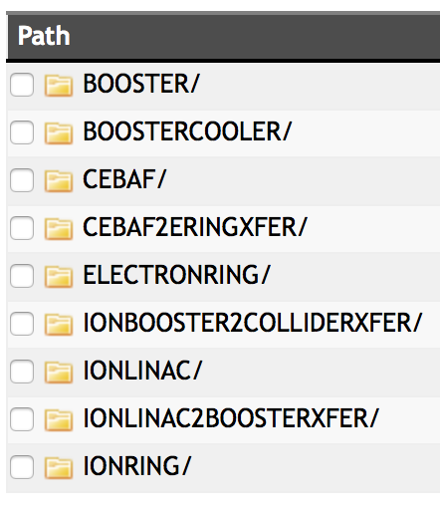
Configuration Management
Lattice design files version controlled in subversion
Version numbers cross-indexed to machine documents
Lattice descriptions vary for design reasons
e.g. madx, elegant, Track (linac)
Lattice owner / accelerator physics lattices
Lattice owners provide regular updates
Controlled lattice versions export many parameters into central JeDi database
Element inventory
Element types
Element parameters
Survey and layout

Slide 12
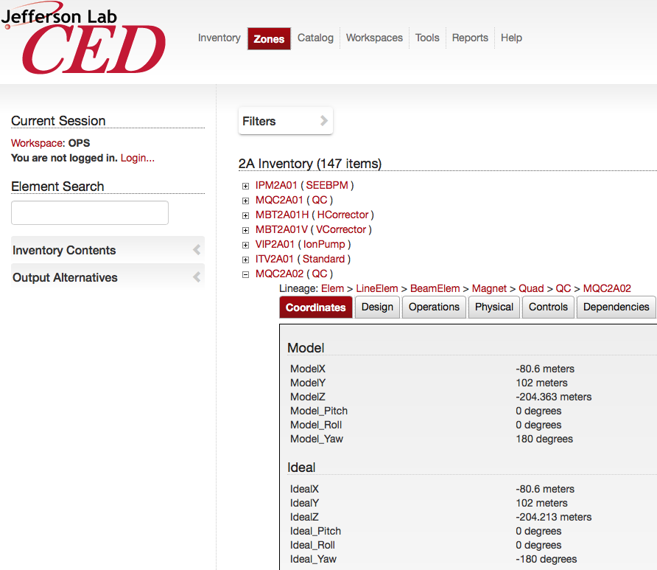
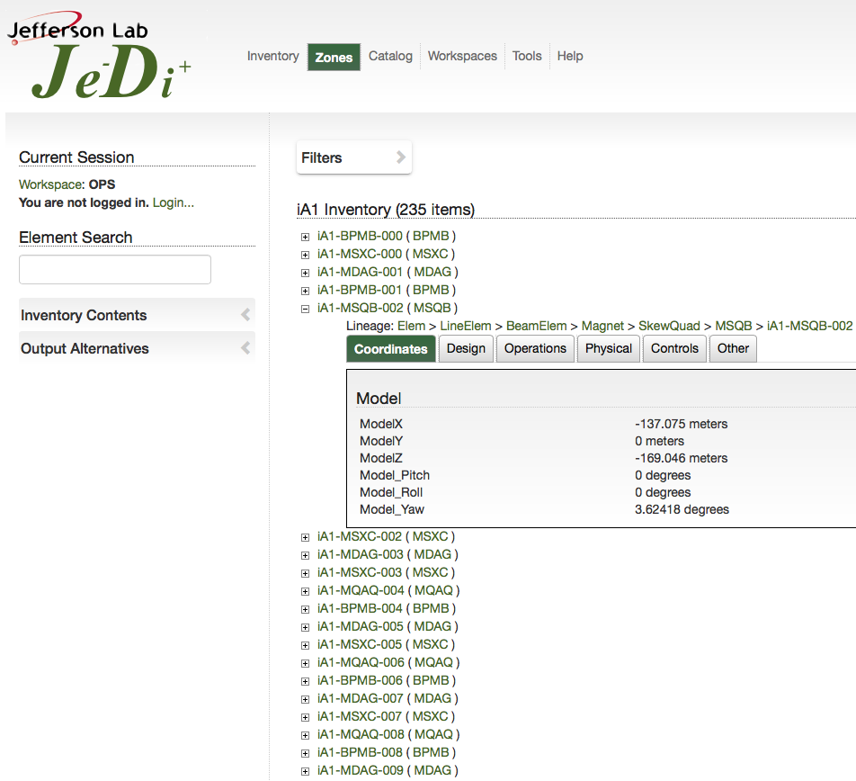
JeDi
Leverage 12 GeV project CEBAF element database (CED) development
CED drives CEBAF online models, control screens, machine control configuration, survey and alignment, …
Data-driven (svn configuration) lattice and element database for JLEIC
Engineering connections: component inventory, drawings for pCDR

Slide 13
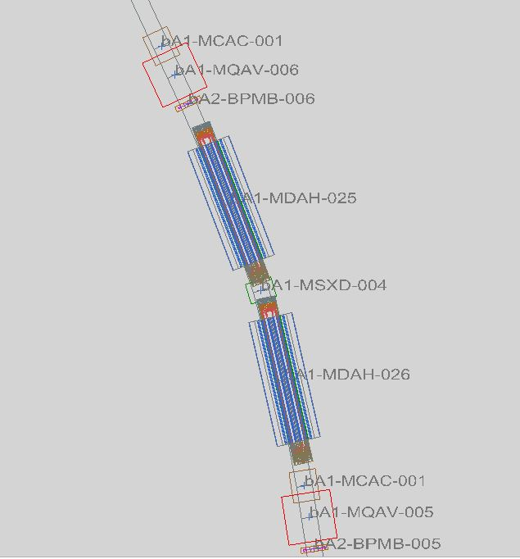
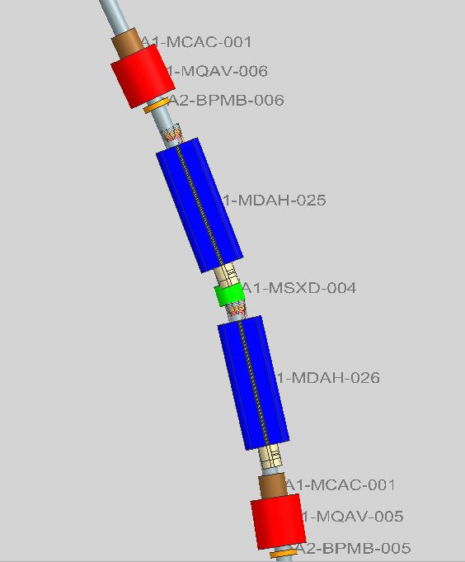
JeDi Ion Booster Ring Detail

Slide 14
Plans and Summary
JLEIC pCDR timescale is mid-late 2018
Aligned with NAS report, anticipated DOE CD0 announcement
pCDR development has commitment from JLab leadership
Documentation and pCDR: T. Satogata and R. Yoshida
Near-term process (Oct-Nov 2017)
Review/merge/update existing design summary reports
Identify and assign completeness issues, compare to other CDRs
Identify and assign pre-project planning, DOE 413.3 areas
Update WBS to align with completeness needs
Significant relevant work in process
Versioned machine definition documents (DocDB)
Lattice version control
Integration with JeDi for inventory, costing, layout

Slide 15
===== Backup Slides =====

Slide 16
Key CDR Elements
From DOE 413.3 - at a minimum, the Conceptual Design shall develop the following:
Scope required to satisfy the Program mission requirements;
Project feasibility;
Attainment of specified performance levels;
Assessment of project risks and identification of appropriate risk mitigation strategies;
Reliable cost and schedule range estimates for the alternatives considered;
Project criteria and design parameters;
Impact on the site Sustainability Plan; and
Identification of requirements and features.
CDR includes a clear and concise description of the alternatives analyzed, the basis for the alternative selected, how the alternative meets the approved mission need, the functions and requirements that define the alternative and demonstrate the capability for success, and the facility performance requirements, planning standards and life-cycle cost assumptions. The CDR should also clearly and concisely describe the KPPs that will form the basis of baseline at CD-2.

Slide 17
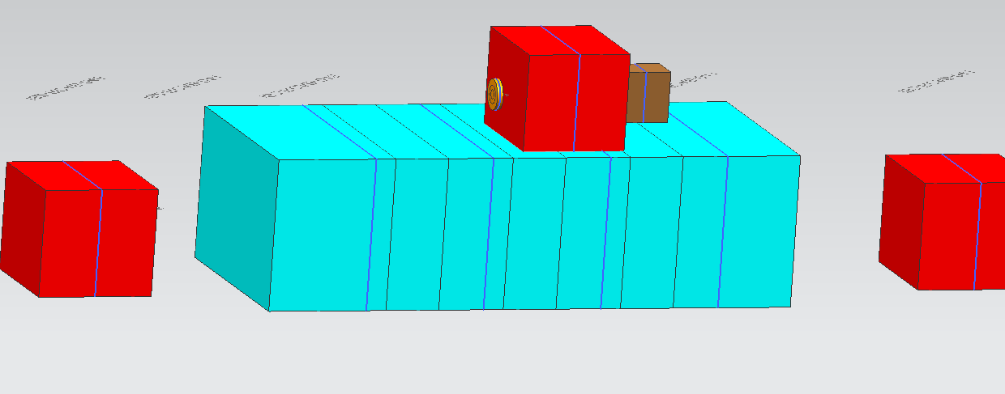
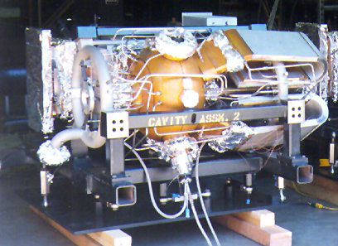
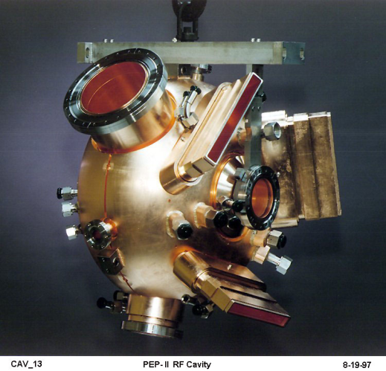
JeDi layout: PEP-II RF Cavities
Listed as 1m length in Lattice File – the cavity is, but the assembly is not

