Slide 1
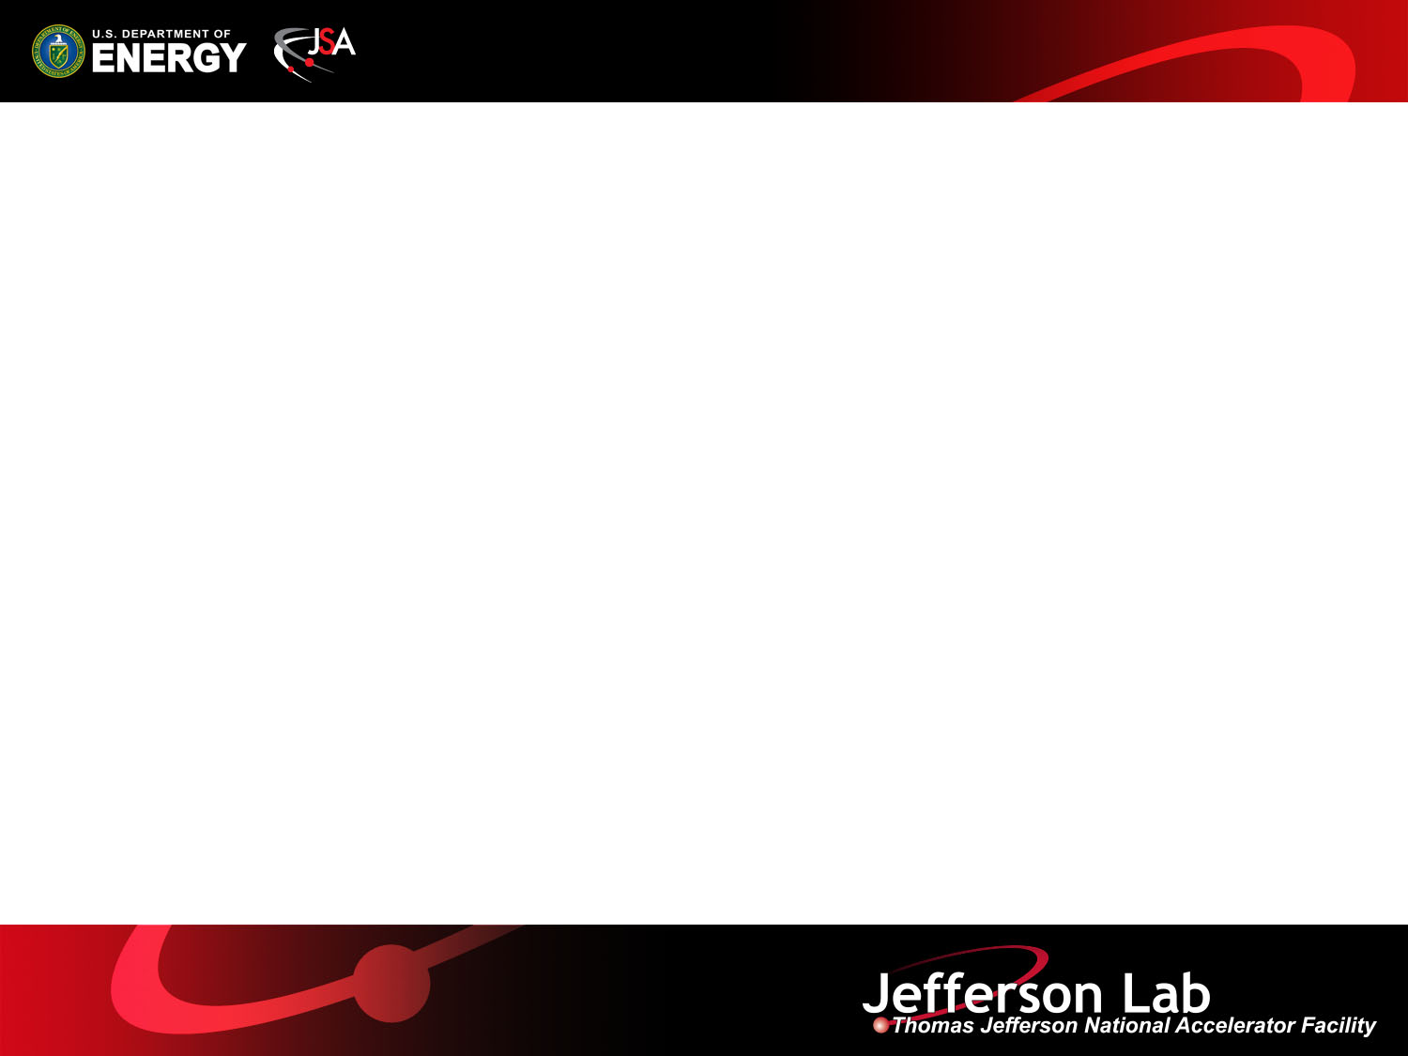
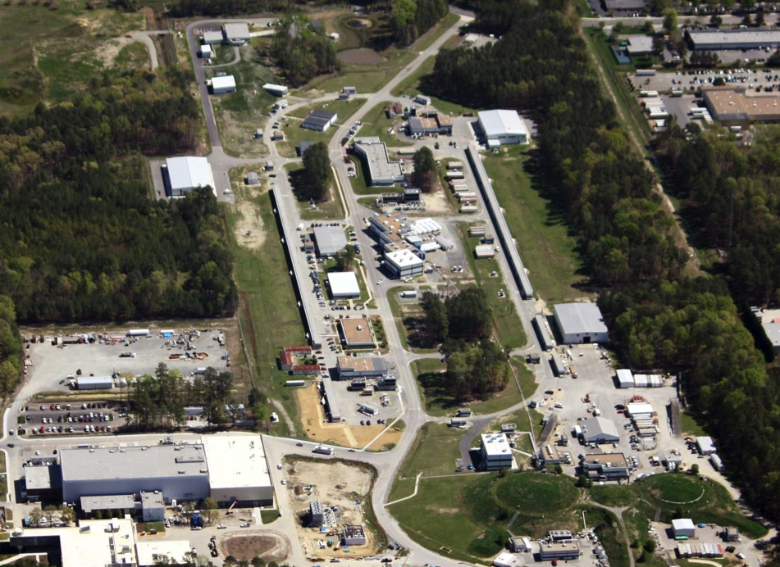
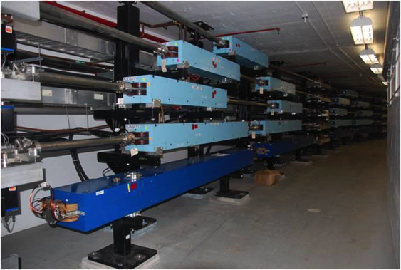
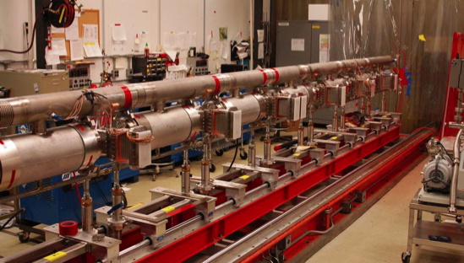
Introduction to Accelerators (Applied E&M and Relativity)
Todd Satogata / Center for Advanced Studies of Accelerators and Old Dominion
June 9 2016 GSPDA Seminar

Slide 2
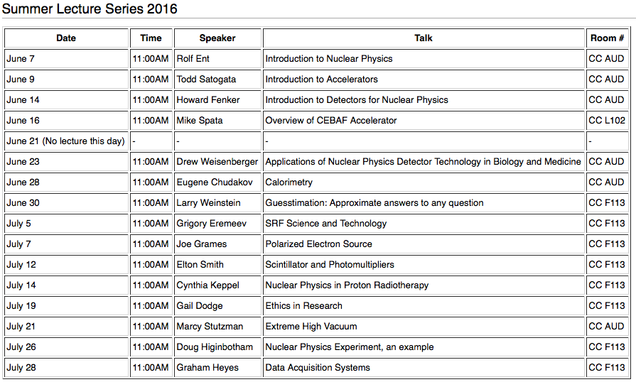
GSPDA Summer Lecture Series

Slide 3
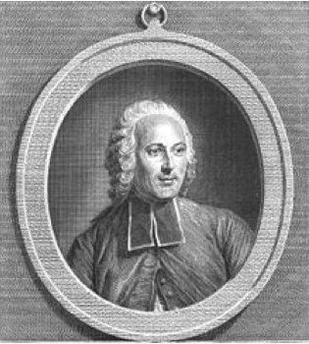
History: Jean-Antoine Nollet
In 1746 he gathered about two hundred monks into a circle over a 2 kilometers in circumference, with pieces of iron wire connecting them. He then discharged a battery of Leyden jars through the human chain and observed that each man reacted at substantially the same time to the electric shock, showing that the speed of electricity's propagation was very high.
Wikipedia, The Handy Physics Answer Book (Zitzewitz)

Slide 4
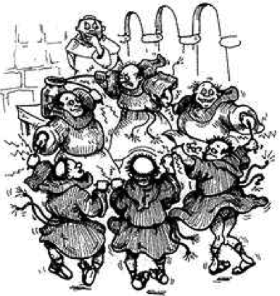
The Monkotron
Nollet had
  lots of charged particles
  moving in a confined 2km ring (!)
  at very high velocities
  accelerated by high voltage
Nollet didn’t have
  controlled magnets
  controlled acceleration
  proper instrumentation
  many friends after this experiment
http://www.yproductions.com/writing/archives/twitch_token_of_such_things.html

Slide 5
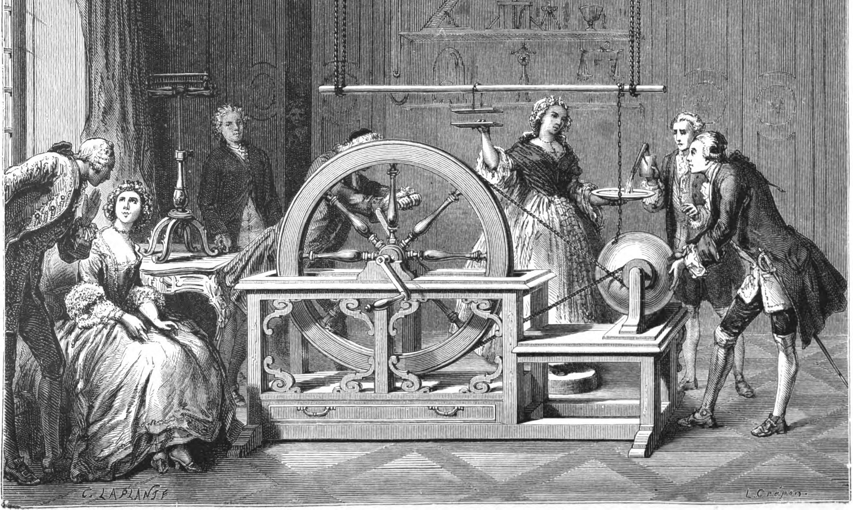
We’ve Come A Long Way Since This
1767 Lecons de Physique, Jean-Antoine Nollet
(Thomas Jefferson, coincidentally, was 24)

Slide 6
A Beam of Particles is a Very Useful Tool
A beam of the right particles with the right energy at the right intensity can…
… or discover the secrets of the universe
Shrink a tumor | Produce cleaner energy
Spot suspicious cargo | Make a better radial tire
Clean up dirty drinking water | Map a protein
Study a nuclear explosion | Design a new drug
Make a heat-resistant cable | Diagnose a disease
Reduce nuclear waste | Detect an art forgery
Implant ions in a semiconductor | Prospect for oil
Date an archaeological find | Package a Thanksgiving turkey
Accelerators for America’s Future, DOE report, 2010

Slide 7
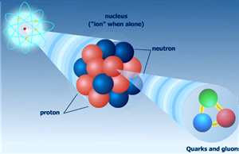
A Beam of Particles is a Very Useful Tool
A beam of the right particles with the right energy at the right intensity can…
… or discover the secrets of the universe
Shrink a tumor | Produce cleaner energy
Spot suspicious cargo | Make a better radial tire
Clean up dirty drinking water | Map a protein
Study a nuclear explosion | Design a new drug
Make a heat-resistant cable | Diagnose a disease
Reduce nuclear waste | Detect an art forgery
Implant ions in a semiconductor | Prospect for oil
Date an archaeological find | Package a Thanksgiving turkey
Accelerators for America’s Future, DOE report, 2010

Slide 8
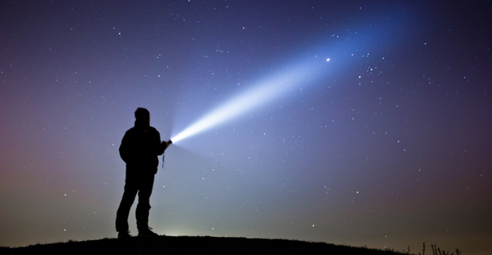
Of Glory not a Beam is left…
E. Dickinson (1685)
A beam of the right particles with the right energy at the right intensity…

Slide 9
Of Glory not a Beam is left…
E. Dickinson (1685)
A beam of the right particles with the right energy at the right intensity…
  Directed
  Focused
  Controlled

Slide 10
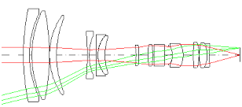
Of Glory not a Beam is left…
E. Dickinson (1685)
A beam of the right particles with the right energy at the right intensity…
  Directed
  Focused
  Controlled

Slide 11
The Right Particles
(except neutrinos, which are always left-handed)
A beam of the right particles with the right energy at the right intensity…
  Accelerator beams are electromagnetically charged subatomic particles
  So we use electromagnetic fields to control them
Protons
Electrons
Ions
And even muons and pions and photons and neutrinos and and and…

Slide 12
The Right Particles
(except neutrinos, which are always left-handed)
A beam of the right particles with the right energy at the right intensity…
  Accelerator beams are electromagnetically charged subatomic particles
  So we use electromagnetic fields to control them
  Lorentz Force:
Protons
Electrons
Ions
And even muons and pions and photons and neutrinos and and and…

Slide 13
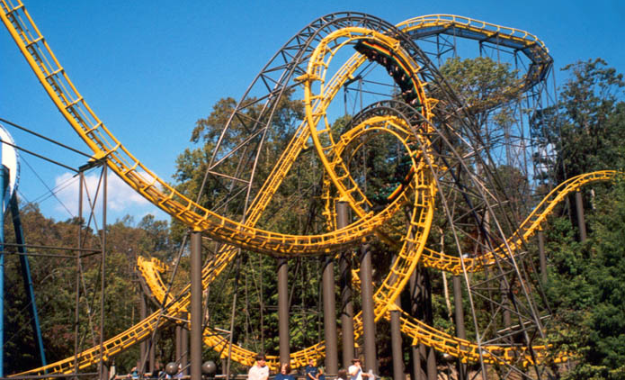
The Right Energy
A beam of the right particles with the right energy at the right intensity…
Potential
Kinetic
The Loch Ness Monster, Busch Gardens Williamsburg (15 miles north of JLab)

Slide 14
The Right Energy
A beam of the right particles with the right energy at the right intensity…
  Lorentz Force:

Slide 15
The Right Energy
A beam of the right particles with the right energy at the right intensity…
  Lorentz Force:
  Electric Field:
    Force in the same direction as electric field
    We use electric fields to speed up/slow down particles

Slide 16
The Right Energy
A beam of the right particles with the right energy at the right intensity…
  Lorentz Force:
  Electric Field:
    Force in the same direction as electric field
    We use electric fields to speed up/slow down particles
  Magnetic Field:
    Force is perpendicular to velocity and magnetic field
    We use magnetic fields to steer and focus particles

Slide 17
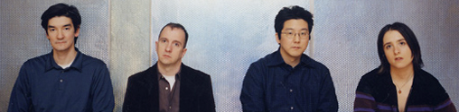
The Right Energy
A beam of the right particles with the right energy at the right intensity…
  Lorentz Force:
  Electric Field:
    Force in the same direction as electric field
    We use electric fields to speed up/slow down particles
  Magnetic Field:
    Force is perpendicular to velocity and magnetic field
    We use magnetic fields to steer and focus particles
    Also a band…

Slide 18
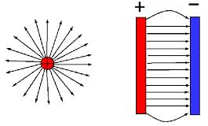
How Accelerators Accelerate
Electric Fields:
Created by distributions of electric charge

Slide 19
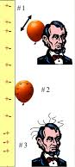
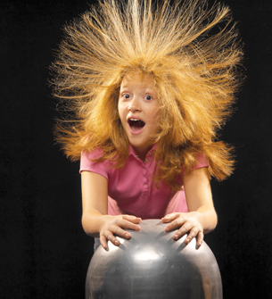
How Accelerators Accelerate
Electric Fields:
Created by distributions of electric charge
We could use static DC charge…

Slide 20
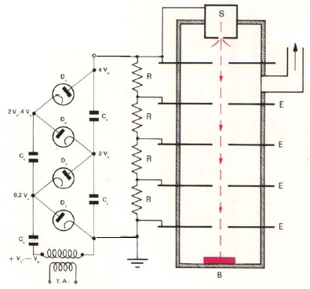
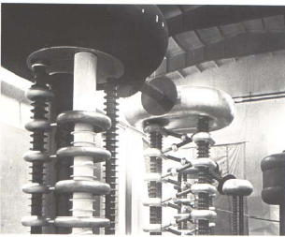
DC Accelerating Gaps: Cockcroft-Walton
Source
Accelerates ions through successive electrostatic voltages
  First to get protons to >MeV
  Continuous HV applied through intermediate electrodes
  Rectifier-multipliers (voltage dividers)
  Limited by HV sparking/breakdown
  FNAL still uses a 750 kV C-W
Also example of early ion source
  H gas ionized with HV current
  Provides high current DC beam
Rectifiers
Target
~1930 1.4 MeV
Cavendish Lab
Notes:
First artificial nuclear reaction (1932) Li⁷+p -> He⁴ + He⁴

Slide 21
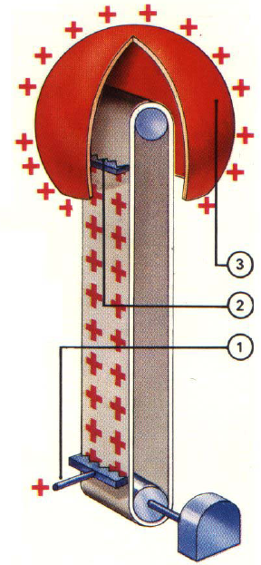
DC Accelerating Gaps: Van de Graaff
How to increase voltage?
  R.J. Van de Graaff: charge transport
  Electrode (1) sprays HV charge onto insulated belt
  Carried up to spherical Faraday cage
  Removed by second electrode and distributed over sphere
Limited by discharge breakdown
  ~2MV in air
  Up to 20+ MV in SF₆!
  Ancestors of Pelletrons (chains)/Laddertrons (stripes)
Notes:
SF₆ also happens to be the worst greenhouse gas known.
Also extremely dense. For amusement, http://www.youtube.com/watch?v=d-XbjFn3aqE

Slide 22
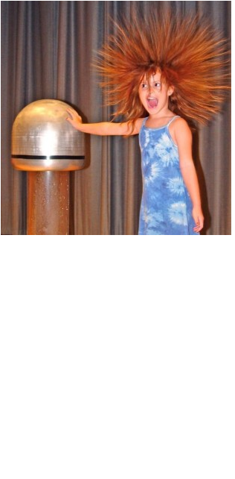
Van de Graaff Popularity

Slide 23

Van de Graaff Popularity

Slide 24
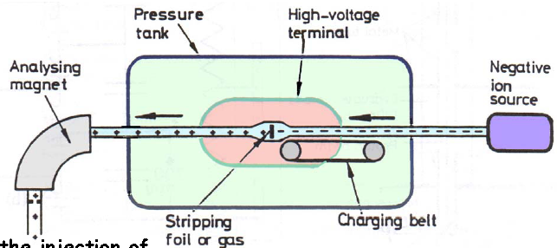
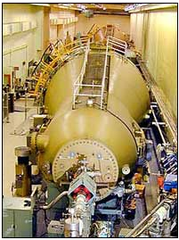
DC Accelerating Gaps: Tandem Van de Graaff
Reverse ion charge state in middle of Van de Graaff allows over twice the energy gain
  Source is at ground
This only works for negative ions
However, stripping need not be symmetric
  Second stage accelerates more efficiently
BNL: two Tandems (1970, 14 MV, 24m)
  Au⁻¹ to Au⁺¹⁰/Au⁺¹¹/Au⁺¹² to Au⁺³² for RHIC
  About a total of 0.85 MeV/nucleon total energy

Slide 25
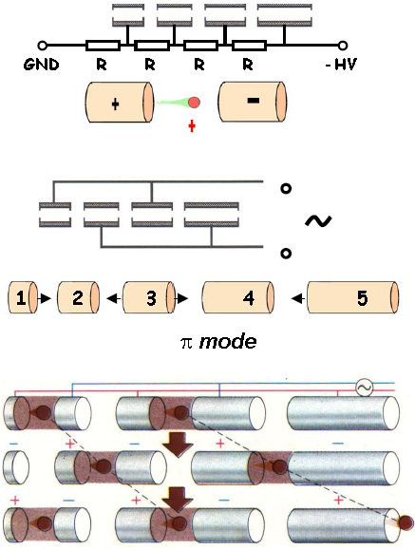
From Electrostatic to RF Acceleration
Cockcroft-Waltons and Van de Graaffs have DC voltages, E fields
What about putting on AC voltage?
  Attach consecutive electrodes to opposite polarities of ACV generator
  Electric fields between successive electrodes vary sinusoidally
  Consecutive electrodes are 180 degrees out of phase (π mode)
At the right drive frequency, particles are accelerated in each gap
  While polarity change occurs, particles are shielded in drift tubes
  To stay in phase with the RF, drift tube length or RF frequency must increase at higher energies
Wideroe linac
Pagani and Mueller 2002

Slide 26
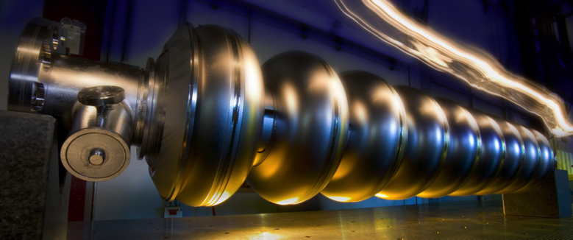
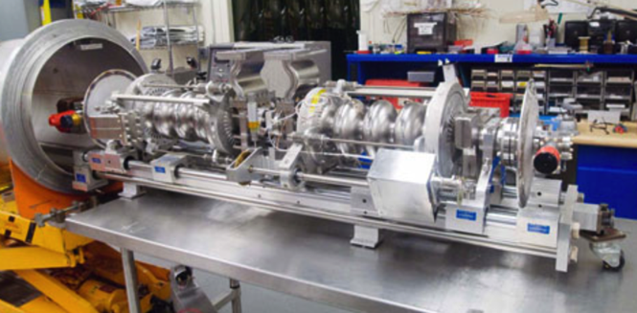
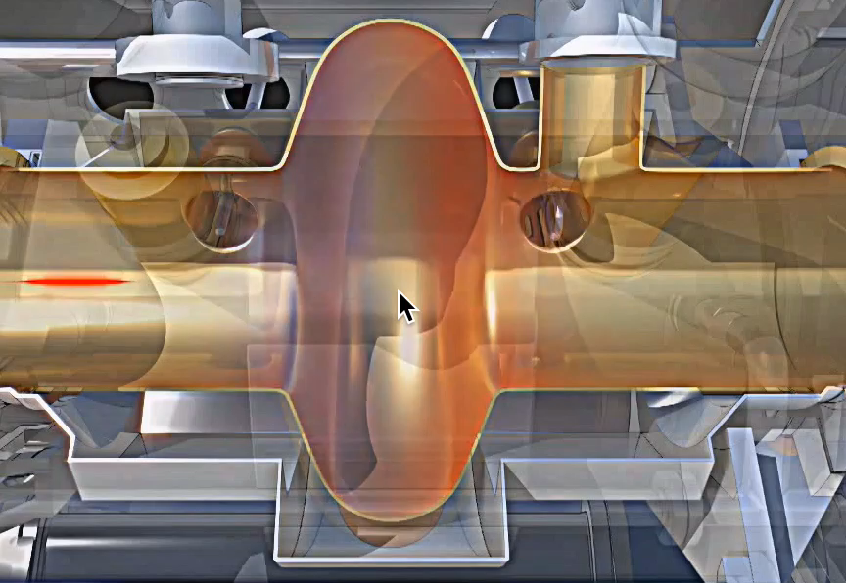
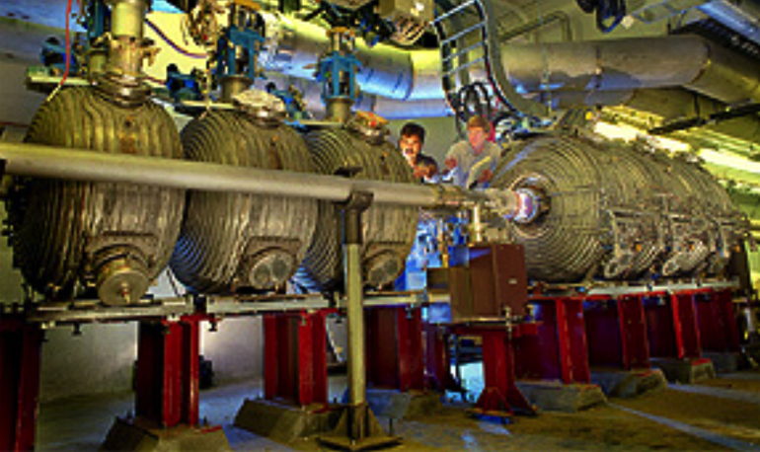
“Radio Frequency” RF Cavity Examples
Tens of Millions of V/m!
1497 MHz
Linear Collider
CEBAF
RHIC (BNL in New York)
197 MHz

Slide 27
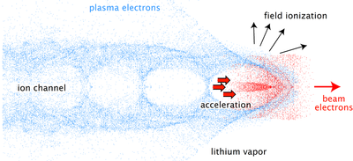
Advanced Acceleration Methods
How far do accelerating gradients go?
  Superconducting RF acceleration: ~40 MV/m
  CLIC (CERN): ~100 MV/m
    Two-beam accelerator: drive beam couples to main beam
  Dielectric wall acceleration: ~100 MV/m
    Induction accelerator, very high gradient insulators
  Dielectric wakefield acceleration: ~GV/m
  Laser plasma acceleration: ~40 GV/m
    electrons to 1 GeV in 3.3 cm
    particles ride in wake of plasma charge separation wave

Slide 28
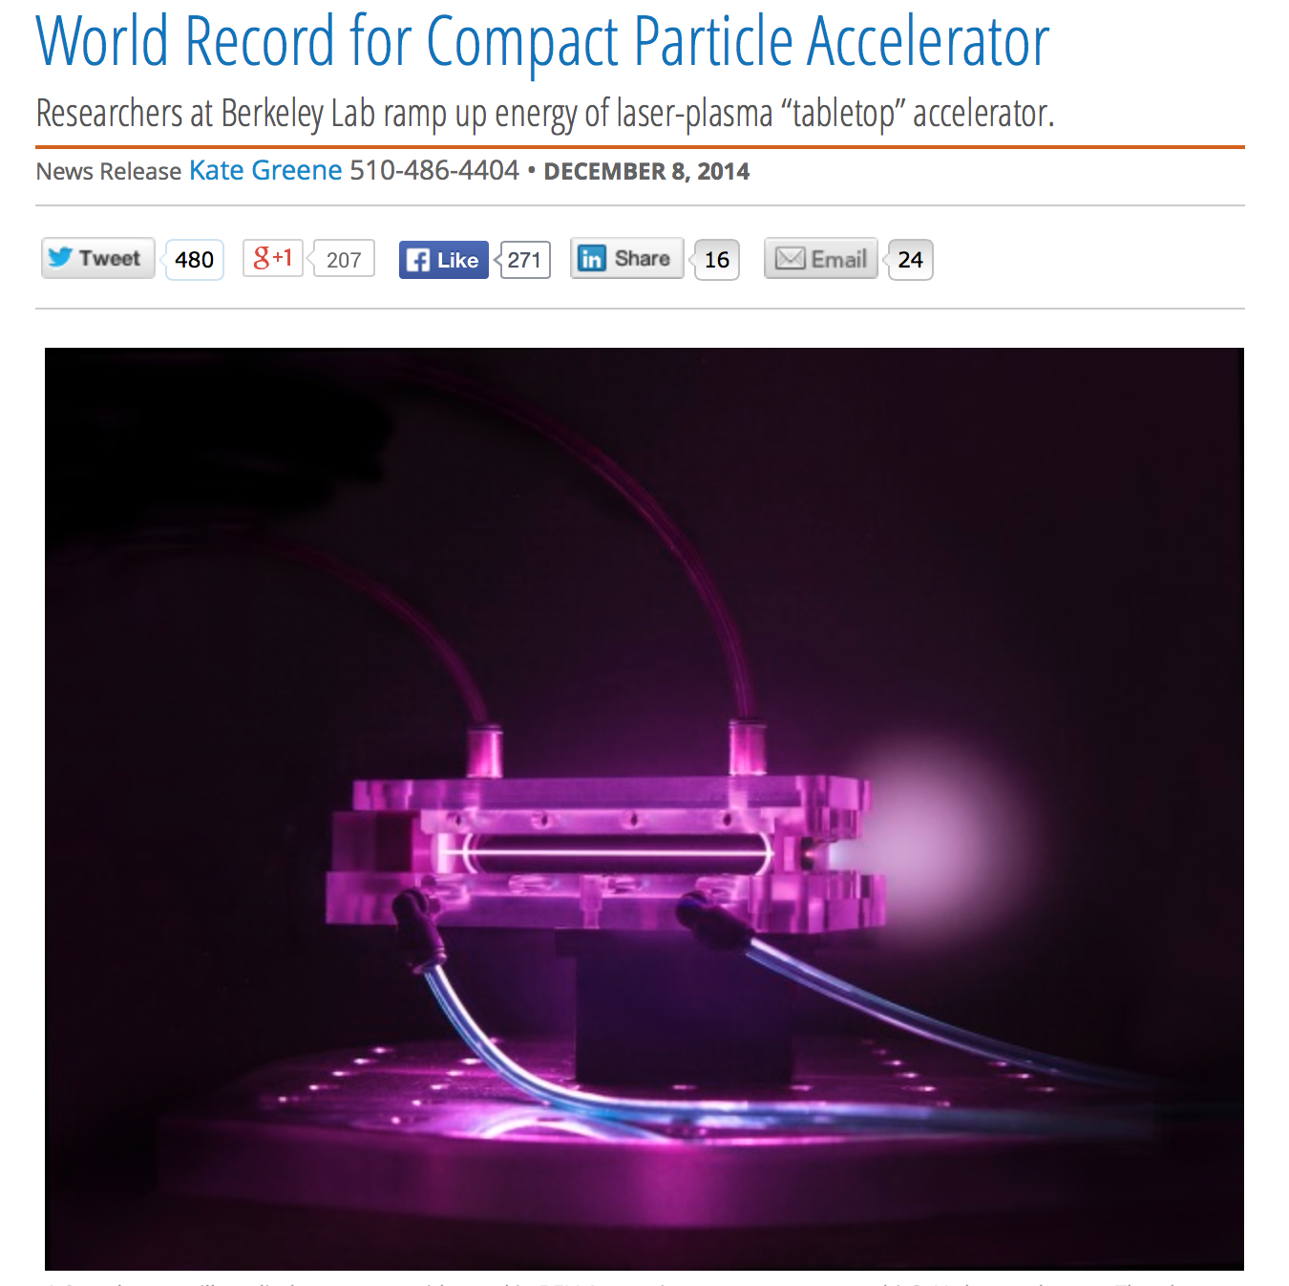
BELLA (Berkeley Lab) Makes the News
4.2 GeV electrons
in 9 cm
40 fs (=12 μm), 0.3 PW peak power drive laser
Multi-GeV Electron Beams from Capillary-Discharge-Guided Subpetawatt Laser Pulses in the Self- Trapping Regime
W. P. Leemans, et al., PRL 113, 245002 2014 (December 8, 2014)

Slide 29
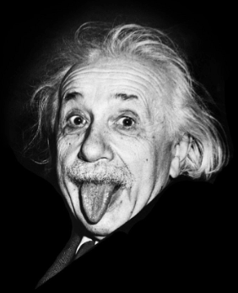
Applied Special Relativity
Particle accelerators are the best examples
that we have of applied special relativity
  Subatomic particles traveling very close to light speed
  Particle kinetic energies >> rest mass energies
    Electron rest mc² equal to energy gained in 0.5 million V
    So electrons going though these accelerators are very quickly very relativistic

Slide 30
Applied Special Relativity
Particle accelerators are the best examples
that we have of applied special relativity
  Subatomic particles traveling very close to light speed
  Particle kinetic energies >> rest mass energies
Relativistic parameters
  γ=1 (classical mechanics) to ~2.05x10⁵ (to date) (where??)
  v=0.99999999997 c

Slide 31
Applied Special Relativity
Particle accelerators are the best examples
that we have of applied special relativity
  Subatomic particles traveling very close to light speed
  Particle kinetic energies >> rest mass energies
Relativistic parameters
  γ=1 (classical mechanics) to ~2.05x10⁵ (to date) (where??)
  v=0.99999999997 c
Total energy U, momentum p, and kinetic energy W

Slide 32
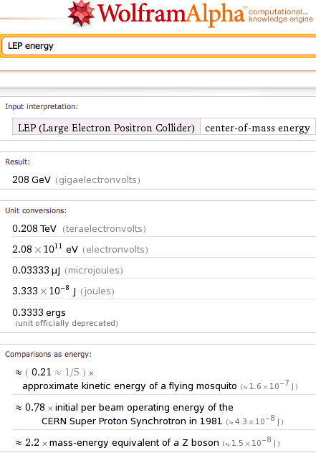
Relative Relativity

Slide 33
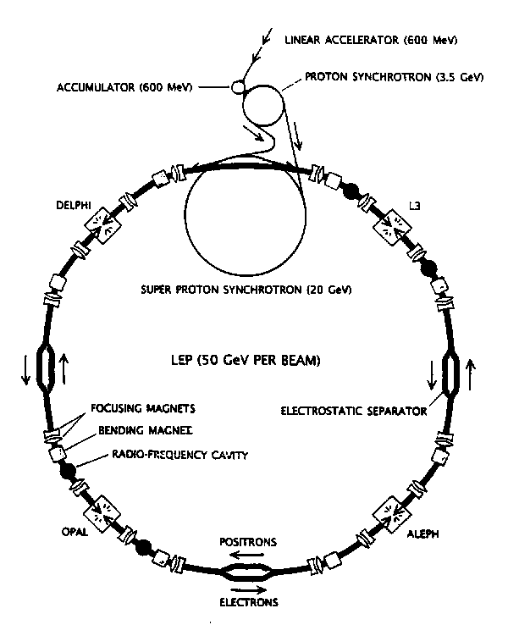
Relative Relativity

Slide 34

Relative Relativity

Slide 35
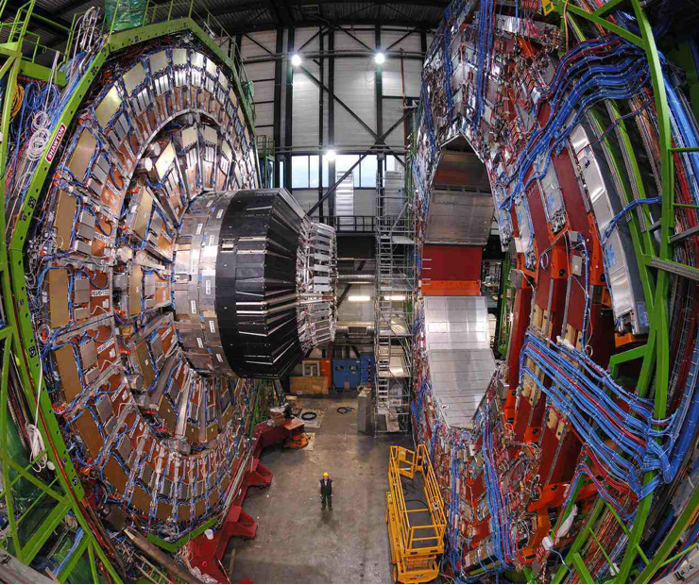

Relative Relativity

Slide 36
“Convenient” Units
How much is a TeV?
  Energy to raise 1g about 16 um against gravity
  Energy to power 100W light bulb 1.6 ns
But many accelerators have 10¹⁰⁻¹² particles
  Single bunch “instantaneous power” of tens
  of Terawatts
Highest energy observed cosmic ray
  ~300 EeV (3x10²⁰ eV or 3x10⁸ TeV!)

Slide 37
“Convenient” Units
How much is a TeV?
  Energy to raise 1g about 16 um against gravity
  Energy to power 100W light bulb 1.6 ns
But many accelerators have 10¹⁰⁻¹² particles
  Single bunch “instantaneous power” of tens
  of Terawatts
Highest energy observed cosmic ray
  ~300 EeV (3x10²⁰ eV or 3x10⁸ TeV!)
OMG particle

Slide 38

“Convenient” Units
How much is a TeV?
  Energy to raise 1g about 16 um against gravity
  Energy to power 100W light bulb 1.6 ns
But many accelerators have 10¹⁰⁻¹² particles
  Single bunch “instantaneous power” of tens
  of Terawatts
Highest energy observed cosmic ray
  ~300 EeV (3x10²⁰ eV or 3x10⁸ TeV!)
OMG particle

Slide 39
“Convenient” Units
How much is a TeV?
  Energy to raise 1g about 16 um against gravity
  Energy to power 100W light bulb 1.6 ns
But many accelerators have 10¹⁰⁻¹² particles
  Single bunch “instantaneous power” of tens
  of Terawatts
Highest energy observed cosmic ray
  ~300 EeV (3x10²⁰ eV or 3x10⁸ TeV!)
(125 g hamster at 100 km/hr)
OMG particle

Slide 40
The Right Intensity
A beam of the right particles with the right energy at the right intensity…
  Make all the particles go where we want them to go
    How do we steer and guide the particles?
  Keep the beam from getting to big or divergent
    How do we keep the particles focused together?

Slide 41
The Right Intensity
A beam of the right particles with the right energy at the right intensity…
  Make all the particles go where we want them to go
    How do we steer and guide the particles?
  Keep the beam from getting to big or divergent
    How do we keep the particles focused together?
  Lorentz Force:
    Magnetic fields dominate as v approaches c

Slide 42
The Right Intensity
A beam of the right particles with the right energy at the right intensity…
  Make all the particles go where we want them to go
    How do we steer and guide the particles?

Slide 43
The Right Intensity
A beam of the right particles with the right energy at the right intensity…
  Make all the particles go where we want them to go
    How do we steer and guide the particles?
  Use areas of constant to bend the particle paths
  Particles move in semi-circles in areas of constant
    They move in lines (circles of infinite radius) when B=0
Zero B field
Zero B field
Constant B field out of page

Slide 44
The Right Intensity
A beam of the right particles with the right energy at the right intensity…
  Make all the particles go where we want them to go
    How do we steer and guide the particles?
  Use areas of constant to bend the particle paths
  Different momentum particles bend slightly differently
    Just like a prism in classical optics
Zero B field
Zero B field
Constant B field out of page

Slide 45
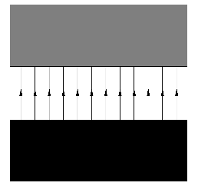
Dipole Field
The type of accelerator magnet that creates a constant magnetic field region is a dipole magnet
South
North

Slide 46
The Right Intensity
A beam of the right particles with the right energy at the right intensity…
  Keep the beam from getting to big or divergent
    How do we keep the particles focused together?

Slide 47
The Right Intensity
A beam of the right particles with the right energy at the right intensity…
  Keep the beam from getting to big or divergent
    How do we keep the particles focused together?
  Bend all particles towards design path = focusing
  B field varies linearly with displacement: B=0 at center
Zero B field
Zero B field
Linearly varying B field – zero along central path

Slide 48
The Right Intensity
A beam of the right particles with the right energy at the right intensity…
  Keep the beam from getting to big or divergent
    How do we keep the particles focused together?
  Just like a lens in classical optics
Zero B field
Zero B field
Linearly varying B field – zero along central path

Slide 49
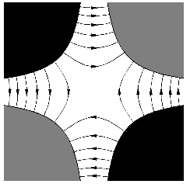
Quadrupole Field
The type of accelerator magnet that creates a magnetic field region that varies linearly with position is a quadrupole magnet
North
South
South
North

Slide 50
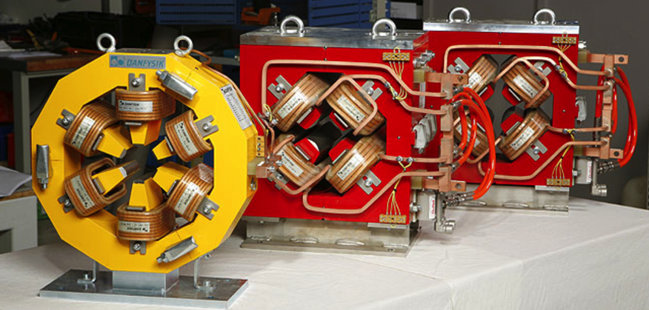
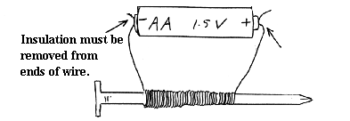
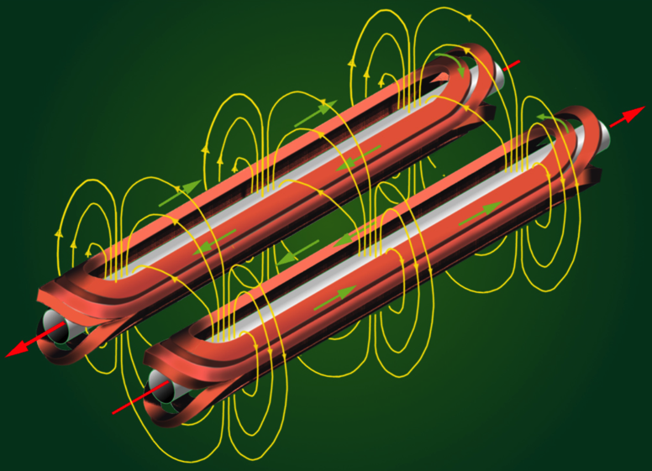
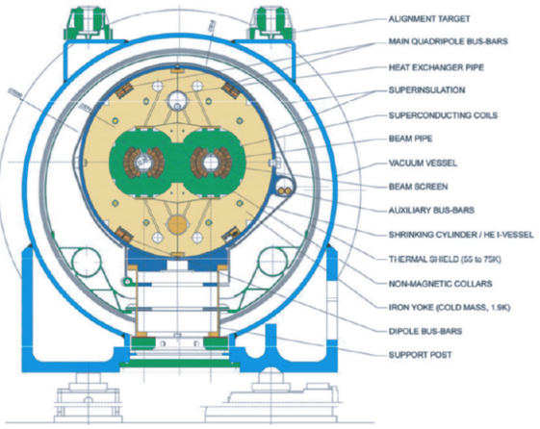
Accelerator Magnet Examples
0.1 to 15 Tesla! (Earth’s field 3-7x10⁻⁵ Tesla)
Air-temperature
steel magnets
(Danfysik)
Superconducting
NbTi magnets (LHC)

Slide 51
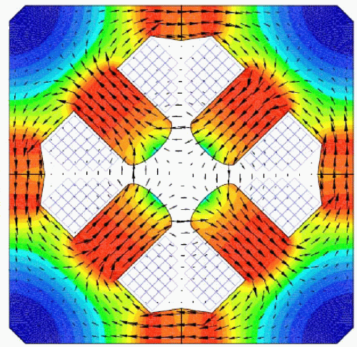
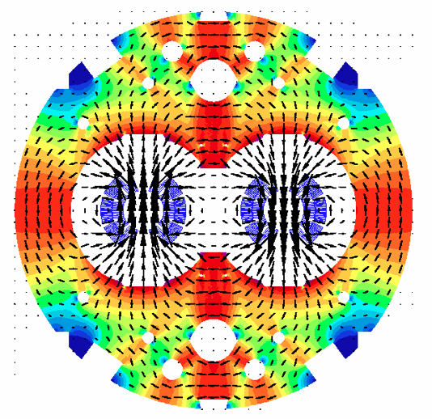
Normal vs Superconducting Magnets
LEP quadrupole magnet (NC)
LHC dipole magnets (SC)
  Note high field strengths (red) where flux lines are densely packed together

Slide 52
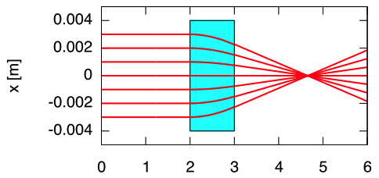
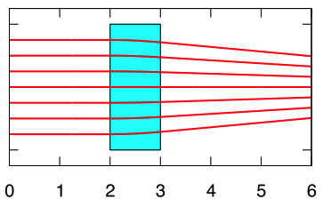
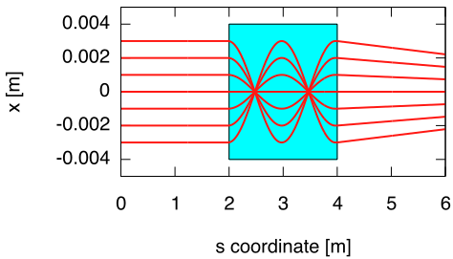
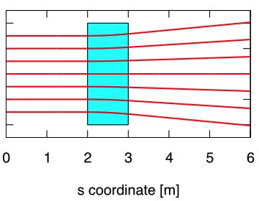
Picturing Drift and Quadrupole Motion
KL=0.5 m⁻¹, f=2m
KL=0.1 m⁻¹, f=20m
KL=20 m⁻¹, f=0.05m
KL=-0.1 m⁻¹, f=-20m
Quadrupoles act just like lenses in classical optics

Slide 53
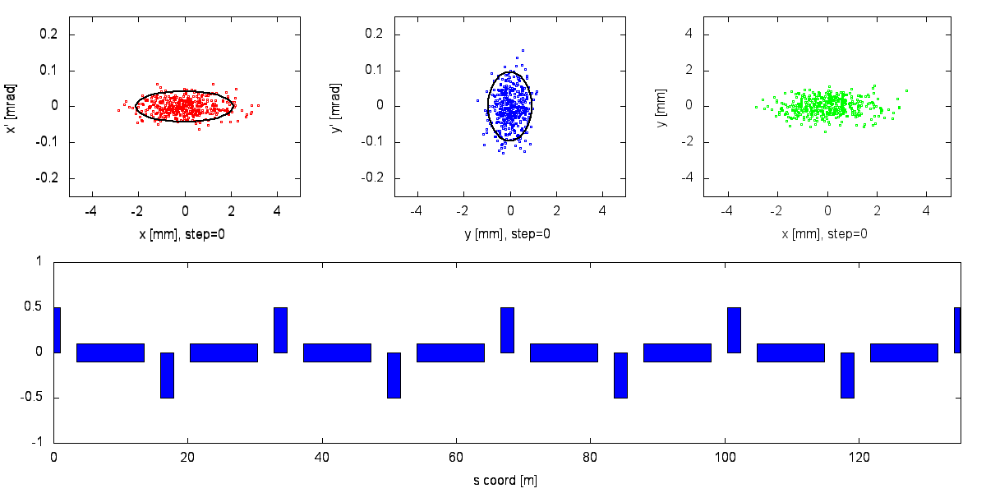

Putting It All Together
Horizontal particle
Position and angle
Vertical particle
Position and angle
Horizontal and
Vertical position

Slide 54
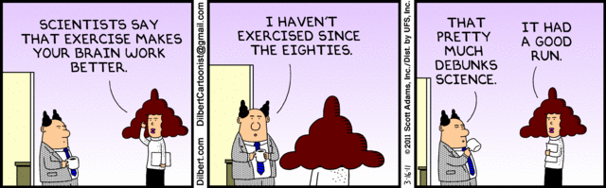

Stretch Break

Slide 55
A Beam of Particles is a Very Useful Tool
A beam of the right particles with the right energy at the right intensity can…
… or discover the secrets of the universe
Shrink a tumor | Produce cleaner energy
Spot suspicious cargo | Make a better radial tire
Clean up dirty drinking water | Map a protein
Study a nuclear explosion | Design a new drug
Make a heat-resistant cable | Diagnose a disease
Reduce nuclear waste | Detect an art forgery
Implant ions in a semiconductor | Prospect for oil
Date an archaeological find | Package a Thanksgiving turkey
Accelerators for America’s Future, DOE report, 2010

Slide 56
A Beam of Particles is a Very Useful Tool
A beam of the right particles with the right energy at the right intensity can…
… or discover the secrets of the universe
Shrink a tumor | Produce cleaner energy
Spot suspicious cargo | Make a better radial tire
Clean up dirty drinking water | Map a protein
Study a nuclear explosion | Design a new drug
Make a heat-resistant cable | Diagnose a disease
Reduce nuclear waste | Detect an art forgery
Implant ions in a semiconductor | Prospect for oil
Date an archaeological find | Package a Thanksgiving turkey
Accelerators for America’s Future, DOE report, 2010

Slide 57
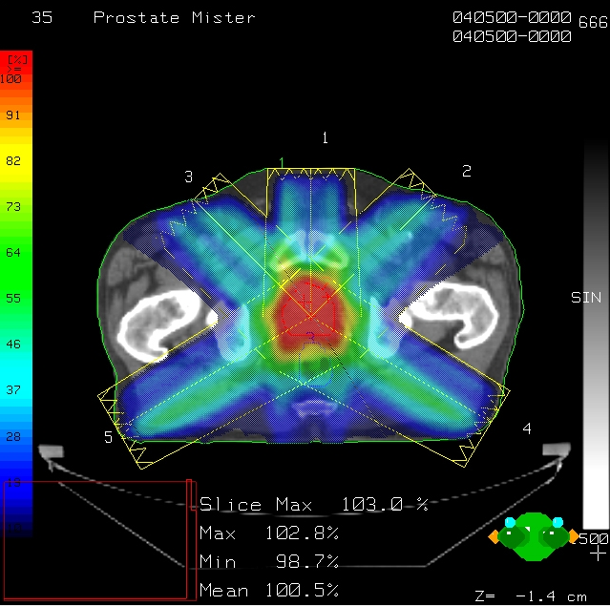
Shrink a Tumor: X-Ray Radiotherapy
From the perspective of medicine
  Irradiate the cancer and spare healthy tissue
  We can use beams of radiation and particles as surgical scalpels to selectively kill cancer cells
X-ray intensity-modulated radation therapy (IMRT)
  Commonly performed “gamma knife”
  Requires multiple directions
Can (mostly) avoid critical structures
  But still residual radiation dose
  Residual dose is high on skin, in early entry areas
  Some unpleasant side effects
Image courtesy of Varian/Eclipse

Slide 58
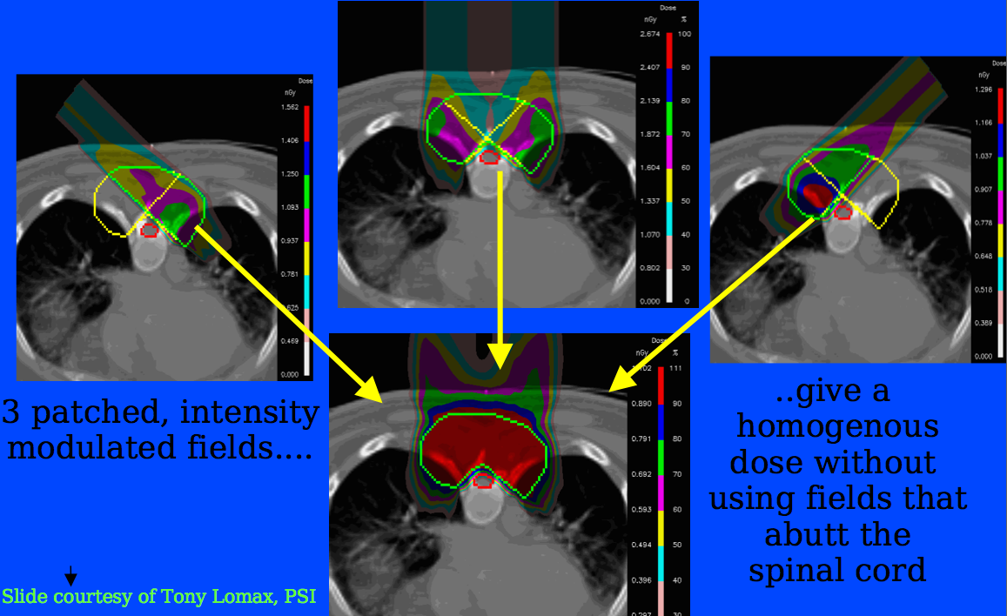
Shrink a Tumor: Proton Radiotherapy
http://iopscience.iop.org/0031-9155/55/12/018

Slide 59
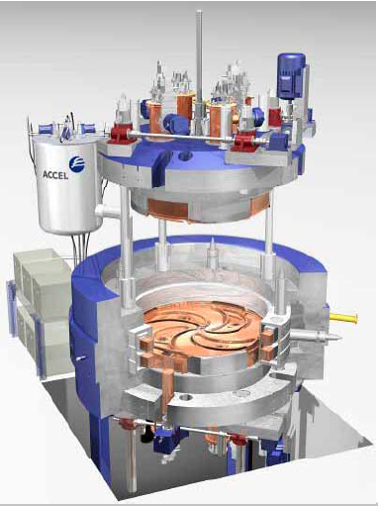

Shrink a Tumor: Radiotherapy Cyclotron
Distinct dose localization advantage for hadrons over X-rays
There is also present work on proton and carbon radiotherapy fast-cycling synchrotrons
Cynthia Keppel, July 14 GSPDA Lecture

Slide 60

Produce Cleaner Energy
S. Henderson, Thorium Energy Alliance Conf 2012

Slide 61

Produce Cleaner Energy: Thorium Reactor
S. Henderson, Thorium Energy Alliance Conf 2012

Slide 62


Date an Archaeological Find
A 4-6 MeV accelerator in the basement of the Louvre
  Date and determine atomic constituents of antiquities
  Induces low-level nuclear emissions of charged particles
    No damage to art objects in process of analysis
  Very trace elements can be detected
    E.g. Far-East provenance
    of Ishtar statue found in
    Mesopotamia near 0 CE
Ruby-eyed ~0 CE Ishtar

Slide 63



Map a Protein
molecule
molecule
Resolution of imaging is directly related to wavelength
  Small wavelengths can resolve molecular, atomic detail
  Smaller wavelengths can resolve electron motion
  Wavelengths: VUV into X-ray region (NSLS)
  Pulse lengths: picoseconds (10⁻¹² s) to attoseconds (10⁻¹⁸ s)
  Ultra-short wavelengths/pulses: very high power (~GW)
Objectives of accelerator-based light sources
  Investigate imaging of atoms, molecules, and materials
  ... in timescales of electron motion around orbitals (~100 as!)

Slide 64

Map a Protein
Coulomb Explosion of Lysozyme (50 fs)
Atomic and molecular dynamics occur at the fsec-scale
J. Hajdu, Uppsala

Slide 65



Map a Protein… with Free Electron Lasers (FELs)
RF Electron Gun
Optical Cavity
Linac
Undulator
Laser Light
Free electrons can be lased
  Not a gas/liquid/solid state laser
  Capture laser in optical cavity
  Laser beam and undulator stimulate further laser emission
Very high brightness
  10²-10⁵ over older accelerators
Tunable laser frequencies
  >5-10, microwaves to X-rays
Bill Gabella, Vanderbilt

Slide 66


Map a Protein… with LCLS-II FEL at SLAC
Being built with Jefferson Lab Superconducting RF technology
LCLS-II Design Report

Slide 67



Discover the Secrets of the Universe
CEBAF
LHC (Switzerland)
KEKB (Japan)
RHIC (New York)

Slide 68


Did Somebody Say CEBAF?
RF and magnets
magnets
RF and magnets
6-12 GeV (~1 MW) polarized electrons
1497 MHz beams
Circumference ~1300m (0.8 miles)
CW recirculating linacs

Slide 69


The CEBAF Tunnel
Arc magnets
Linac RF cryomodules
Superconducting RF operates at 2K
High vacuum systems
Instrumentation/diagnostic systems
High-power electrical systems
Control system: 10k+ control points

Slide 70
Why CEBAF?
Let’s say we want to do a diffraction/scattering experiment to get images of atomic nuclei (protons and neutrons)
  Proton charge radius: ~0.88 x 10⁻¹⁵ m (0.88 fm)
We also want to measure electroweak interactions
  So our probe better be EM charged and polarizable (to see asymmetric scattering from weak force parity violation)
High-energy electrons fit the bill perfectly
  Higher energies can also excite new nuclear/parton states
  Polarized beam asymmetries are sensitive to weak interaction currents

Slide 71
How CEBAF?
A multi-GeV continuous electron beam is not common!
  Equivalent to accelerating through GV of potential
  Far far too large to create with electrostatics
Regular (non-superconducting) RF cavities?
  CW state of the art was ~2 MV/m: 2 GeV = 1 km of cavities
  We want high frequency (100s of MHz): high Ohmic losses
  This implies many 10s of MW of wall plug power!
Superconducting RF cavities!
  Requires construction of large 2K (or 4K) cryogenic facility
  But can achieve high energy, “high current” CW beams
  Original gradients: ~5 MV/m => E_{e} ~ 4 GeV
  The first major superconducting RF facility in the world

Slide 72
CEBAF Reminder
RF and magnets
magnets
RF and magnets

Slide 73

Refurbished CEBAF RF Cavities
Made out of very pure large-grain Nb
  Superconducting RF technology research is a very active area
    Includes many active control loops for consistent fields
  Nb RF technology theoretical limit: 55 MV/m
  Insulating cryomodule layers removed here for visibility

Slide 74

CEBAF: From 6 GeV to 12 GeV

Slide 75


C100 RF
New RF cryomodules: 4x gradient of old modules
  Adding 5 new modules doubles energy of accelerator
  Each module: 20 MV/m, ~100 MeV energy gain/module
Shahid Ahmed
Ilkyoung
Shin

Slide 76

Thank you!!!

