Slide 1
Introduction to Accelerator Physics
Spring 2018
Introductions
Overview of Particle Accelerators
Todd Satogata (Jefferson Lab and ODU) / satogata@jlab.org
http://www.toddsatogata.net/2018-ODU-AP
Happy Birthday to Nina Dobrev, Dave Matthews, Jimmy Page, Joan Baez, and Vladimir Steklov!
Happy National Cassoulet day, Static Electricity Day, and Word Nerd Day!

Slide 2
Introductions and Outline
A sign-in sheet is being passed around
Introductions: Getting to know you, and us…
Let’s get it started
  Course administrivia
  Survey of accelerators and accelerator concepts
Next lecture
  Special relativity and E&M fundamentals

Slide 3

Todd’s Absence and Recovery
Todd will be absent a few weeks after his vehicle was hit by a school bus on Jefferson Ave on Dec 6
Drs. Geoff Krafft and Charles Hyde will be filling in for the first several weeks of the class
Todd <3 Toyota Airbags

Slide 4
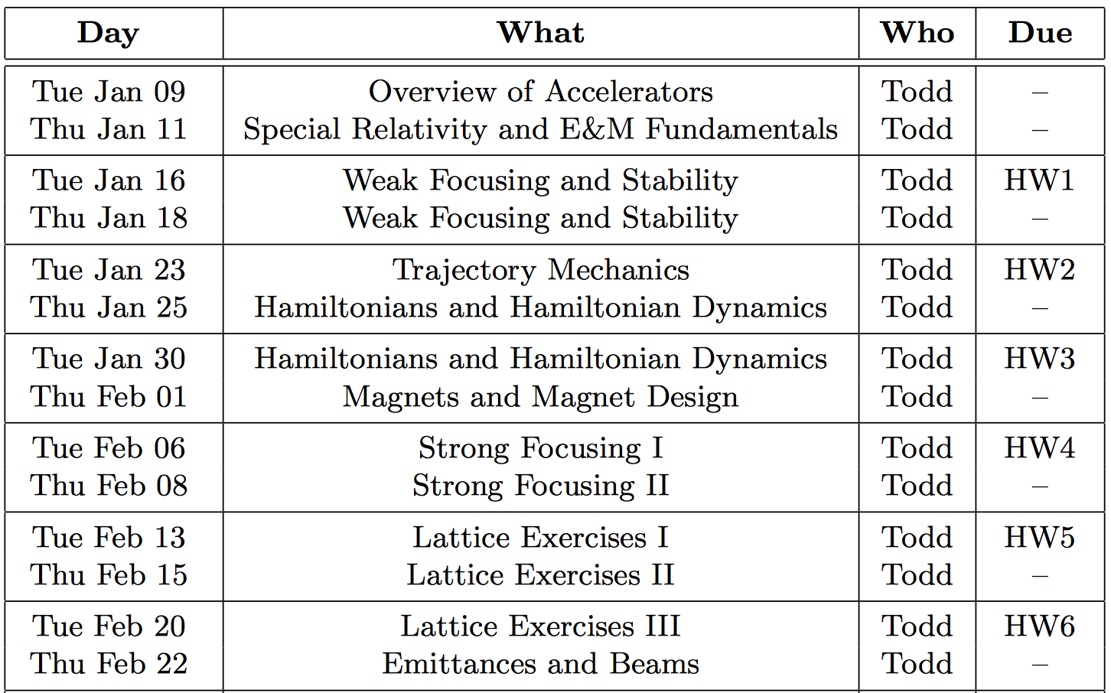
Syllabus I
First half of semester: Mostly transverse linear optics
  Fundamentals and equations of motion
  Magnet design, fields, descriptions
  Linear transverse optics, “labs” with simulation codes
  Magnetic lattices and lattice design

Slide 5

Text
Conte and MacKay
  2nd edition
We will cover quite a bit of this text
One advantage over other texts: lots of fairly clear derivations
Lots of undergraduate level material with some graduate level sections

Slide 6
Homework and Schedule
Homework is half of your grade!! (50%)
  Collected at start of Tuesday classes when due
Collaboration is encouraged! (Except on the midterm on Mar 1)
  In fact, it’s a good part of the reason why you’re here!
  Todd is available via email to help and answer questions
  One-on-one meetings can be set up according to demand
Please cite references, contributions of teammates, etc
  But everyone must hand in individual copies of homework

Slide 7
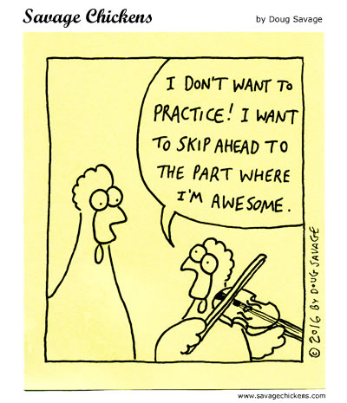
Growth Comes From Effort

Slide 8
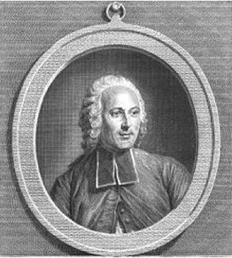
Earliest “Accelerator”: Jean-Antoine Nollet
In 1746 he gathered about two hundred monks into a circle over a mile in circumference, with pieces of iron wire connecting them. He then discharged a battery of Leyden jars through the human chain and observed that each man reacted at substantially the same time to the electric shock, showing that the speed of electricity's propagation was very high.

Slide 9
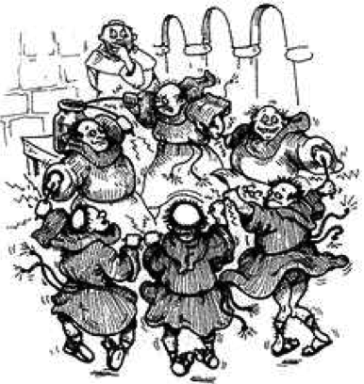
Earliest “Accelerator”: The Monkotron
Nollet had
  lots of charged particles
  moving in a confined 2km ring (!)
  at “high” velocities (for them)
  accelerated by high voltage
Nollet didn’t have
  controlled magnets
  controlled acceleration
  proper instrumentation
  many friends after this experiment
http://www.yproductions.com/writing/archives/twitch_token_of_such_things.html

Slide 10
Simplified Particle Motion
design trajectory
Magnets
RF Cavity
Design trajectory
  Particle motion will be perturbatively expanded around a design trajectory or orbit
  This orbit can be over 10¹⁰ km in a storage ring
Separation of fields: Lorentz force
  Magnetic fields from static or slowly-changing magnets
    transverse to design trajectory
  Electric fields from high-frequency RF cavities
    in direction of design trajectory
Relativistic charged particle velocities

Slide 11
Classical Constant Magnetic Field
(Zero Electric Field and ignoring relativity for now)
In a constant magnetic field, charged particles move in circular arcs of radius ρ with constant angular velocity ω:
  For we then have

Slide 12
Rigidity: Bending Radius vs Momentum
(A true relationship even for relativistic particles)
Beam properties
(charge, momentum)
Accelerator properties
(magnets, geometry)
This is such a useful expression in accelerator physics that it has its own name: rigidity
Ratio of momentum to charge
  How hard (or easy) is a particle to deflect?
  Often expressed in [T-m] (easy to calculate B)
  Be careful when q≠e!!
A very useful scaling expression
Notes:
Perpendicular B!
Add q[e] (or Z) to last equation
Be careful; very low-energy people may define rigidity relative to KE rather than p
RHIC: dAu tradeoff

Slide 13
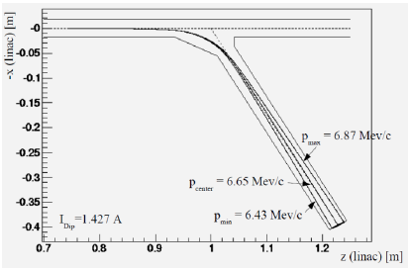
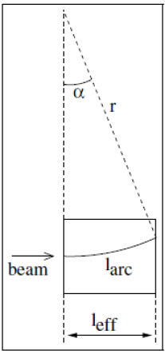
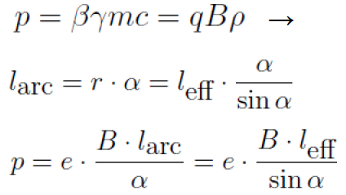
Application: Particle Spectrometer
Identify particle momentum by measuring bend angle from a calibrated magnetic field

Slide 14
Cyclotron Frequency
(True only in non-relativistic regime)
Another very useful expression for particle angular frequency in a constant field: cyclotron frequency
Revolution frequency is independent of radius or energy!
  Relativistic version:

Slide 15
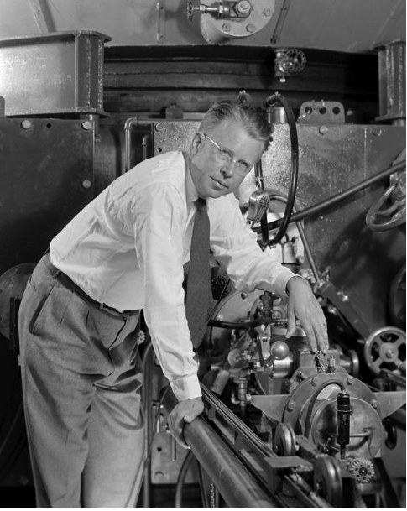
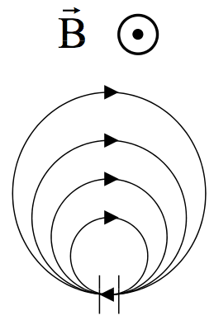
Lawrence and the Cyclotron
Can we repeatedly spiral and accelerate particles through the same potential gap?
Accelerating gap ΔΦ
Ernest Orlando Lawrence

Slide 16
Cyclotron Frequency Again
Recall that for a constant B field (nonrelativistic):
  Radius/circumference of orbit scale with velocity
    Circulation time (and frequency) are independent of v
  Apply AC electric field in the gap at frequency f_{rf}
    Particles accelerate until they drop out of resonance
    Note a first appearance of “bunches”, not DC beam
    Works best with heavy particles (hadrons, not electrons)
Notes:
Why not a DC electric field?
Electrons don’t accelerate in cyclotron, but comment on ECR for electron stripping/ion sources

Slide 17
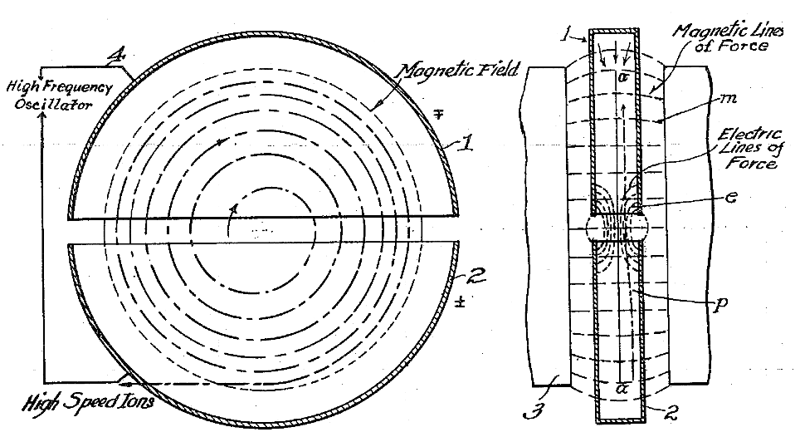
A Patentable Idea
1934 patent 1948384
  Two accelerating gaps per turn!

Slide 18
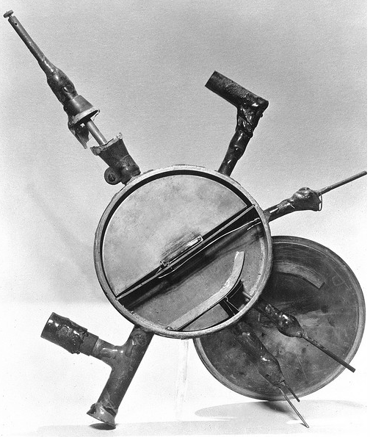
All The Fundamentals of an Accelerator
Large static magnetic fields for guiding (~1T)
  But no vertical focusing
HV RF electric fields for accelerating
  (No phase focusing)
  (Precise f control)
p/H source, injection, extraction, vacuum
13 cm: 80 keV
28 cm: 1 MeV
69 cm: ~5 MeV
… 223 cm: ~55 MeV
(Berkeley)
~13 cm

Slide 19
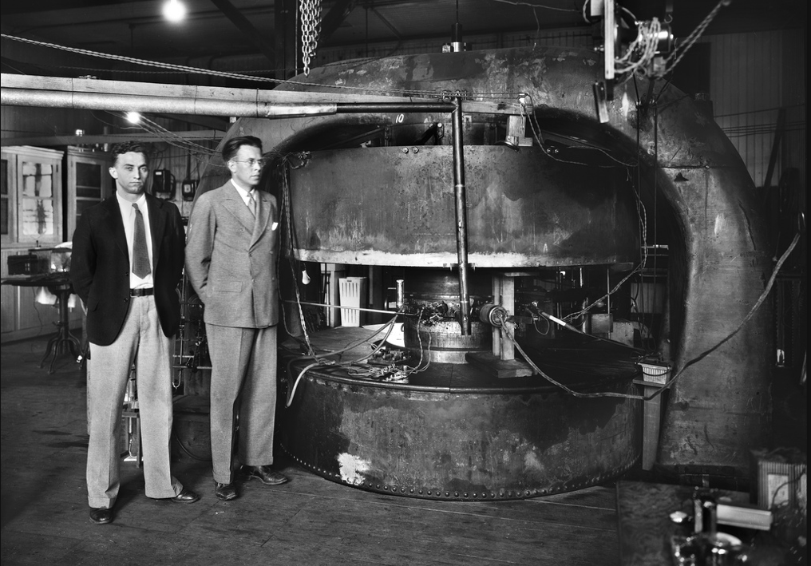
Livingston, Lawrence, 27”/69 cm Cyclotron
M.S. Livingston and E.O. Lawrence, 1934
Notes:
Yes, this is the same M. (Morton) Stanley Livingston that built the Cosmotron and AGS, “Courant/Snyder/Livingston”
Livingston was Lawrence’s student and his thesis work was to build cyclotrons!

Slide 20
The Joy of Physics
Describing the events of January 9, 1932, Livingston is quoted saying:
  “I recall the day when I had adjusted the oscillator to a new high frequency, and, with Lawrence looking over my shoulder, tuned the magnet through resonance. As the galvanometer spot swung across the scale, indicating that protons of 1-MeV energy were reaching the collector, Lawrence literally danced around the room with glee. The news quickly spread through the Berkeley laboratory, and we were busy all that day demonstrating million-volt protons to eager viewers.”
APS Physics History, Ernest Lawrence and M. Stanley Livingston

Slide 21
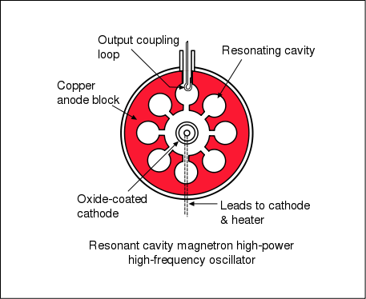
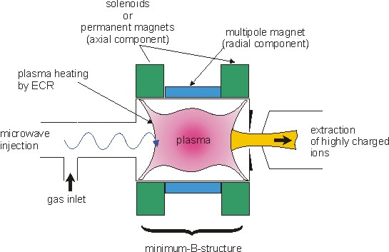
Electrons, Magnetrons, ECRs
Radar/microwave magnetron
Cyclotrons aren’t good for accelerating electrons
  Very quickly relativistic!
But narrow-band response has advantages and uses
  Magnetrons
    generate resonant high-power microwaves from circulating electron current
  ECRs
    generate high-intensity ion beams and plasmas by resonantly stripping electrons with microwaves
ECR plasma/ion source
Notes:
Microtrons are nonlinear amplifiers, vs klystrons which have better linear performance over uwave to RF
Microtrons were crucial to radar development, still common in microwave ovens
ECRs are important as ion sources, particularly for medical and industrial applications

Slide 22
Cyclotrons Today
Cyclotrons continue to evolve
  Many contemporary developments
    Superconducting cyclotrons
    Synchrocyclotrons (FM modulated RF)
    Isochronous/Alternating Vertical Focusing (AVF)
    FFAGs (Fixed Field Alternating Gradient)
  Versatile with many applications even below ~500 MeV
    High power (>1MW) neutron production
    Reliable (medical isotope production, ion radiotherapy)
    Power+reliability: ~5 MW p beam for ADSR (accelerator driven subcritical reactors, e.g. Thorium reactors)

Slide 23
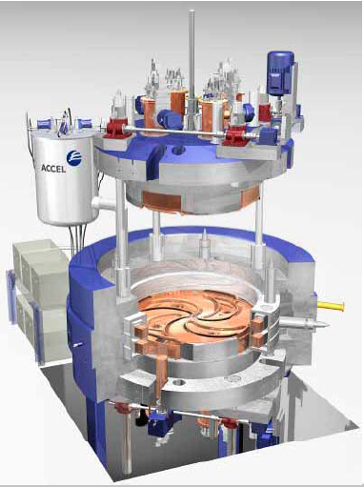
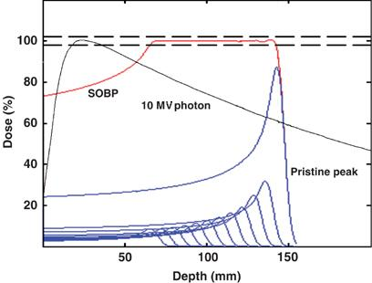
Accel Radiotherapy Cyclotron
Bragg peak
Distinct dose localization advantage for hadrons over X-rays
Also present work on proton and carbon radiotherapy fast-cycling synchrotrons

Slide 24
(Brief) Survey of Accelerator Concepts
Producing accelerating gaps and fields (DC/AC)
Microtrons and their descendants
Betatrons (and betatron motion)
Synchrotrons
  Fixed Target Experiments
  Colliders and Luminosity (Livingston Plots)
  Light Sources (FELs, Compton Sources)
Others include
  Medical Applications (radiotherapy, isotope production)
  Spallation Sources (SNS, ESS)
  Power Production (ADSR)

Slide 25
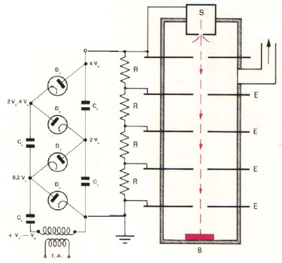
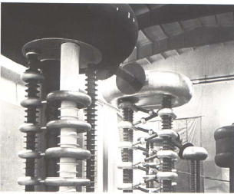
DC Accelerating Gaps: Cockcroft-Walton
Source
Accelerates ions through successive electrostatic voltages
  First to get protons to >MeV
  Continuous HV applied through intermediate electrodes
  Rectifier-multipliers (voltage dividers)
  Limited by HV sparking/breakdown
  FNAL still uses a 750 kV C-W
Also example of early ion source
  H gas ionized with HV current
  Provides high current DC beam
Rectifiers
Target
~1930 1.4 MeV
Cavendish Lab
Notes:
First artificial nuclear reaction (1932) Li⁷+p -> He⁴ + He⁴

Slide 26
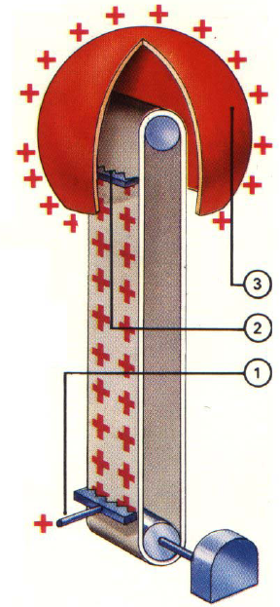
DC Accelerating Gaps: Van de Graaff
How to increase voltage?
  R.J. Van de Graaff: charge transport
  Electrode (1) sprays HV charge onto insulated belt
  Carried up to spherical Faraday cage
  Removed by second electrode and distributed over sphere
Limited by discharge breakdown
  ~2MV in air
  Up to 20+ MV in SF₆!
  Ancestors of Pelletrons (chains)/Laddertrons (stripes)
Notes:
SF₆ also happens to be the worst greenhouse gas known.
Also extremely dense. For amusement, http://www.youtube.com/watch?v=d-XbjFn3aqE

Slide 27
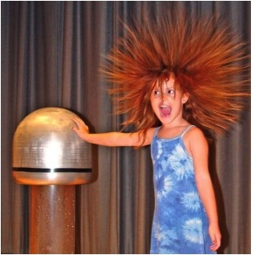

Van de Graaff Popularity

Slide 28
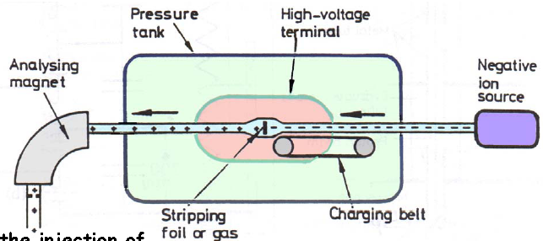
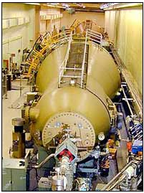
DC Accelerating Gaps: Tandem Van de Graaff
Reverse ion charge state in middle of Van de Graaff allows over twice the energy gain
  Source is at ground
This only works for negative ions
However, stripping need not be symmetric
  Second stage accelerates more efficiently
BNL: two Tandems (1970, 14 MV, 24m)
  Au⁻¹ to Au⁺¹⁰/Au⁺¹¹/Au⁺¹² to Au⁺³² for RHIC
  About a total of 0.85 MeV/nucleon total energy

Slide 29
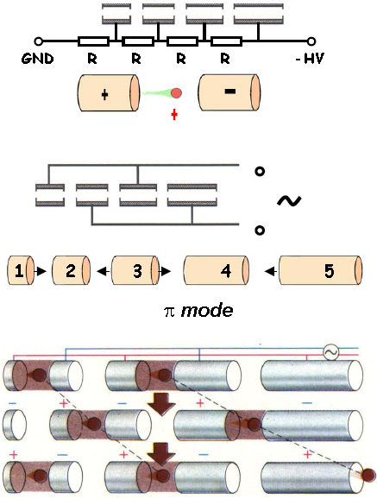
From Electrostatic to RF Acceleration
Cockcroft-Waltons and Van de Graaffs have DC voltages, E fields
What about putting on AC voltage?
  Attach consecutive electrodes to opposite polarities of ACV generator
  Electric fields between successive electrodes vary sinusoidally
  Consecutive electrodes are 180 degrees out of phase (π mode)
At the right drive frequency, particles are accelerated in each gap
  While polarity change occurs, particles are shielded in drift tubes
  To stay in phase with the RF, drift tube length or RF frequency must increase at higher energies
Wideroe linac
Pagani and Mueller 2002

Slide 30
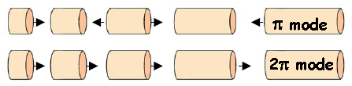


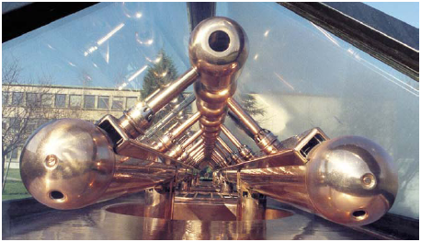
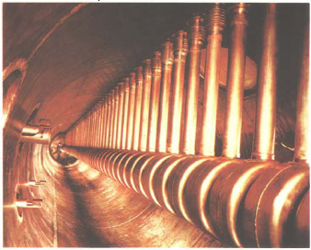
Resonant Linac Structures
Wideroe linac: π mode
Alvarez linac: 2π mode
Need to minimize excess RF power (heating)
  Make drift tubes/gaps resonant to RF frequency
  In 2π mode, currents in walls separating two subsequent cavities cancel; tubes are passive
  We’ll cover RF and longitudinal motion next week…
Wideroe linac
ALICE HI injector, IPN Orsay
Drift tube linac
Saturne, Saclay
30

Slide 31
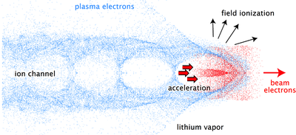
Advanced Acceleration Methods
How far do accelerating gradients go?
  Superconducting RF acceleration: ~40 MV/m
  CLIC: ~100 MV/m
    Two-beam accelerator: drive beam couples to main beam
  Dielectric wall acceleration: ~100 MV/m
    Induction accelerator, very high gradient insulators
  Dielectric wakefield acceleration: ~GV/m
  Laser plasma acceleration: ~40 GV/m
    electrons to 1 GeV in 3.3 cm
    particles ride in wake of plasma charge separation wave

Slide 32
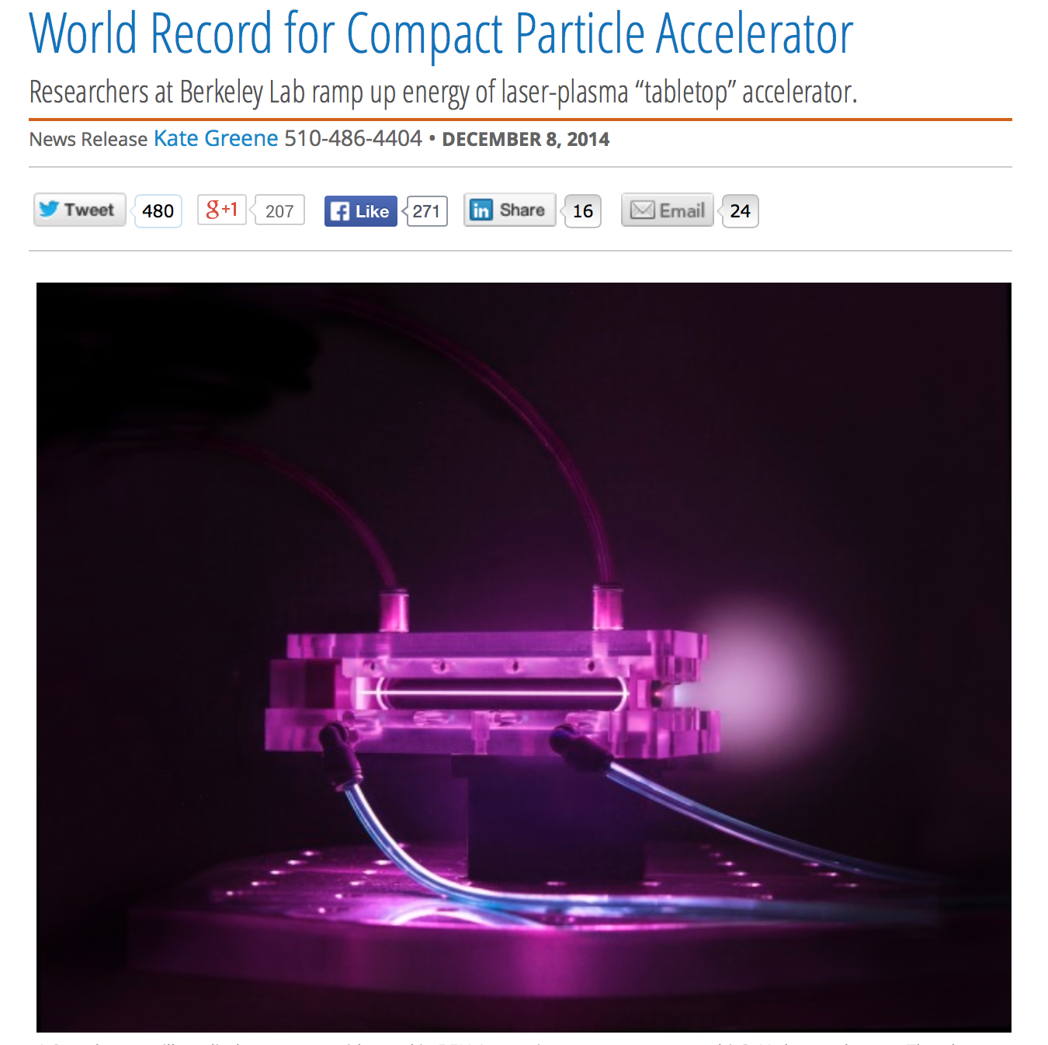
BELLA (LBL) Makes the News
4.2 GeV electrons
in 9 cm
40 fs (=12 μm), 0.3 PW peak power drive laser
Multi-GeV Electron Beams from Capillary-Discharge-Guided Subpetawatt Laser Pulses in the Self- Trapping Regime
W. P. Leemans, et al., PRL 113, 245002 2014 (December 8, 2014)

Slide 33
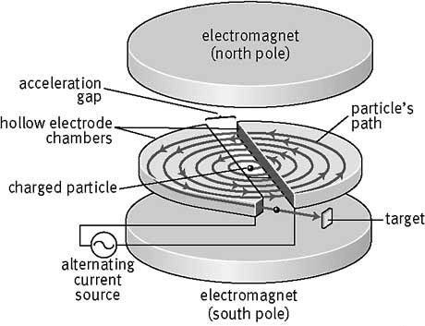
Cyclotrons (Again)

Slide 34
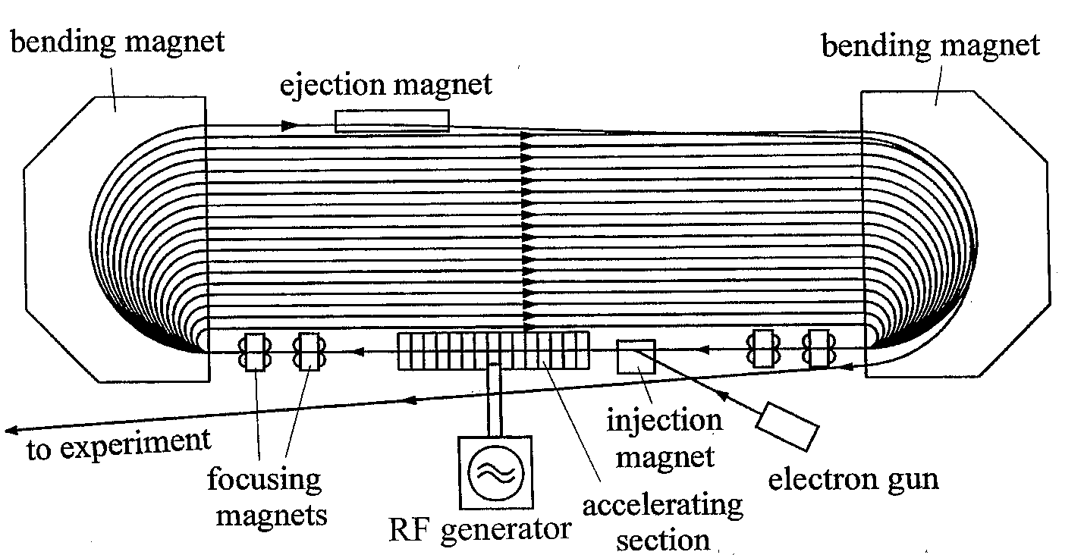
Microtrons
What about electrons? Microtrons are like cyclotrons
  but each revolution electrons “slip” by integer # of RF cycles
  Trades off large # of revs for minimal RF generation cost
  Bends must have very large momentum aperture
  Used for medical applications today (20 MeV, 1 big magnet)
  Mainz MAMI: 855 MeV, used for nuclear physics

Slide 35
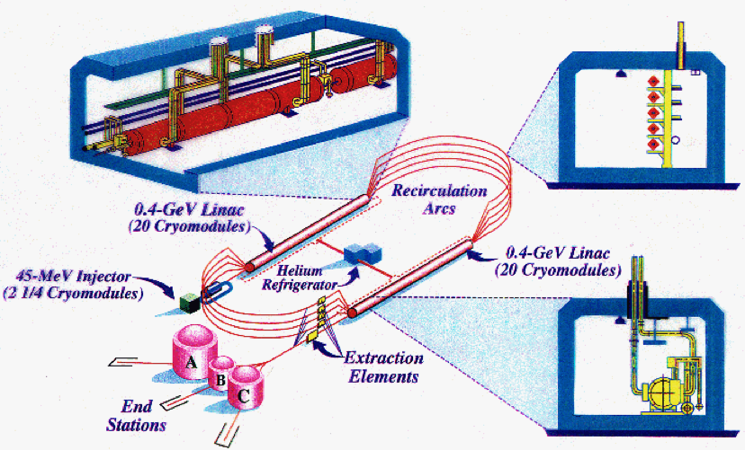
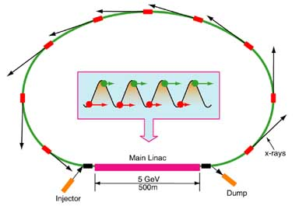
Recirculating Linacs and ERLs
CEBAF
Cornell ERL Light Source
Recirculating linacs have separate arcs, longer linacs
  CEBAF: 4->6->12 GeV polarized electrons, 2 SRF linacs
  Higher energy at cost of more linac, separated bends
Energy recovery linacs recirculate exactly out of phase
  Raise energy efficiency of linac, less beam power to dump
  Requires high-Q SRF to recapture energy efficiently

Slide 36
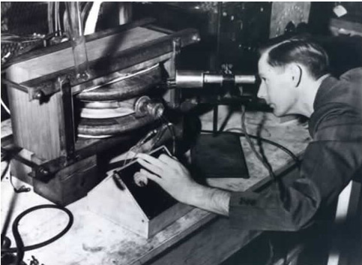
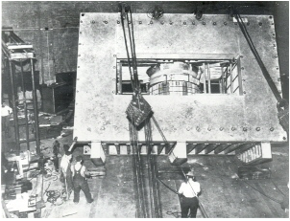
Weak Focusing: Betatrons
I(t)=I₀ cos(2πω_{I}t)
B_{g}
B_{ave}
B_{g}
Iron Magnet
Apply Faraday’s law with time-varying current in coils
Beam sees time-varying electric field – accelerate half the time!
Early proofs of stability: focusing and “betatron” motion
Donald Kerst
UIUC 2.5 MeV
Betatron, 1940
UIUC 312 MeV
betatron, 1949
Don’t try this at home!!
Really don’t try this at home!!

Slide 37
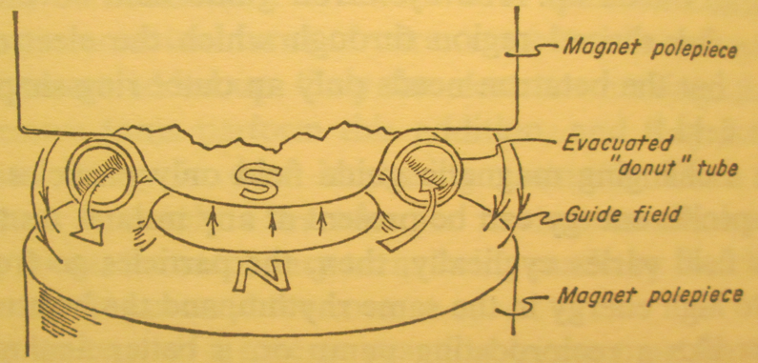
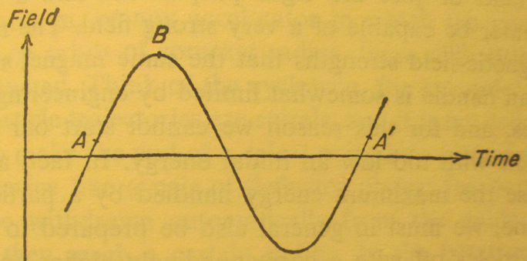
Weak Focusing: Betatrons
Wilson and Littauer: “Accelerators, Machines of Nuclear Physics”, 1960
extraction
acceleration
acceleration
injection

Slide 38
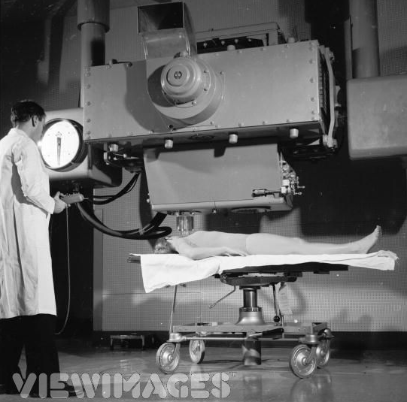
Weak Focusing: Betatrons
Betatrons produced electrons up to 300+ MeV
  Early materials and medical research
  Also produced medical hard X-rays and gamma rays
Betatrons have their challenges
  Linear aperture scaling
  Large stored energy/impedance
  Synchrotron radiation losses
  Quarter duty cycle
  Ramping magnetic field quality
  - More on betatrons/weak focusing next week
This will only hurt a bit…

Slide 39
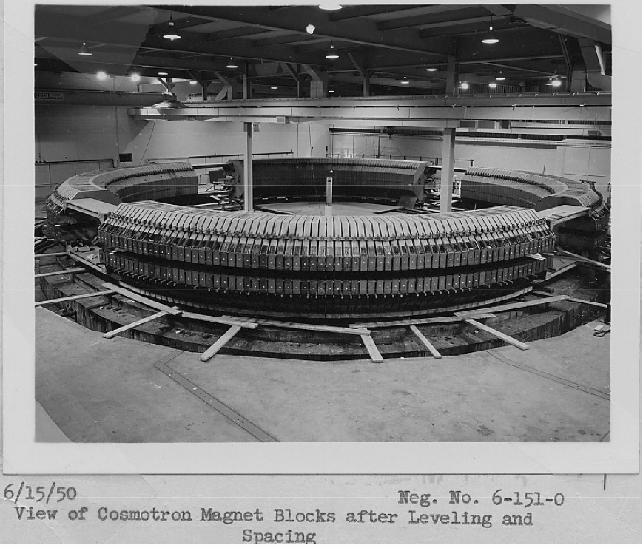
Weak Focusing: BNL Cosmotron
National Academy of Sciences, Biographical Memoir of M. Stanley Livingston by Ernest D. Courant
1953-1968, 3.3 GeV protons, weak focusing
first external fixed target experiments
Livingston again! (Including C-magnets)

Slide 40
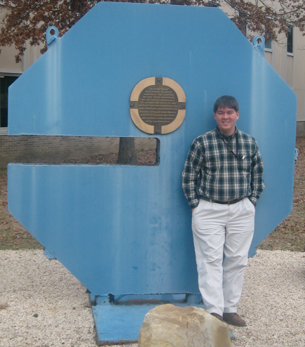
Would you buy a used Cosmotron lamination from this man?

Slide 41
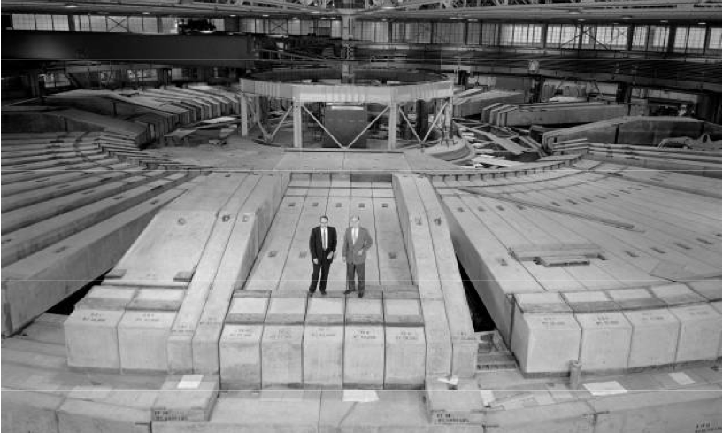
Weak Focusing: LBL Bevatron
Ed McMillan and Ed Lofgren
Last and largest weak-focusing proton synchrotron
1954, Beam aperture about 4’ square!, beam energy to 6.2 GeV
Discovered antiproton 1955; 1959 Nobel for Segre/Chamberlain
  (Became Bevelac, decommissioned 1993, demolished ~2010)

Slide 42
Fixed Target Experiments
Why did the Bevatron need 6.2 GeV protons?
  Antiprotons are “only” 930 MeV/c² (times 2…)
  Bevatron used Cu target, p+n->p+n+p+pbar
  Mandelstam variables give:
Fixed Target experiment
  Available CM energy scales with root of beam energy
    Main issue: forward momentum conservation steals energy

Slide 43
Two Serious Problems
These machines were getting way too big
  Bevatron magnet was 10,000 tons
  Apertures scale linearly with machine size, energy
  (Length/circumference scales linearly with energy at fixed field strength too…)
Fixed target energy scaling is painful
  Available CM energy only scales with √E_{beam}
Accelerator size grew with the square of desired CM energy
  Something had to be done!!!
Strong Focusing (1952) and Colliders (1958-62ish) to the rescue!!!

Slide 44
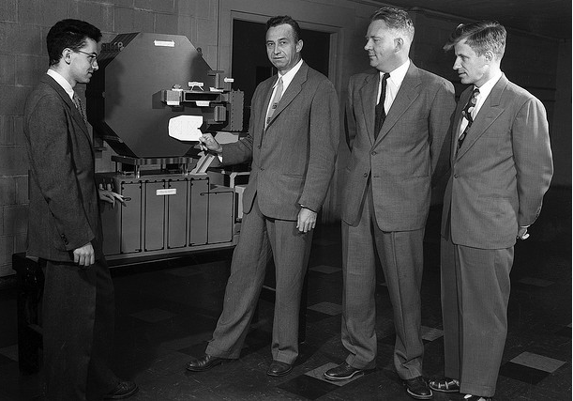
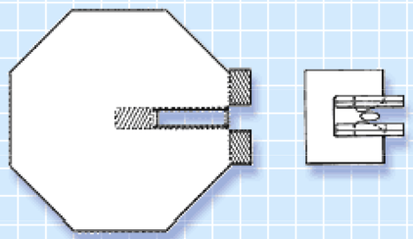
Livingston *Again*?
E. Courant, M.S. Livingston, H. Snyder, and J.P. Blewett
Strong focusing (and its mathematical treatment) is really the focus (ha) of first half of the semester

Slide 45
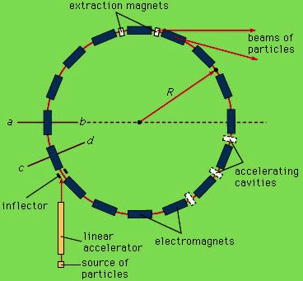
The Synchrotron
The best of both worlds (1944)
  Cyclotron accelerating system (RF gaps)
  (Not inductive betatron acceleration)
  Variable Betatron magnetic bending field
    (Not constant cyclotron bending field)
“Synch”-rotron
  Particle bend radius is close to constant
  B field changes with particle momentum p
  Circumference is also close to constant
    Revolution frequency and RF frequency also changes with particle velocity v and particle momentum p

Slide 46
Why is this such a big deal?
The big deal is that both existing technologies scaled very badly with particle energy
  Betatrons: central induction magnet area (flux) scales quadratically with accelerator radius (energy); beam size also scales badly
  Cyclotrons: main magnet scales quadratically with energy radius (energy); problems with relativistic hadrons
  (High gradient linacs weren’t quite developed yet)
Large, high-energy accelerator cost was completely dominated by scaling of large magnets
  The synchrotron permitted the decoupling of peak accelerator energy and magnetic field apertures
  Higher energies required more magnets (linear scaling) but not larger aperture magnets (quadratic scaling, or worse)

Slide 47
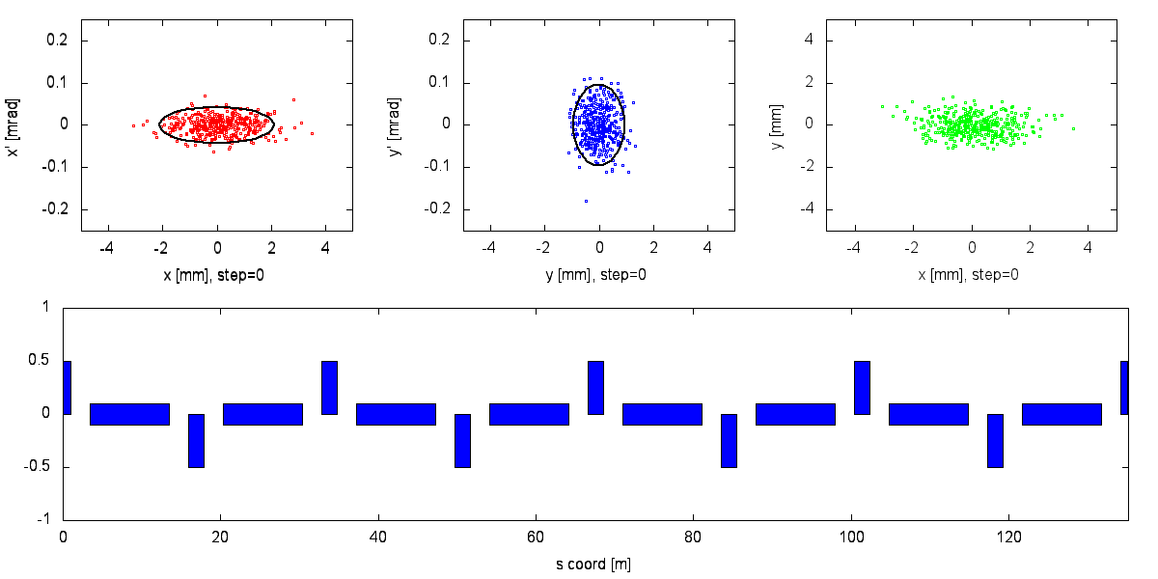
Particle Motion through Part of a Synchrotron
Horizontal motion
Vertical motion
H/V positions
focusing magnets
“defocusing” magnets
By the midterm you will be able to describe this motion
Fundamentally “modulated simple harmonic oscillators”
Linear form is very similar to classical linear optics

