Slide 1
Introduction to Accelerator Physics
Spring 2018
E&M and Relativity for Accelerator Physics
Todd Satogata (Jefferson Lab and ODU) / satogata@jlab.org
http://www.toddsatogata.net/2018-ODU-AP
Happy Birthday to Diana Gabaldon, Clarence Clemons, and Alexander Hamilton!
Happy National Arkansas Day and National Step in the Puddle and Splash Your Friends Day!

Slide 2
Special Relativity
Accelerators are – by far -- the best and most precise tests of special relativity in modern science.
  Low-mass, high energy particles
  Velocities approaching the speed of light (v/c ➔ 1)
It is worth reading Einstein’s original paper sometime
  On the Electrodynamics of Moving Bodies (1905)
  It is generally accessible to advanced undergraduates
  A good copy is at
    http://hermes.ffn.ub.es/luisnavarro/nuevo_maletin/Einstein_1905_relativity.pdf
  page 22: Kinetic energy = mc² (γ-1)

Slide 3
1.3: Relativity Review
Accelerators: applied special relativity and E&M
Relativistic (dimensionless) parameters:
  Later β and γ will also be used for other quantities, but the context should usually make them clear
  γ≈1 (classical mechanics) to ~2.04x10⁵ (to date) (where??)
Total energy U, momentum p, and kinetic energy W
Notes:
gamma=2.05e5 is LEP (104.5 GeV/511 keV),
NIST m_{p}c²=938.272046(21) MeV, m_{e}c²=0.510998928(11) MeV

Slide 4
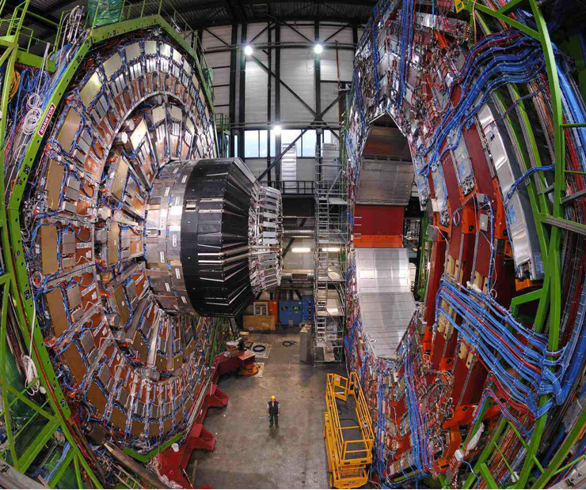
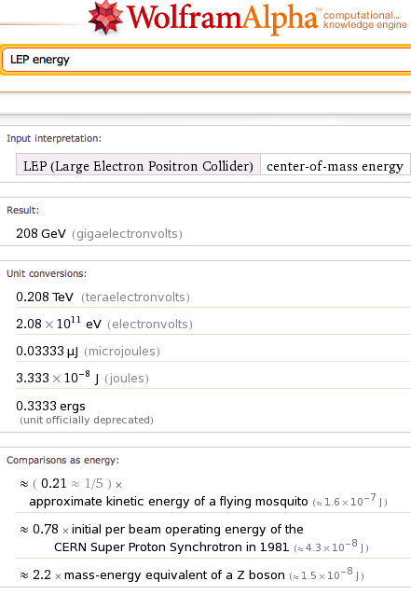


Relative Relativity

Slide 5

Convenient Units
How much is a TeV?
  Energy to raise 1g about 16 μm against gravity
  Energy to power 100W light bulb 1.6 ns
But many accelerators have 10¹⁰⁻¹² particles
  Single bunch “instantaneous power” of tens of
  Terawatts
Highest energy cosmic ray (1991)
  ~300 EeV (3x10²⁰ eV or 3x10⁸ TeV!)
(125 g hamster at 100 km/hr)
OMG particle
Notes:
Total human power use worldwide is o(20 TW)
NOVA laser at Livermore can get to o(PW) in o(ps) timescales
OMG particle was actually 3.2+/-0.9e20 eV https://www.fourmilab.ch/documents/OhMyGodParticle/
Zevatrons

Slide 6
1.3: Relativity Review (Again)
Accelerators: applied special relativity and E&M
Relativistic parameters:
  Later β and γ will also be used for other quantities, but the context should usually make them clear
  γ=1 (classical mechanics) to ~2.04x10⁵ (oh yeah, at LEP)
Total energy U, momentum p, and kinetic energy W
Notes:
gamma=2.05e5 is LEP (104.5 GeV/511 keV),
NIST mpc^2=938.272046(21) MeV, mec^2=0.510998928(11) MeV

Slide 7
Rest Masses
One of the great revelations of these equations is that when particles are at rest, (β=0, γ=1), we have
which is of course a Famous Formula.
This establishes energy scales at which subatomic particles in accelerators become relativistic

Slide 8
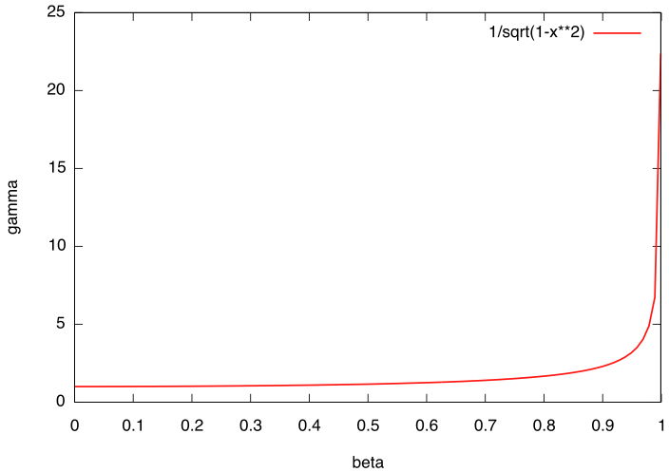
Convenient Relativity Relations
p 22 of
Einstein
paper
These hold for all velocities
In “ultra” relativistic limit, β is often approximated as 1
  Usually must be careful about β below γ≈5 or U≈5 mc²
    For electrons this is “only” U≈2.5 MeV
  Many accelerator physics phenomena scale with γ^{k} or (βγ)^{k}

Slide 9
Other Convenient Relativity Relations
These can be combined in various useful ways
For example:
You will evaluate a differential relationship between energy and momentum in homework problem 1
Useful for
hw prob 3
(derive it!)

Slide 10
Relativistic Electromagnetism
Classical electromagnetic potentials can be shown to combine to a relativistic four-potential (with c=1):
The field-strength tensor is related to the four-potential
  E/B fields Lorentz transform with factors of γ, (βγ)
  (This is a preview of graduate-level E&M/relativity)
Notes:
c=1

Slide 11
Relativistic Electromagnetism II
The relativistic electromagnetic force equation becomes
  Thankfully we can write this in somewhat simpler terms
  That is, “classical” E&M force equations hold if we treat the momentum as relativistic,
  If we dot in the velocity, we get relative energy transfer
  Unsurprisingly, we can only get energy changes from electric fields, not (conservative) magnetic fields

Slide 12
Constant Magnetic Field (Zero Electric Field)
In a constant magnetic field, charged particles move in circular arcs of radius ρ with constant angular velocity ω:
  For we then have
Note gamma!

Slide 13
Cyclotron Frequency (Relativistic)
Another very useful expression for particle angular frequency in a constant field: cyclotron frequency
In the nonrelativistic approximation
Revolution frequency is independent of radius or energy,
but really only when particles are non-relativistic!

Slide 14
============================

Slide 15
(Frames and Lorentz Transformations)
The lab frame will dominate most of our discussions
  But not always (synchrotron radiation, space charge…)
Invariance of space-time interval (Minkowski)
Lorentz transformation of four-vectors
  For example, time/space coordinates in z velocity boost
Notes:
successive boosts do not commute (Thomas precession and spin)

Slide 16
(Four-Velocity and Four-Momentum)
The proper time interval dτ=dt/γ is Lorentz invariant
So we can make a velocity 4-vector
We can also make a 4-momentum
Double-check that Minkowski norms are invariant
Notes:
dtau/dt = gamma, NOT gamma^2

Slide 17
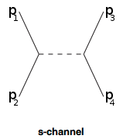
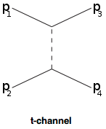
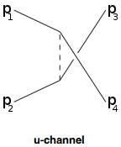
(Mandelstam Variables)
Lorentz-invariant two-body kinematic variables
  p₁₋₄ are four-momenta
√s is the total available center of mass energy
  Often quoted for colliders
Used in calculations of other two-body scattering processes
  Moller scattering (e-e), Compton scattering (e-γ)

Slide 18
(Relativistic Newton)
But now we can define a four-vector force in terms of four-momenta and proper time:
We are primarily concerned with electrodynamics so now we must make the classical electromagnetic Lorentz force obey Lorentz transformations

Slide 19
(Lorentz Lie Group Generators)
Lorentz transformations can be described by a Lie group where a general Lorentz transformation is
where L is 4x4, real, and traceless. With metric g, the matrix gL is also antisymmetric, so L has the general six-parameter form
Deep and profound connection to EM tensor F^{αβ}
J.D. Jackson, Classical Electrodynamics 2nd Ed, Section 11.7

