Slide 1
Introduction to Accelerator Physics
Spring 2018
Chapter 2: Coordinate Systems and Weak Focusing
Todd Satogata (Jefferson Lab and ODU) / satogata@jlab.org
http://www.toddsatogata.net/2018-ODU-AP
For January 16
Happy Birthday to Lin-Manuel Miranda, Susan Sontag, Jill Tarter, and Robert L Park!
Happy Appreciate A Dragon Day, National Fig Newton Day, and National Religious Freedom Day!

Slide 2
Chapter 2: Overview
Coordinate and reference systems
Equations of motion in an azimuthally symmetric field
  e.g. betatron a particular point in time
  Elucidation of approximations
  Transverse separability (when fields are uncoupled)
Example: the betatron
Solutions of equations of motion
  2nd order linear ODEs as matrix equations
Momentum offsets and dispersion
Example: the weak focusing synchrotron
Momentum compaction
  Connections to orbital mechanics

Slide 3
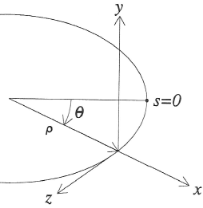
2.1: Parameterizing Particle Motion: Coordinates
Now we derive more general equations of motion
We need a local coordinate system
relative to the design particle trajectory
  s is the direction of design particle motion
  y is the main magnetic field direction
  x is the radial direction
  is not a coordinate, but the design
  bending radius in magnetic field
Can express total radius R as
Also define local trajectory angle

Slide 4
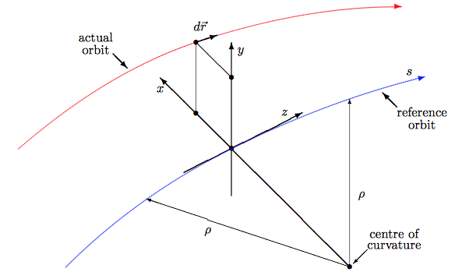
Example: MAD/madx Coordinate System
http://madx.web.cern.ch/madx/madX/doc/latexuguide/madxuguide.pdf p.10
Right-handed

Slide 5
Example: MAD/madx Coordinate System
http://madx.web.cern.ch/madx/madX/doc/latexuguide/madxuguide.pdf p.10
Right-handed

Slide 6
2.2: Parameterizing Particle Motion: Approximations
We will make a few reasonable approximations:
  0) No local currents (beam travels in a near-vacuum)
  1) Paraxial approximation:
  2) Perturbative coordinates:
  3) Transverse uncoupled linear magnetic field:
    Note this obeys Maxwell’s equations in free space
  4) Negligible E field:
    Equivalent to assuming adiabatically changing B fields relative to
(A0)
(A1)
(A2)
(A3)
(A0)
(A4)

Slide 7
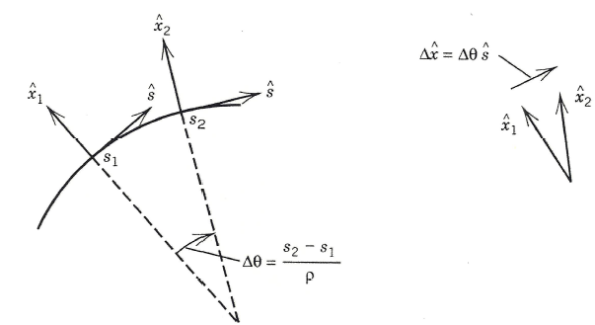
Parameterizing Particle Motion: Acceleration
Coordinate system is time-dependent, so unit vectors have non-zero time derivatives!
Lorentz force equation of motion is
Calculate velocity and acceleration
in our coordinate system
so
(A4)

Slide 8
Parameterizing Particle Motion: Eqn of Motion
Component equations of motion
  Vertical:
  Horizontal:
Notes:
Note: Fix y equation R->\rho

Slide 9
Equations of Motion
Apply our paraxial and linearization approximations
Horizontal:
Vertical:
(A2)
(A3)
(A3)
(A2)

Slide 10
Things to try sometime
Expand the horizontal equation of motion to second order in x
  Does it reduce to the stated equation at first order?
  Use expansions for R, B that are still first order!
Expand the horizontal and vertical equations of motion to second order in x, y, δ
  Use expansions for R, B that are still first order!

Slide 11
Simple Equations of Motion!
These are simple harmonic oscillator equations
  (Not surprising since we linearized 2nd order differential equations; this is a very general physics approach)
These are known as the weak focusing equations
  If n does not depend on θ, stability is only possible in both planes if 0<n<1
  This is known as the weak focusing criterion
  There is less than one oscillation per 2π advance in θ

Slide 12
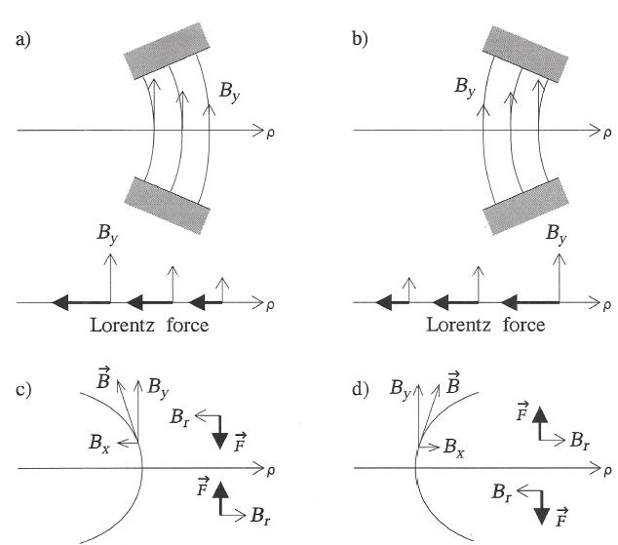
Visualization: Weak Focusing Forces
electron velocity INTO page
Radially opening magnet: n>0
Radially closing magnet: n<0
accelerator
center
accelerator
center
Radially defocusing
Radially focusing
Vertically focusing
Vertically defocusing

Slide 13
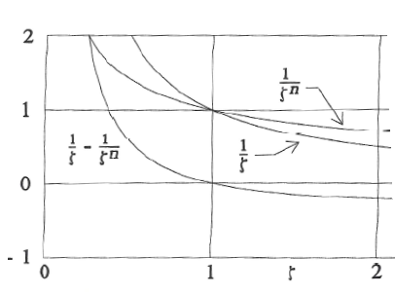
But Wasn’t 0<n<1 Stable?
This seems to indicate n>0 is horizontally unstable!
Horizontal motion is a combination of two forces
  “Centrifugal” and centripetal Lorentz
  Both forces cancel by definition for the design trajectory
Nonlinear too! But we
linearize near ζ=1

Slide 14
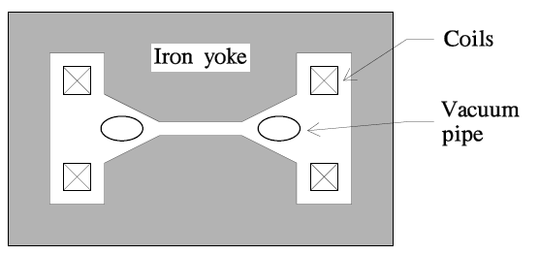
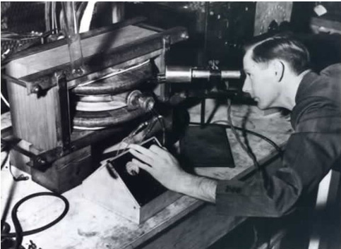
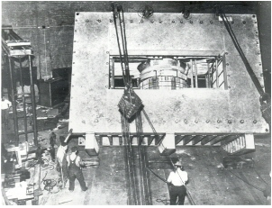
Interlude: The Betatron Again
I(t)=I₀ cos(2πω_{I}t)
Weak focusing formalism was originally developed for the Betatron
Apply Faraday’s law with time-varying current in coils
Beam sees time-varying accelerating electric field too!
Early proofs of stability: focusing and “betatron” motion
Donald Kerst
UIUC 2.5 MeV
Betatron, 1940
UIUC 312 MeV
betatron, 1949
Don’t try this at home!!
Really don’t try this at home!!

Slide 15
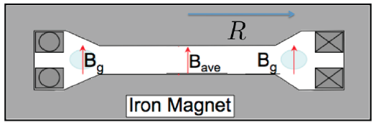
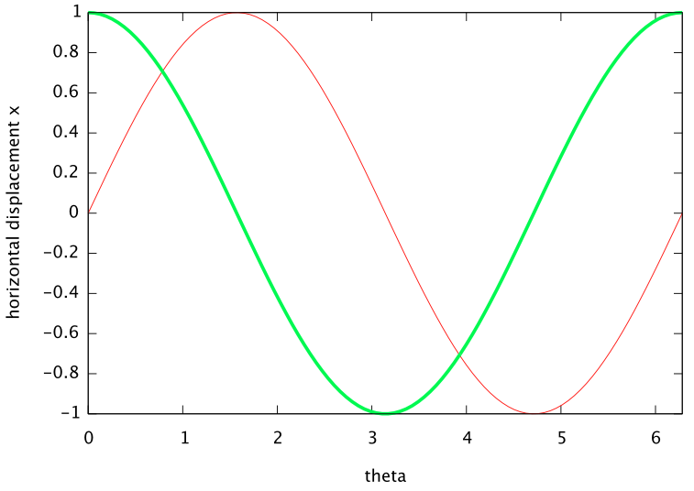
The Betatron
apply sinusoidally varying
current to toroidal conductors
cylindrically symmetric
about center vertical axis
I(t), B(t)
E(t), F(t)
Usable
Part of
Cycle

Slide 16
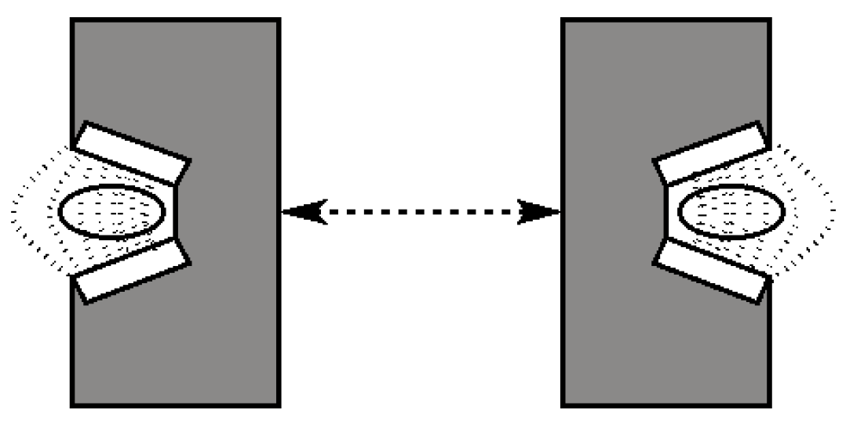
Example: Synchrotron Weak Focusing
Separate RF cavities can eliminate the need for central iron (and corresponding huge inductance)
  Accelerator can be (much) larger (higher energies for same B₀!)
  But stability equation scaling with ρ is still not good:

Slide 17
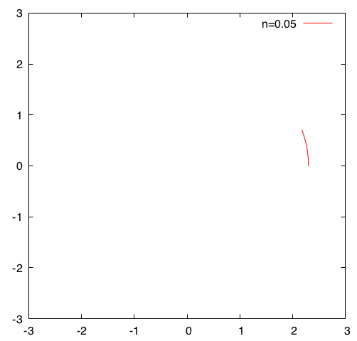
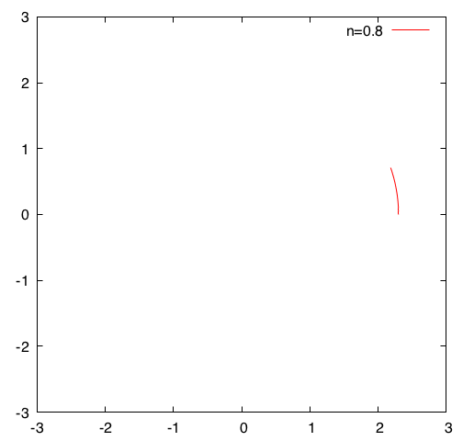


Weak Focusing Orbits
Two animations of weak focusing show just how weak it is. Oscillation amplitude scales with radius.

Slide 18
2.3: Back to Solutions of Equations of Motion
Assume azimuthal symmetry (n does not depend on θ)
Solutions are simple harmonic oscillator solutions
Constants A,B are related to initial conditions

Slide 19
Solutions of Equations of Motion
Write down solutions in terms of initial conditions
This can be (very) conveniently written as matrices (including both horizontal and vertical)

Slide 20
Transport Matrices
M_{V} here is an example of a transport matrix
  Linear: derived from linear equations
    Can be concatenated to make further transformations
  Depends only on “length” θ, radius ρ, and “field” n
    Acts to transform or transport coordinates to a new state
    Our accelerator “lattices” will be built out of these matrices
  Unimodular: det(M_{V})=1
    More strongly, it’s symplectic:
    Hamiltonian dynamics, phase space conservation (Liouville)
    These matrices here are scaled rotations!
Note order

Slide 22
Sinusoidal Solutions, Betatron Phases
Sinusoidal simple harmonic oscillators solutions
  Particles move in transverse betatron oscillations around the design trajectory
We define betatron phases
  Write matrix equation in terms of s rather than θ

Slide 23
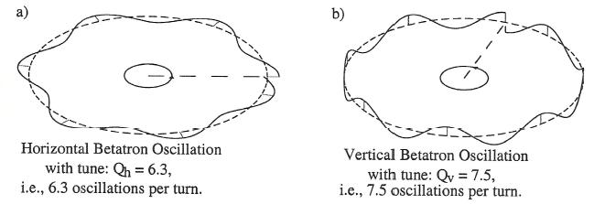
Visualization of Betatron Oscillations
Simplest case: constant uniform vertical field (n=0)
More complicated strong focusing
sine-like
design
design
design
cosine-like
sine-like
cosine-like

Slide 24
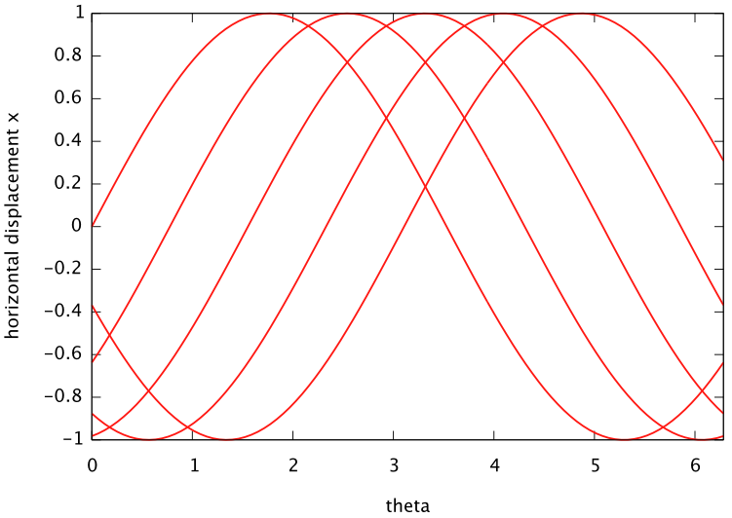
Visualization of Betatron Oscillations, Tunes
What happens for 0<n<1?
  Example picture below has 5 “turns” with sin(0.89 θ)
  The betatron oscillation precesses, not strictly periodic
  Betatron tune Q_{X,Y}: number of cycles made for every revolution or turn around accelerator
turn 1
2
3
4
Frequency of betatron oscillations
relative to turns around accelerator
For weak focusing:
design
5

Slide 25
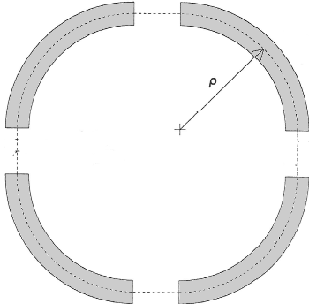

Transport Matrices: Piecewise Solutions
Linear transport matrices make piecewise solutions of equations of motion accessible
“Cell” transport matrix:
“One turn” transport matrix:
Build accelerator optics out of
“Lego” transport matrices
(everything is awesome!)

Slide 26
Transport Matrices: Accelerator Legos
(A3)
With linear fields, there are two basic types of Legos
  Dipoles
    Often long magnets to bend design trajectory
    Entrance/exit locations can become important
    May or may not include focusing (“combined function”)
    Special case: drift when all B components are zero
  Quadrupoles
    Design trajectory is straight! (no fields at x=y=0)
    Act to focus particles moving off of design trajectory
    Special case: “thin lens” approximation
    We’ll talk about quadrupoles tomorrow

Slide 27
Transport Matrices: Dipole
We have already derived a very general transport matrix for a dipole magnet with focusing
Taking n->0 (and being careful) gives the transport matrix for a dipole of bend angle θ without focusing

Slide 28
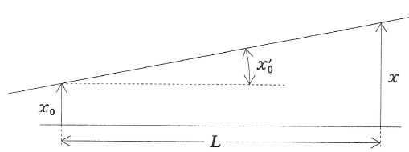
Transport Matrices: Drifts
For n=0, there is no horizontal field or vertical force
  The vertical transport matrix here is for a field-free drift
  This applies in both x,y planes when there is no field

Slide 29
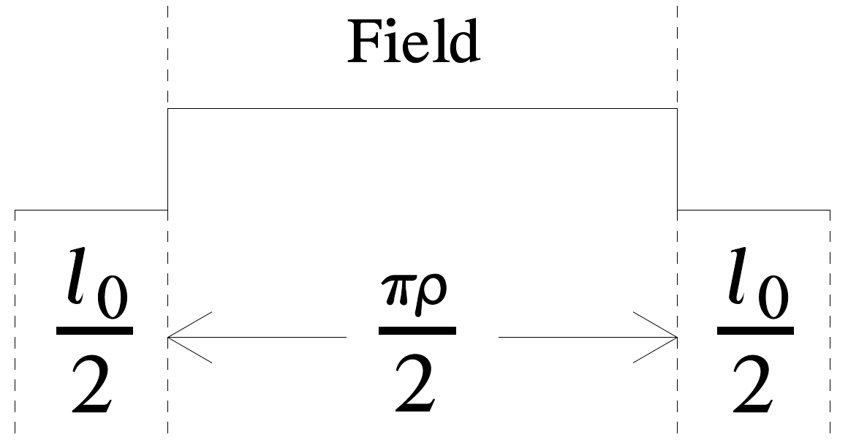
2.5: Weak Focusing Synchrotron
Back to our Lego machine
Pick a more symmetric cell
For “one can show”
Circumference

Slide 30
Weak Focusing Synchrotron Parameterization
We can write the cell transport matrix in a form that is very similar to a rotation matrix
  We will investigate this parameterization (and its non-periodic lattice extensions) extensively later this week
  is a length scale for the betatron oscillations
  Details in Section 2.5 derive:
  Note the familiar scaling with the radius of curvature !

Slide 31
2.4: What About Momentum?
So far we have assumed that the design trajectory particle and our particle have the same momentum
How do equations change if we break this assumption?
  Expect only horizontal motion changes to first order
(A2)
(A1)
(A2)
Add inhomogeneous term to
original δ=0 equation of motion

Slide 32
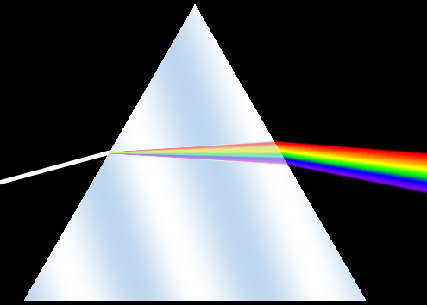
Solutions of Dispersive Equations of Motion
This momentum effect is called dispersion
  Similar to prism light dispersion in classical optics
Solutions are simple harmonic oscillator solutions
  But now we add a specific inhomogeneous solution
Constants A,B again related to initial conditions
  δ is constant
inhomogeneous term!
(A4)

Slide 33
Solutions of Dispersive Equations of Motion
Write down solutions in terms of initial conditions
This can be now be “conveniently” written in terms of a 3x3 matrix:
  As usual, this can be simplified for n=0 (pure dipole)
  Note that δ has become a “coordinate”!

Slide 34
Sector Dipole Magnets
This transport matrix applies for any angle
So it is also the transport matrix of any section of constant field, and now includes dispersion.
  In particular, it is the horizontal transport for a combined function sector dipole of length
  With n=0 this is the horizontal transport for a sector dipole of length , bend angle , and radius of curvature
  Sector dipole: design trajectory at entrance and exit of magnet is perpendicular to magnet face

Slide 35
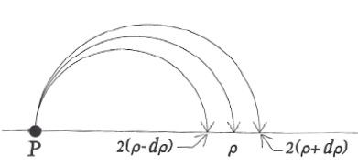
Example: 180 Degree Dipole Magnet
electrons moving through uniform vertical B field












This makes sense from p/q=Bρ!

Slide 36
2.6: Momentum Compaction
Different momenta particles will have different path lengths around the accelerator
  Naively
  This is not necessarily true (as we’ll see!)
This is quantified by a quantity called momentum compaction
  Ratio of fractional change in pathlength to fractional change in momentum
recall

Slide 37
Transition Energy
Relativistic particle motion in a periodic accelerator (like a synchrotron) creates some weird effects
  For particles moving around with frequency in circumference
  At “transition”, and particle revolution frequency does not depend on its momentum
    Reminiscent of a cyclotron but now we’re strong focusing and at constant radius!
  At higher momentum gives lower revolution frequency
  At higher momentum gives higher revolution frequency
  Hadron synchrotrons can accelerate through transition!
momentum compaction
transition gamma
electron ring
electron linac

Slide 38
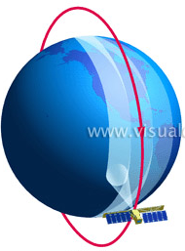
Momentum Compaction: A Classic Example
Consider a satellite in circular orbit
A classical gravity/centripetal force problem
momentum compaction
Raising momentum p lowers orbit radius, raises angular frequency

Slide 39
Momentum Compaction: Weak Focusing Synchrotron
Recall
Now
Circumference

