Slide 1
Introduction to Accelerator Physics
Spring 2018
Start of Chapter 6: Lattice Exercises I
Todd Satogata (Jefferson Lab and ODU) / satogata@jlab.org
http://www.toddsatogata.net/2018-ODU-AP
~~~~~ February 15 ~~~~~
Happy Birthday to Galileo, Charles Guillaume (1920 Nobel!), and Owen Richardson (1928 Nobel!)
Happy National Gumdrop Day, National Hippo Day, and Annoy Squidward Day!

Slide 2
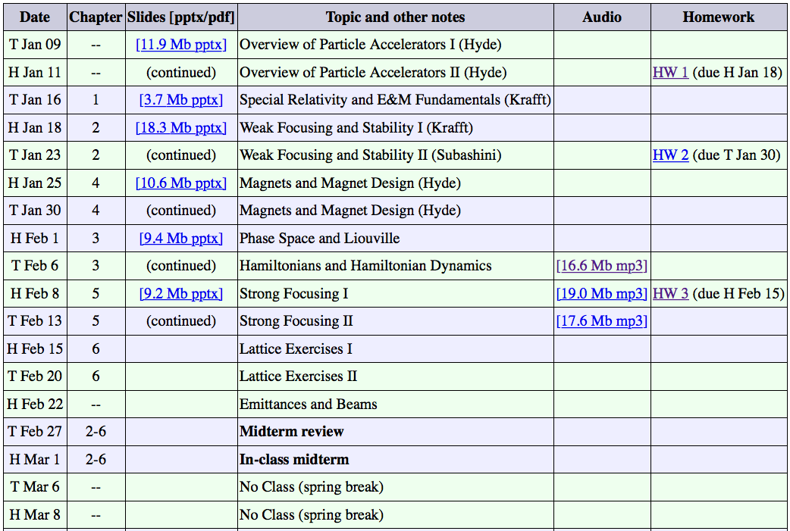
You (We) Are Here

Slide 3
Objectives for Thu Feb 15
Quick review of Courant-Snyder parameters and FODO
Non-periodic transport matrices
Invariants and ellipses, first look at “emittance”
Rings and tunes
Stability diagrams
Dispersion and dispersion suppressors
Other insertions (pi and pi/2)

Slide 4
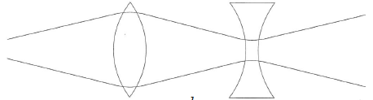
Matrix Example: Strong Focusing
Consider a doublet of thin quadrupoles separated by drift L
  There is net focusing given by this alternating gradient system
  A fundamental point of optics, and of accelerator strong focusing
Thin quadrupole
matrices

Slide 5
Strong Focusing: Another View
  For this to be focusing, x’ must have opposite sign of x where these are coordinates of transformation of incoming paraxial ray
  Equal strength doublet is net focusing under condition that each lens’ focal length is greater than distance between them

Slide 6
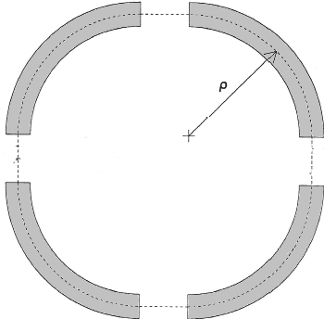
More Math: Hill’s Equation
Let’s go back to our quadrupole equations of motion for
  What happens when we let the focusing K vary with s?
  Also assume K is periodic in s with some periodicity C
  This periodicity can be one revolution around the
  accelerator or as small as one repeated “cell”
  of the layout
  (Such as a FODO cell in the previous slide)
  The simple harmonic oscillator equation with a
  periodically varying spring constant K(s) is
  known as Hill’s Equation

Slide 7
Hill’s Equation Solution Ansatz
Solution is a quasi-periodic harmonic oscillator
  where w(s) is periodic in C but the phase Ψ(s) is not!!
  Substitute this educated guess (“ansatz”) to find
  For and to be independent of , coefficients of the sin and cos terms must vanish identically

Slide 8
Courant-Snyder Parameters
Notice that in both equations so we can scale this out and define a new set of functions, Courant-Snyder Parameters or Twiss Parameters

Slide 9
Towards The Matrix Solution
What is the matrix for this Hill’s Equation solution?
Take a derivative with respect to s to get
Now we can solve for A and B in terms of initial conditions
And take advantage of the periodicity of to find

Slide 10
Hill’s Equation Matrix Solution
We can write this down in a matrix form where
is the betatron phase advance through one period C

Slide 11
Interesting Observations
is independent of s: this is the betatron phase advance of this periodic system
Determinant of matrix M is still 1!
Looks like a rotation and some scaling
M can be written down in a beautiful and deep way
  remember

Slide 12
Convenient Calculations
If we know the transport matrix M, we can find the lattice parameters (periodic in C)

Slide 13
General Non-Periodic Transport Matrix
We can parameterize a general non-periodic transport matrix from s₁ to s₂ using lattice parameters and
This does not have a pretty form like the periodic matrix
  However both can be expressed as
  where the C and S terms are cosine-like and sine-like; the second row is the s-derivative of the first row!
  A common use of this matrix is the m₁₂ term:
Effect of angle kick
on downstream position

Slide 14
(Deriving the Non-Periodic Transport Matrix)
  Calculate A, B in terms of initial conditions and
  Substitute (A,B) and put into matrix form:

Slide 15
Review

Slide 16
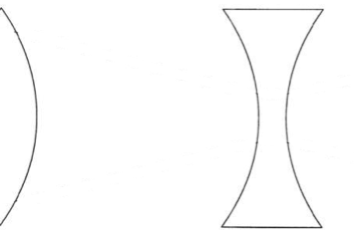



Lattice Optics: FODO Lives!
cell
Most accelerator lattices are designed in modular ways
  Design and operational clarity, separation of functions
One of the most common modules is a FODO module
  Alternating focusing and defocusing “strong” quadrupoles
  Spaces between are combinations of drifts and dipoles
  Strong quadrupoles dominate the focusing
  Periodicity is one FODO “cell” so we’ll investigate that motion
  Horizontal beam size largest at centers of focusing quads
  Vertical beam size largest at centers of defocusing quads

Slide 17
Periodic Example: FODO Cell Phase Advance
cell
Select periodicity between centers of focusing quads
  A natural periodicity if we want to calculate maximum β(s)
  only has real solutions (stability) if

Slide 18
Periodic Example: FODO Cell Beta Max/Min
cell
What is the maximum beta function, ?
  A natural periodicity if we want to calculate maximum β(s)
  Follow a similar strategy reversing F/D quadrupoles to find the minimum β(s) within a FODO cell (center of D quad)

Slide 19
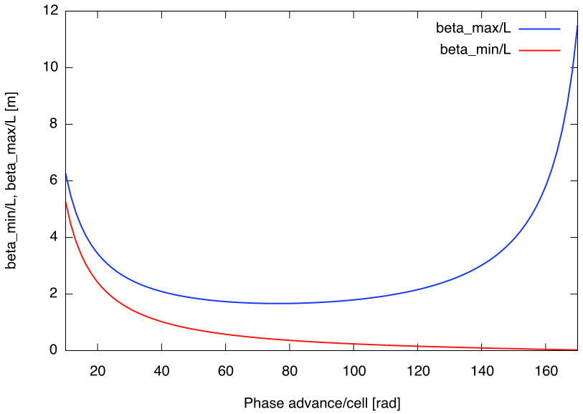
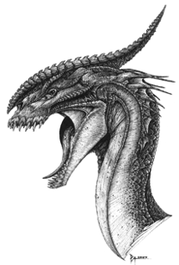
FODO Betatron Functions vs Phase Advance
Here there be dragons
Generally want /L small
Strong focusing
Smaller magnets
Less expensive accelerator
[deg]

Slide 20
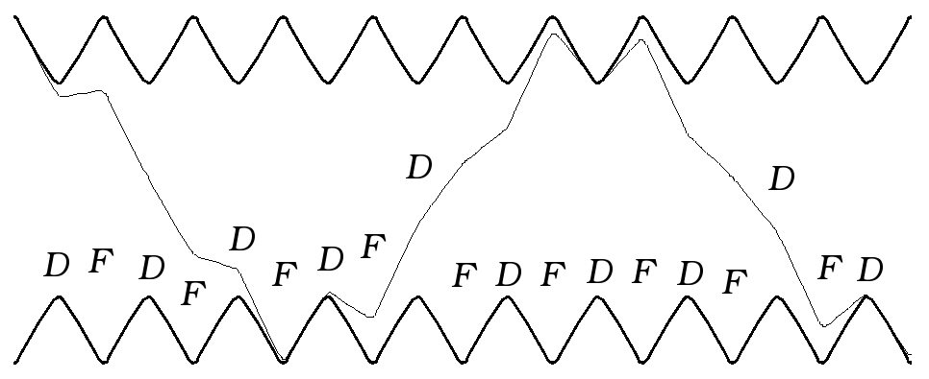
FODO Beta Function, Betatron Motion
Betatron motion
trajectory
design trajectory
This is a picture of a FODO lattice, showing contours of since the particle motion goes like
  This also shows a particle oscillating through the lattice
  Note that provides an “envelope” for particle oscillations
    is sometimes called the envelope function for the lattice
  Min beta is at defocusing quads, max beta is at focusing quads
  6.5 periodic FODO cells per betatron oscillation

Slide 21
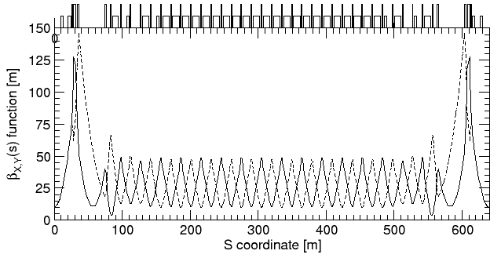
Example: RHIC FODO Lattice
quadrupoles
dipoles
low-beta insertion
low-beta insertion
Horizontal
Vertical
matching
FODO
1/6 of one of two RHIC synchrotron rings, injection lattice
  FODO cell length is about L=30 m
  Phase advance per FODO cell is about
☺

Slide 22
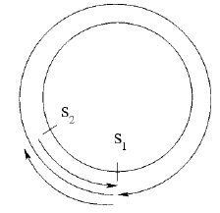
Propagating Lattice Parameters
If I have and I have the transport matrix that transports particles from , how do I find the new lattice parameters ?
  The J(s) matrices at s₁, s₂ are related by
  Then expand, using det M=1
  Quadratic: Lattice elements repeat themselves for

Slide 23
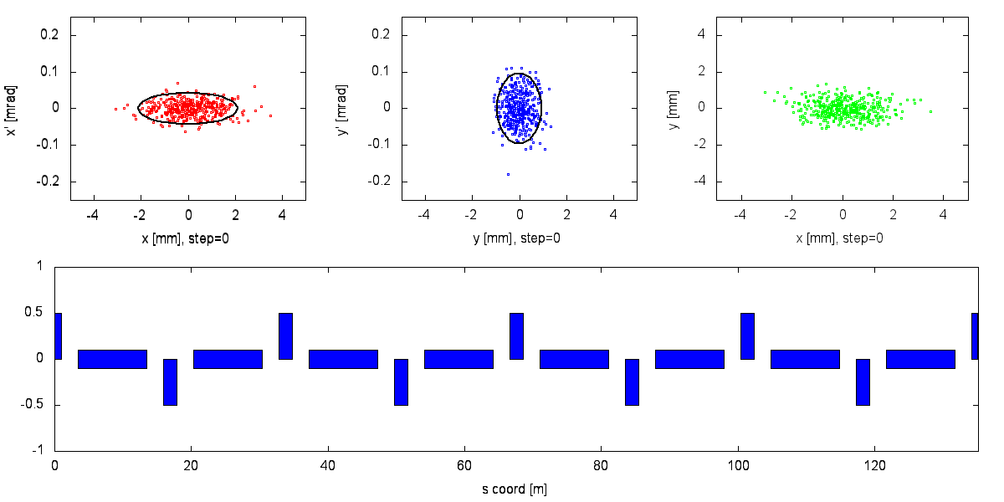
========== What’s the Ellipse? ==========
Area of an ellipse that envelops a given percentage of the beam particles in phase space is related to the emittance
  We can express this in terms of our lattice functions!

Slide 24
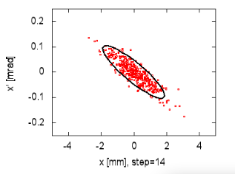
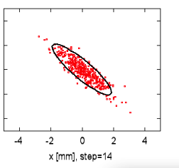
Invariants and Ellipses
We assumed A was constant, an invariant of the motion
  A can be expressed in terms of initial coordinates to find
  This is known as the Courant-Snyder invariant: for all s,
  Similar to total energy of a simple harmonic oscillator
  looks like an elliptical area in phase space
  Our matrices look like scaled rotations (ellipses) in phase space
s=s₀
s=s₀+C
s=s₀+2C
s=s₀+3C

Slide 25
Emittance
The area of the ellipse inscribed by any given particle in phase space as it travels through our accelerator is called the emittance : it is “constant” and given by
  Emittance is often quoted as the area of the ellipse that would contain a certain fraction of all (Gaussian) beam particles
  e.g. RMS emittance contains 39% of 2D beam particles
  Related to RMS beam size
  RMS beam size depends on s!
  RMS emittance convention is fairly standard
  for electron rings, with units of mm-mrad

Slide 26
Adiabatic Damping and Normalized Emittance
But we introduce electric fields when we accelerate
  When we accelerate, invariant emittance is not invariant!
  We are defining areas in phase space
  The definition of x doesn’t change as we accelerate
  But does since changes!
  scales with relativistic beta, gamma:
  This has the effect of compressing x’ phase space by
  Normalized emittance is the invariant in this case
    unnormalized emittance goes down as we accelerate
    This is called adiabatic damping, important in, e.g., linacs

Slide 27
Phase Space Ellipse Geography
y2
y1
x1
x2
Now we can figure out some things from a phase space ellipse at a given s coordinate:

Slide 28
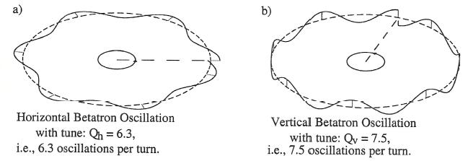
Rings and Tunes
A synchrotron is by definition a periodic focusing system
  It is very likely made up of many smaller periodic regions too
  We can write down a periodic one-turn matrix as before
  We define tune as the total betatron phase advance in one revolution around a ring divided by the total angle

Slide 29
Tunes
There are horizontal and vertical tunes
  turn by turn oscillation frequency
Tunes are a direct indication of the amount of focusing in an accelerator
  Higher tune implies tighter focusing, lower
Tunes are a critical parameter for accelerator performance
  Linear stability depends greatly on phase advance
  Resonant instabilities can occur when
  Often adjusted by changing groups of quadrupoles

Slide 30
6.2: Stability Diagrams
Designers often want or need to change the focusing of the two transverse planes in a FODO structure
  What happens if the focusing/defocusing strengths differ?
  Recalculate the M matrix and use dimensionless quantities
  then take the trace for stability conditions to find
cell

Slide 31
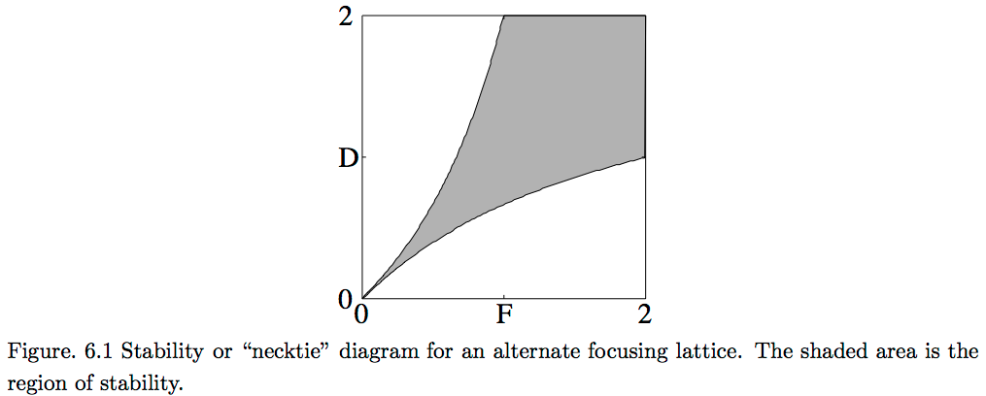
Stability Diagrams II
  For stability, we must have
  Using , stability limits are where
  These translate to an a “necktie” stability diagram for FODO

Slide 32
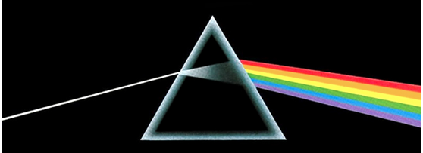
6.3: Dispersion
There is one more important lattice parameter to discuss
Dispersion is defined as the change in particle position with fractional momentum offset
  Dispersion originates from momentum dependence of dipole bends
  Equivalent to separation of optical wavelengths in prism
White light with many frequencies
(momenta) enters, all with same initial trajectories (x,x’)
Different positions
due to different bend angles of different wavelengths (frequencies, momenta) of incoming light

Slide 33
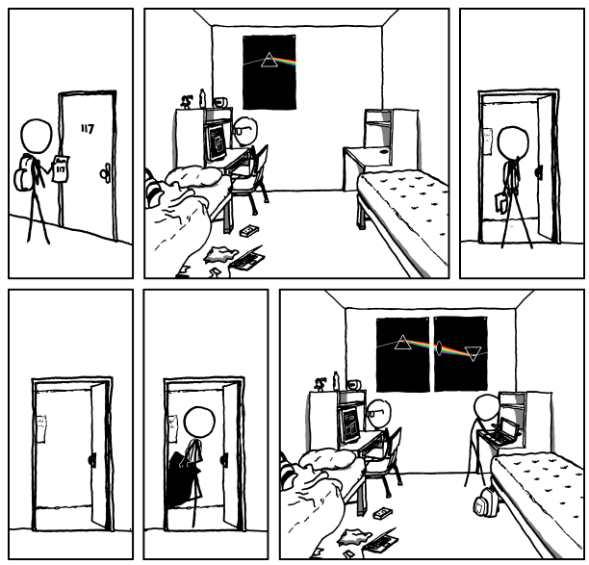
(xkcd interlude)
http://www.xkcd.org/964/
This is known in accelerator lattice design language as a “double bend achromat”

Slide 34
Dispersion
Add explicit momentum dependence to equation of motion again
  Assume our ansatz solution and use initial conditions to find
  The trajectory has two parts:
Particular solution of inhomogeneous differential equation with periodic ρ(s)

Slide 35
Dispersion Continued
Substituting and noting dispersion is periodic,
  If we take we can solve this in a clever way
  Solving gives

Slide 36
FODO Cell Dispersion
cell
A periodic lattice without dipoles has no intrinsic dispersion
Consider FODO with long dipoles and thin quadrupoles
  Each dipole has total length so each cell is of length
  Assume a large accelerator with many FODO cells so

Slide 37
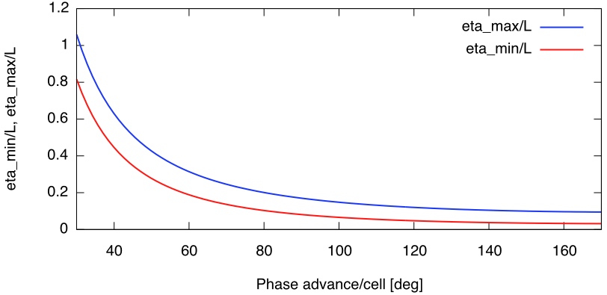
FODO Cell Dispersion
Like before, this choice of periodicity gives us
Changing periodicity to defocusing quad centers gives

Slide 38
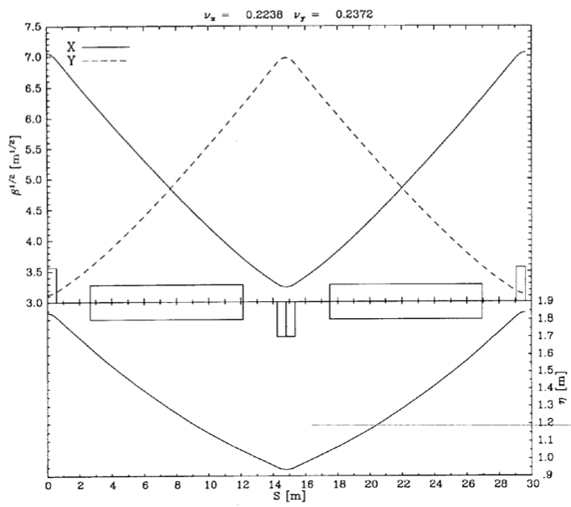
RHIC FODO Cell
Horizontal
Vertical
half quadrupole
half quadrupole
dipole
dipole
quadrupole
Horizontal dispersion

Slide 39
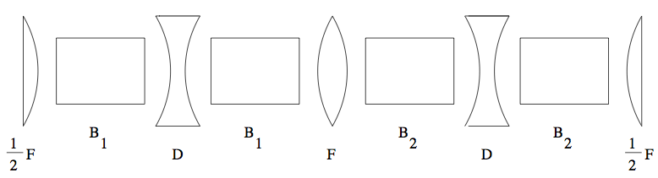
6.6: Dispersion Suppressor
The FODO dispersion solution is non-zero everywhere
  But in straight sections we often want
    e.g. to keep beam small in wigglers/undulators in a light source
  We can “match” between these two conditions with with a dispersion suppressor, a non-periodic set of magnets that transforms FODO to zero.
  Consider two FODO cells with different total bend angles
    Same quadrupole focusing to not disturb much
    We want this to match to
    at ends to simplify periodic matrix

Slide 40
FODO Dispersion Suppressor
Zero dispersion area
slope η’=0
FODO peak dispersion,
slope η’=0

Slide 41
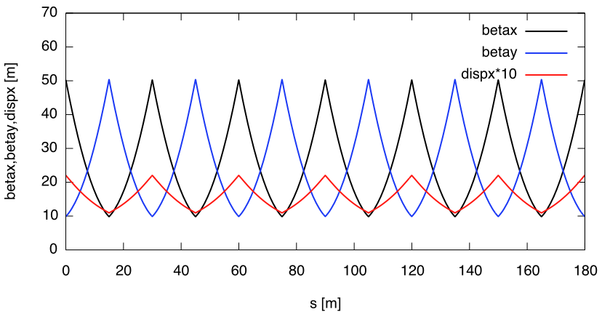
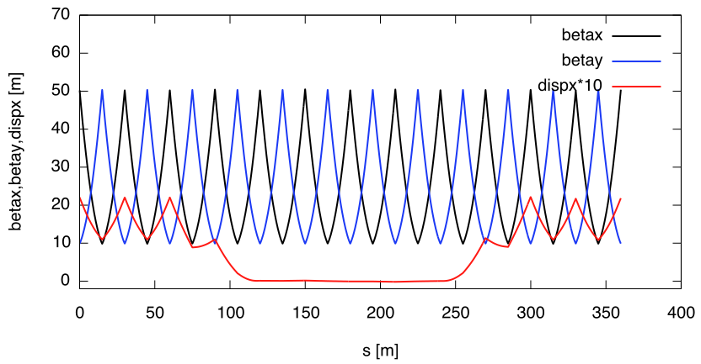
FODO Cell Dispersion and Suppressor
Dispersion-free Insertion

Slide 42
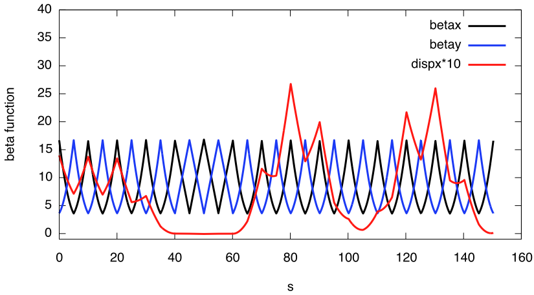
Mismatched Dispersion
Someone in class asked what mismatched dispersion looks like
  For example, this is what happens when the second dispersion suppressor is eliminated and the dipole-free FODO cells run right up against the FODO cells with dipoles
Dispersion
Mismatch –
not periodic!
Dispersion-free Insertion

Slide 43
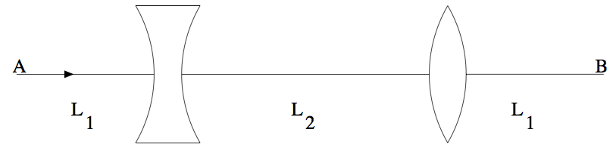
6.5: π/2 Insertion
Insertions and matching: modular accelerator design
FODO sections have very regular spacings of quads
  Periodicity of quadrupoles => periodicity of focusing
But we need some long quadrupole-free sections
  RF, injections, extraction, experiments, long instruments
Can we design a “module” that fits in a FODO lattice with a long straight section, and matches to FODO optics?
  Yes: a minimal option is called the π/2 insertion
  Matching lattice functions (β,α)_{x,y} at locations A,B

Slide 44
π/2 Insertion

Slide 45
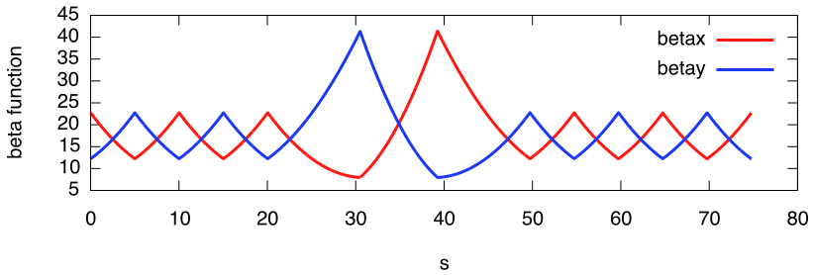
π/2 Insertion
π/2 insertion
5m FODO drifts
l₁=7.95m, l₂=8.75m

Slide 46
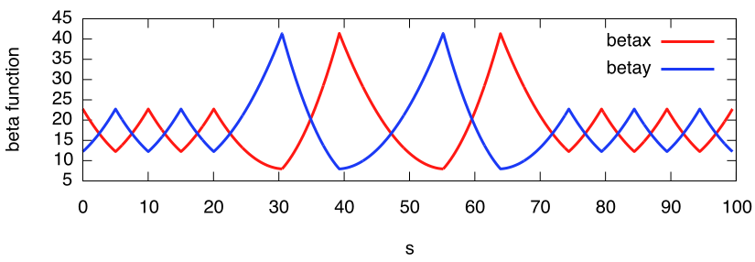
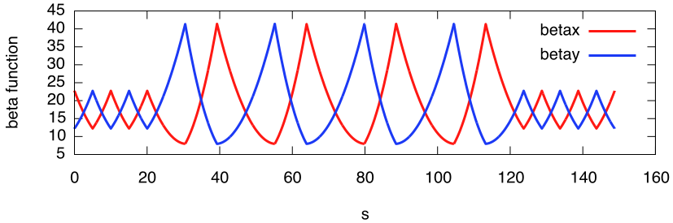
Multiple π/2 Insertions

Slide 47
Multiple π/2 Insertions
Lattice elements repeat: see p. 22

Slide 48
Example: RHIC FODO Lattice Revisited
quadrupoles
dipoles
Missing dipole dispersion suppressor
low-beta insertion
low-beta insertion
Horizontal
Vertical
matching
FODO
Note modular design, including low-beta insertions
  Used for experimental collisions
  Minimum beam size σ (with zero dispersion)
    maximize luminosity
  Large s, beam size in “low beta quadrupoles”
  Other facilities also have longitudinal bunch compressors
    Minimize longitudinal beam size (bunch length) for, e.g, FELs

