Slide 1
Introduction to Accelerator Physics
Spring 2018
RF Cavities
Todd Satogata (Jefferson Lab and ODU) / satogata@jlab.org
http://www.toddsatogata.net/2018-ODU-AP
Subashini De Silva (ODU) / sdesilva@jlab.org
Happy Birthday to Ovid, Mr. Rogers, and Spike Lee!
Happy Spring Equinox, National Ravioli Day, National Proposal Day,
and Extraterrestrial Abductions Day!

Slide 2
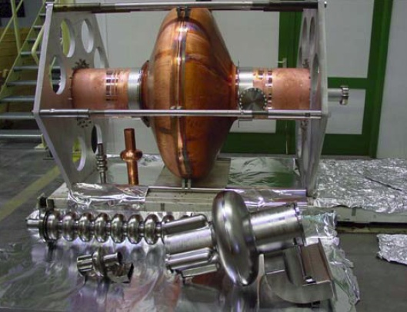
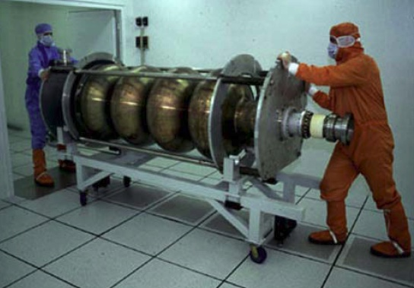
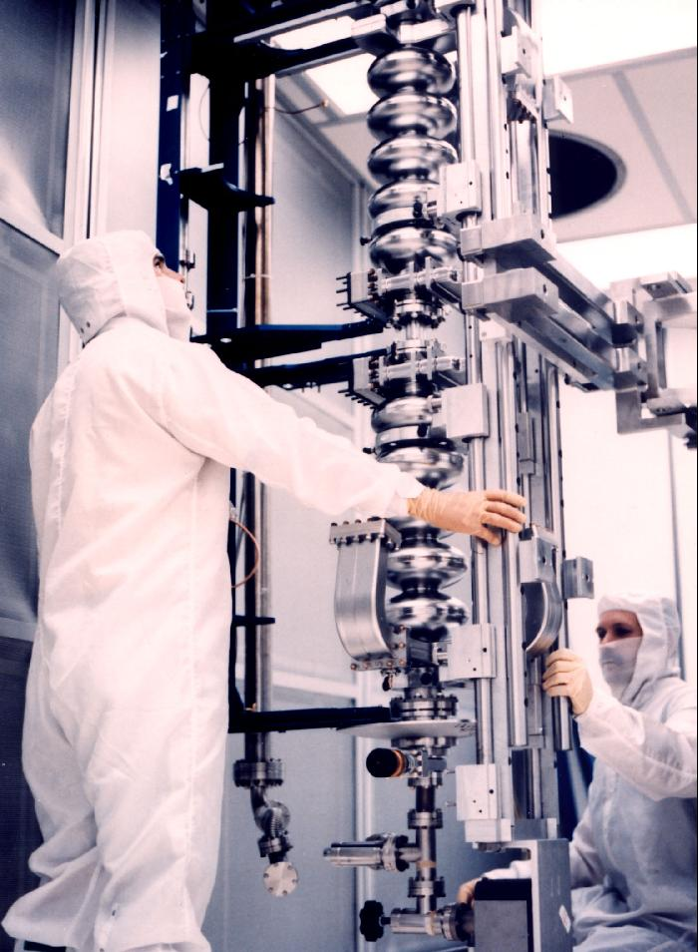
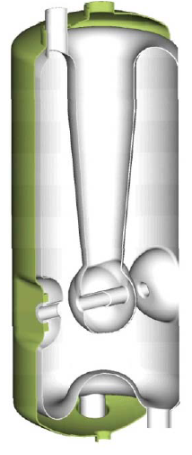
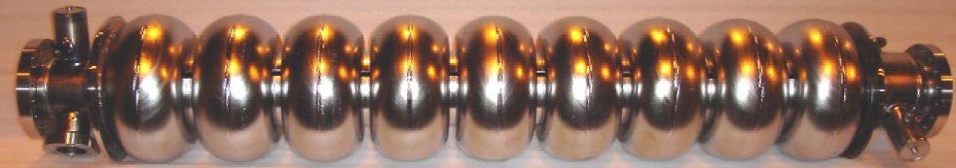
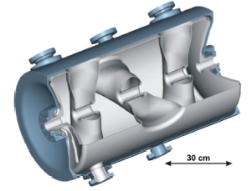
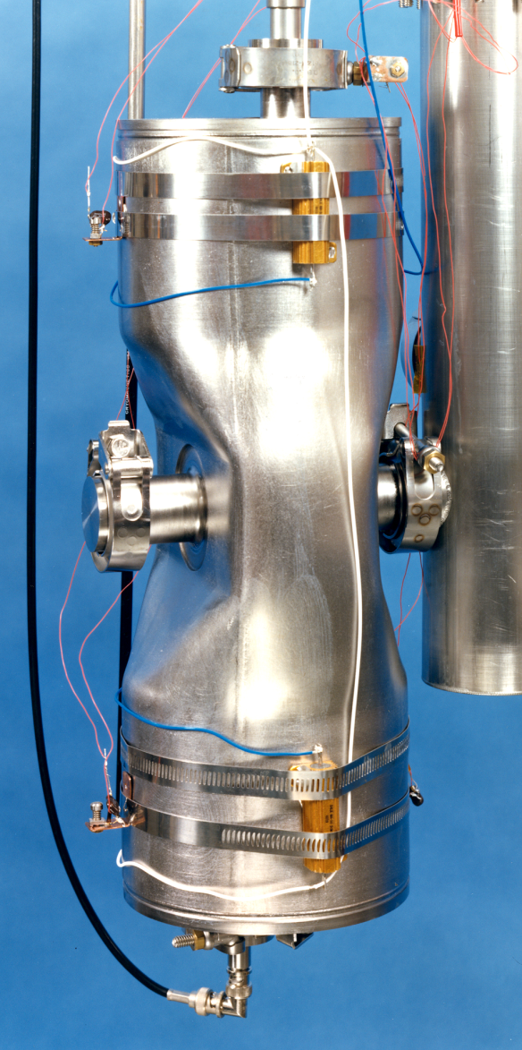
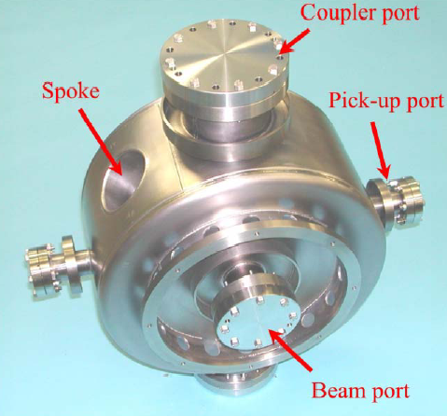
RF Cavities
RF cavities made of different materials, in different shapes and sizes
CESR Type Cavity (Cornell)
1300 MHz 9-cell
Quarter Wave Cavity
1500 MHz 5-cell
Triple Spoke Cavity
Half Wave Cavity
Single Spoke Cavity

Slide 3
RF Concepts and Design
Much of RF is really a review of graduate-level E&M
  See, e.g., J.D. Jackson, “Classical Electrodynamics”
  The beginning of this lecture is hopefully review
    But it’s still important so we’ll go through it
  Particularly important are cylindrical waveguides and cylindrical RF cavities
    Will find transverse boundary conditions are typically roots of Bessel functions
    TM (transverse magnetic) and TE (transverse electric) modes
    RF concepts (energy gain, gradient, stored energy, resistive losses, quality factor)

Slide 5
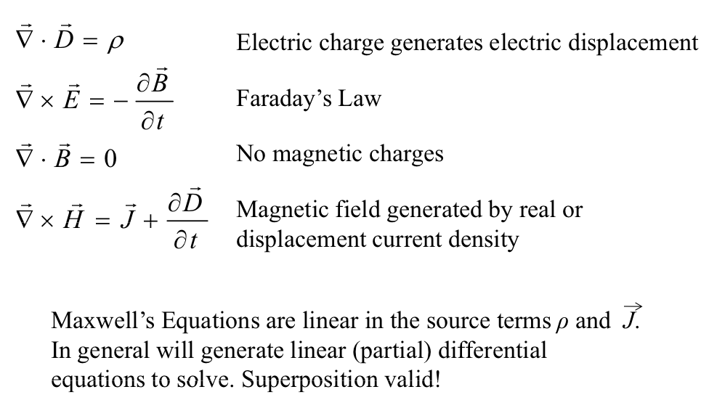
9.1: Maxwell’s Equations
Electric charge density
Electric current density

Slide 6
Constitutive Relations and Ohm’s Law

Slide 7
Boundary Conditions
Boundary conditions on fields at the surface between two media depend on the surface charge and current densities:
  and are continuous
  changes by the surface charge density (scalar)
  changes by the surface current density
C&M Chapter 9: no dielectric or magnetic materials

Slide 8
Wave Equations and Symmetry
Taking the curl of each curl equation and using the identity
then gives us two identical wave equations
These linear wave equations reflect the deep symmetry between electric and magnetic fields. Harmonic solutions:

Slide 9
Plane Wave Properties
The source-free divergence Maxwell equations imply
so the fields are both transverse to the direction
(This will be the direction in a lot of what’s to come)
Faraday’s law also implies that both fields are spatially transverse to each other

Slide 10
Standing Waves
Note that Maxwell’s equations are linear, so any linear combination of magnetic/electric fields is also a solution.
Thus a standing wave solution is also acceptable, where there are two plane waves moving in opposite directions:

Slide 11
9.2: Cylindrical Waveguides
Consider a cylindrical waveguide, radius a, in z direction
  can be imaginary for attenuation down the guide
  We’ll find constraints on this cutoff wave number
  Maxwell in cylindrical coordinates (math happens) gives

Slide 12
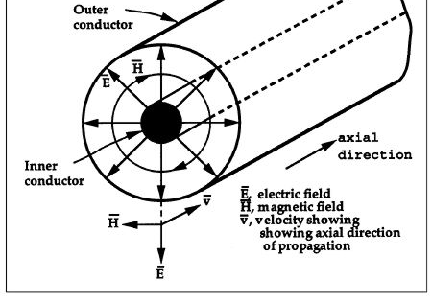
Transverse Electromagnetic (TEM) Modes
Various subsets of solutions are interesting
  For example, the nontrivial solutions require
  The wave number of the guide matches that of free space
  Wave propagation is similar to that of free space
  This is a TEM (transverse electromagnetic) mode
    Requires multiple separate conductors for separate potentials or free space
    Sometimes similar to polarization pictures we had before
Coaxial
cable

Slide 13
Transverse Magnetic (TM) Modes
Maxwell’s equations are linear so superposition applies
  We can break all fields down to TE and TM modes
  TM: Transverse magnetic (H_{z}=0, E_{z}≠0)
  TE: Transverse electric (E_{z}=0, H_{z}≠0)
  TM provides particle energy gain or loss in z direction!
  Maxwell’s equations in cylindrical coordinates give
Bessel equation
SHO equation
=> n integer, real

Slide 14
TM Mode Solutions
The radial equation has solutions of Bessel functions of first J_{n}(k_{c}r) and second N_{n}(k_{c}r) kind
  Toss N_{n} since they diverge at r=0
  Boundary conditions at r=a require J_{n}(k_{c}a)=0
  This gives a constraint on k_{c}
  This mode of this field is commonly known as the TM_{nj} mode
  The first index corresponds to theta periodicity, while the second corresponds to number of radial Bessel nodes
  TM₀₁ is the usual fundamental accelerating mode

Slide 15
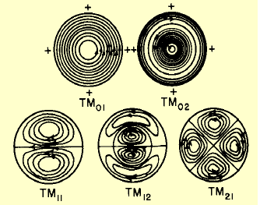
TM Mode Visualizations
Java app visualizations are also linked to the class website
  For example, http://www.falstad.com/emwave2 (TM visualization)
    Scroll down to Circular Modes 1 or 2 in first pulldown

Slide 16
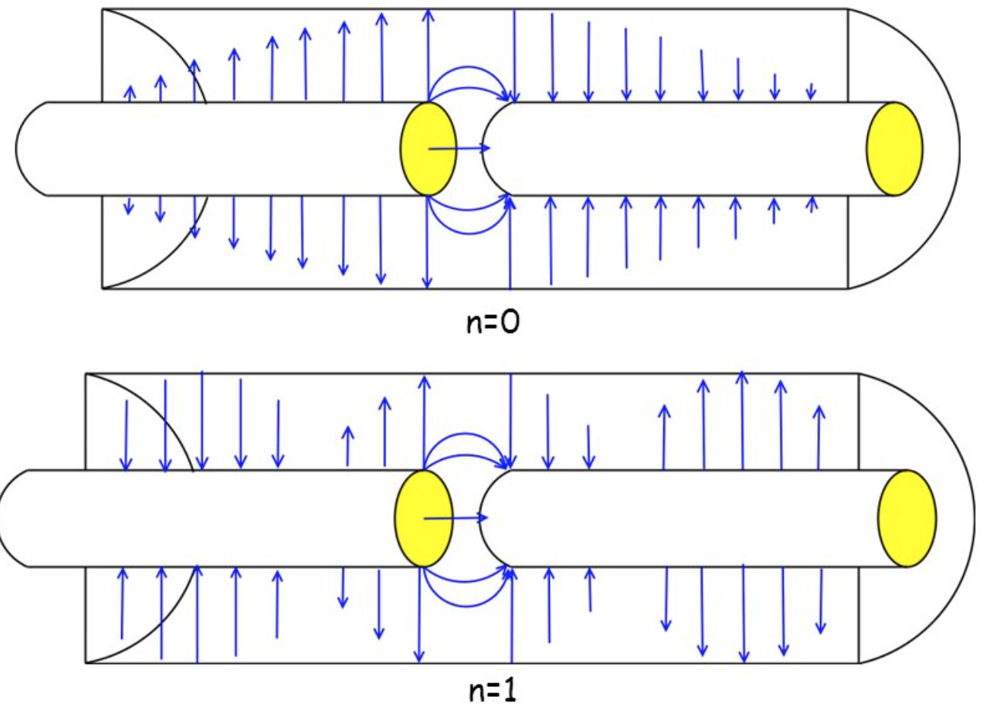
Cavity Modes
Dave McGinnis, FNAL

Slide 17
Cutoff Frequency
It’s easy to see that there is a minimum frequency for our waveguide that obeys the boundary conditions
  Modes at lower frequencies will suffer resistance
  Dispersion relation in terms of radial boundary condition zero
  A propagating wave must have real group velocity
  This gives the expected lower bound on the frequency
  Wavelength of lowest cutoff frequency for j=1 is

Slide 18
Cylindrical RF Cavities
What happens if we close two ends of a waveguide?
  With the correct length corresponding to the longitudinal wavelength, we can produce longitudinal standing waves
  Can produce long-standing waves over a full linac
  Modes have another index for longitudinal periodicity
TM₀₁₀ mode
Simplified “tuna fish can”
RF cavity model

Slide 19

Boundary Conditions
Additional boundary conditions at end-cap conductors at z=0 and z=l

Slide 20


TE_{njm} Modes
Longitudinal
periodicity

Slide 21
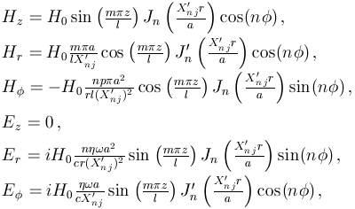
TE_{njm} ModesModes in a Cylindrical Cavity
X_{nj} is the j^{th} root of J_{n}
X’_{nj} is the j^{th} root of J’_{n}

Slide 22
TM_{njm} Modes
Longitudinal
periodicity
TM₀₁₀ is (again) the preferred acceleration mode

Slide 23
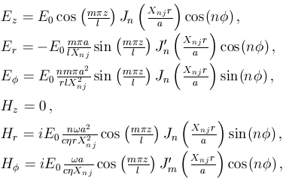
TM_{njm} Modes in a Cylindrical Cavity
X_{nj} is the j^{th} root of J_{n}
X’_{nj} is the j^{th} root of J’_{n}

Slide 24
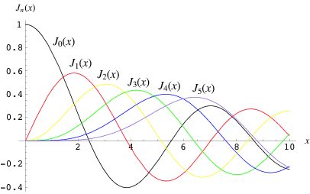
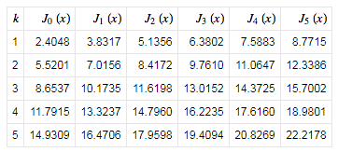
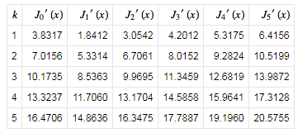
Bessel Functions and Roots

Slide 25
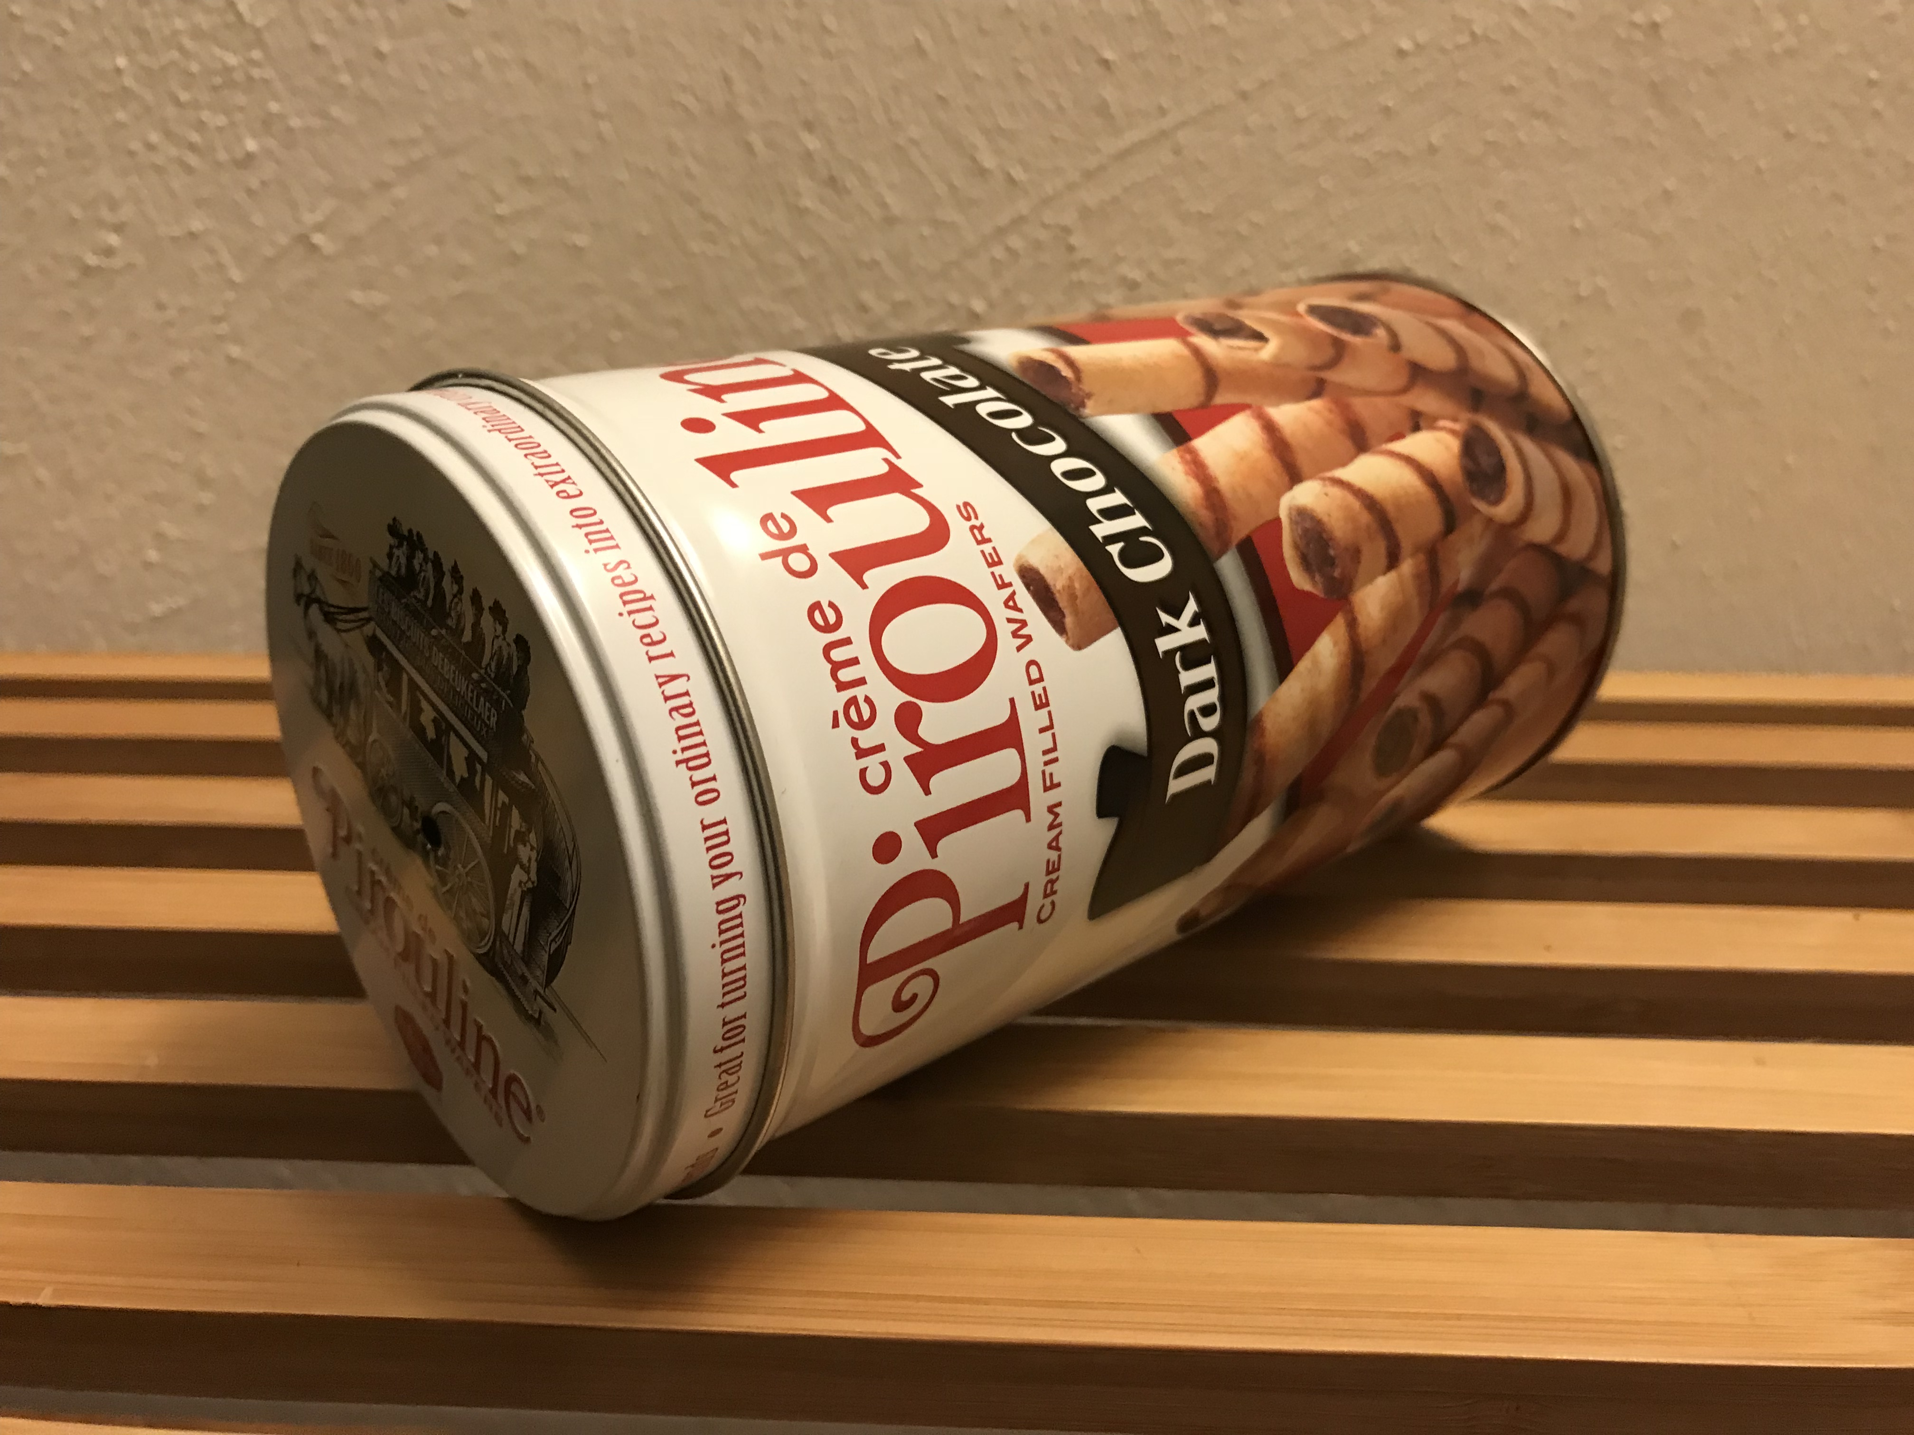
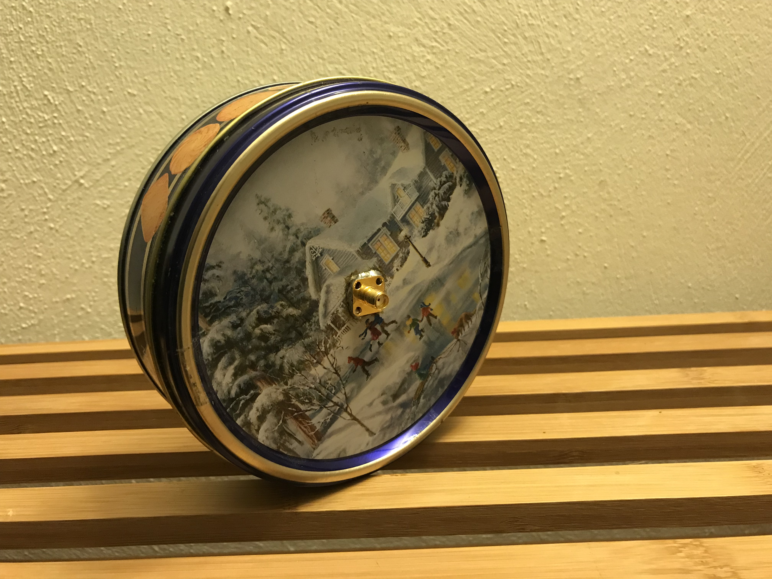
Problem (1): Calculate Frequencies
Radius (a)
Length (l)
Freq. of TM₀₁₀
Freq. of TM₀₂₀
Freq. of TM₁₁₀
Freq. of TE₀₁₁
Freq. of TE₁₁₁

Slide 26

TM₀₁₀ Mode
Cut off frequency:
Magnetic Field
E
Electric Field
TM₀₁₀ mode

Slide 27
TM₀₂₀ Mode
Peggs/Satogata

Slide 28
TM₁₁₀ Mode
Peggs/Satogata

Slide 29
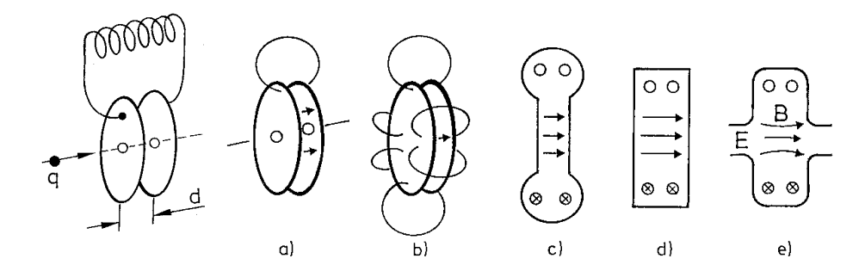
Equivalent Circuit
A TM₀₁₀ cavity looks much like a lumped LRC circuit
  Ends are capacitive
  Stored magnetic energy is inductive
  Currents move over resistive walls
E, H fields 90 degrees out of phase
  Electric field is concentrated near axis
  Magnetic field is concentrated at outer cylindrical wall

Slide 30
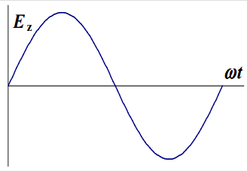
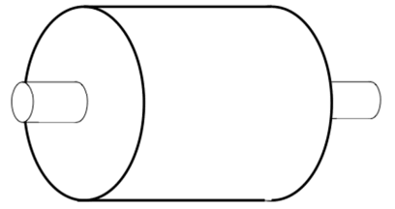
Accelerating Energy Gain
L
H
2a
E
At r=0
Lorentz force
Energy gain
Gradient
No contribution

Slide 31
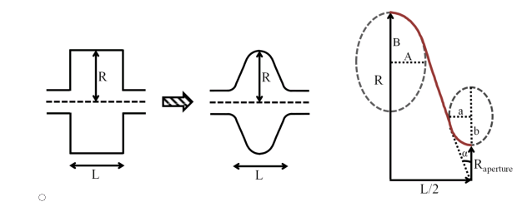
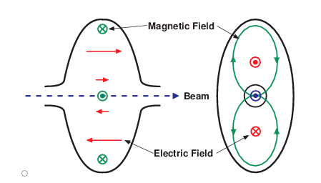
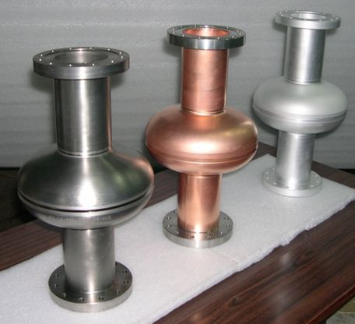
Elliptical Accelerating Cavities

Slide 32
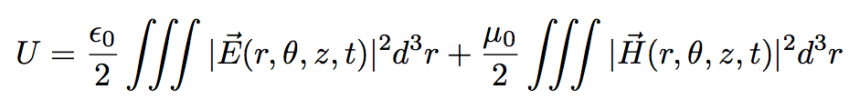
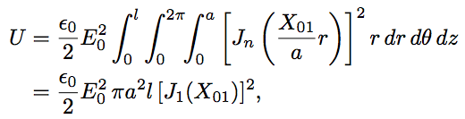
Stored Energy for TM₀₁₀ in a Cylindrical Cavity
Stored energy
C&M 9.82

Slide 33
Surface Resistance and Power Losses
There is still non-zero power loss for finite resistivity
  Surface resistance: resistance to current flow per unit area
  This isn’t just applicable to RF cavities, but to transmission lines, power lines, waveguides, etc – anywhere that electromagnetic fields are interacting with a resistive media

Slide 34
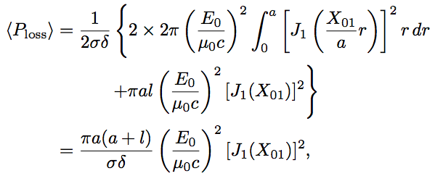
TM₀₁₀ Average Power Loss
ends
sides
Compare to stored energy
  Both vary like square of field, square of Bessel root
  Dimensional area vs dimensional volume in stored energy

Slide 35
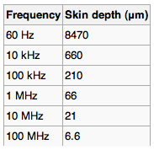
Conductivity and Skin Depth
For high conductivity, , charges move freely enough to keep electric field lines perpendicular to surface (RF oscillations are adiabatic vs movement of charges)
  Copper:
  Conductivity condition holds for very high frequencies (10¹⁵ Hz)
For this condition
  Inside the conductor, the fields drop off exponentially
e.g. for Copper

Slide 36
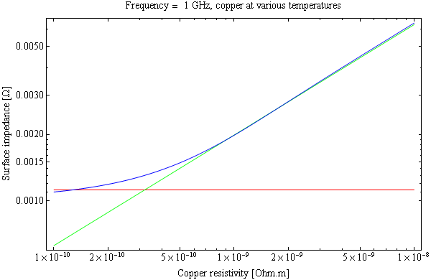
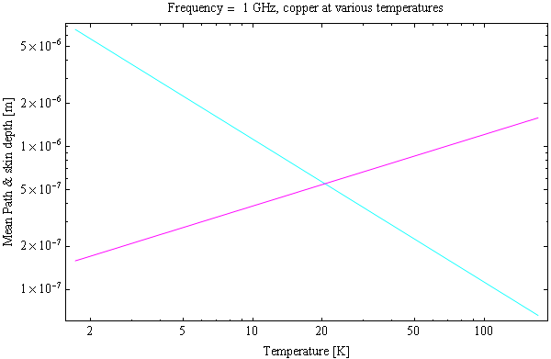
Anomalous Skin Effect
Conductivity really depends on the frequency and mean time between electron interactions (or inverse temperature)
  Classical limit is , adiabatic field wrt electron interactions
  For non-classical limit, no longer applies since electrons see changing fields between single interactions
Anomalous skin effect
Mean free path
Asymptotic value
Skin depth
Normal skin effect
Reuter and Sondheimer, Proc. Roy. Soc. A195 (1948), from Calatroni SRF’11 Electrodynamics Tutorial

Slide 37
Quality Factor
Ratio of average stored energy to average power lost (or energy dissipated) during one RF cycle
  How many cycles does it take to dissipate its energy?
  High Q: nondissipative resonator
  Copper RF: Q~10³ to 10⁶
  SRF: Q up to 10¹¹

Slide 38
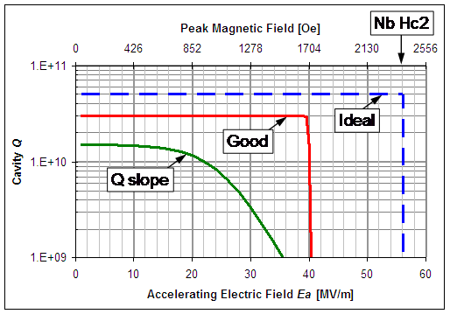
Niobium Cavity SRF “Q Slope” Problem

