Slide 1
Introduction to Accelerator Physics
Spring 2018
Midterm Review
Moments, Observables, and the Sigma Matrix
Todd Satogata (Jefferson Lab and ODU) / satogata@jlab.org
http://www.toddsatogata.net/2018-ODU-AP
Happy Birthday to Mikaela Shiffrin, Common, and John Hasbrouck Van Vleck (1977 Nobel)!
Happy Donald Duck Day, Earmuff Day, and National Coconut Torte Day!

Slide 2
Midterm Review
Midterm was clearly too long => grading curve
Total exam statistics (55 pts): 31.25 +/- 11.7
Prob | Pts | Ave | Rms
1 | 15 | 7.63 | 4.60
2 | 15 | 10.00 | 6.00
3 | 15 | 9.13 | 3.60
4 | 10 | 4.50 | 4.28
A | A- | B+ | B | B- | C
44 | 38 | 32 | 26 | 20 | 14
2 | 1 | 1 | 1 | 2 | 1

Slide 3
Beams as Distributions of Particles
We have talked a lot about magnets, lattices, and motion of individual particles through magnets
  But beams are made up of distributions of particles
  These can often number in excess of 10⁹-10¹¹
  We (usually) do not measure individual particles but properties of these distributions of particles

Slide 4
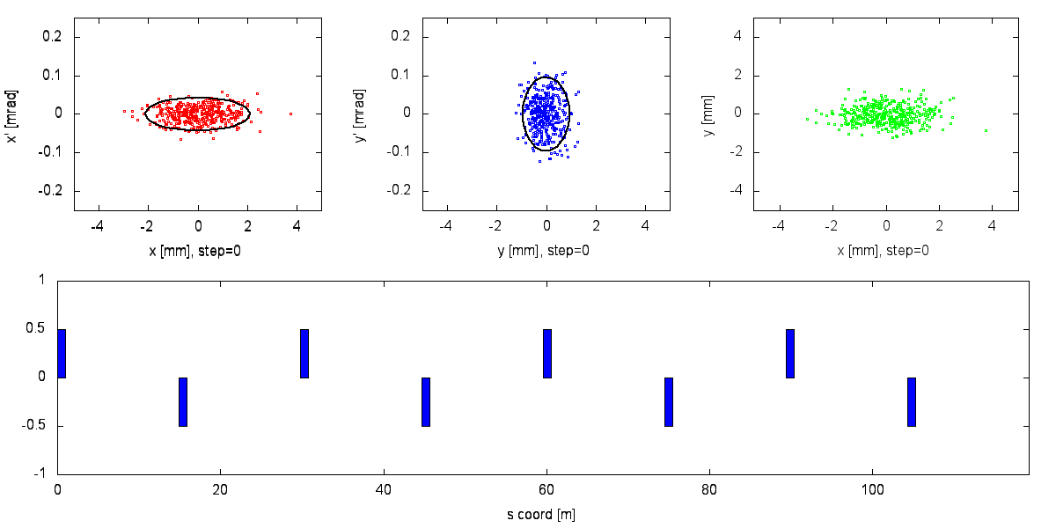
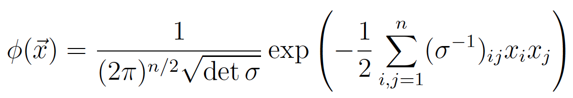

One dimensional Gaussian:
N-dimensional Gaussian:

Slide 5
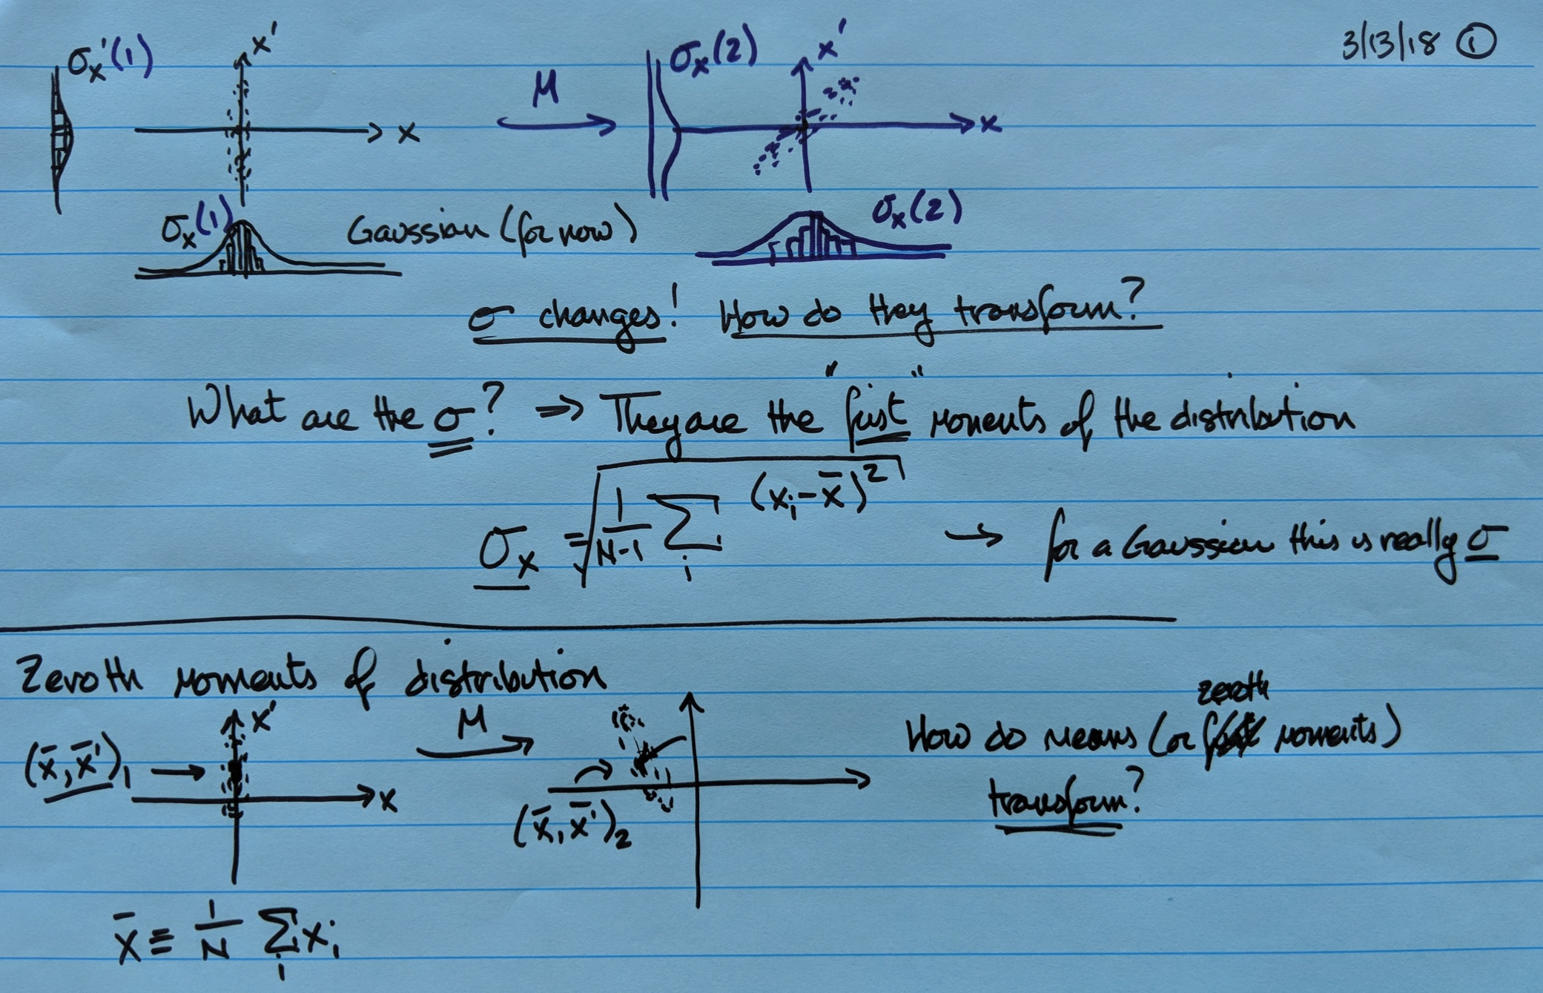

Slide 6
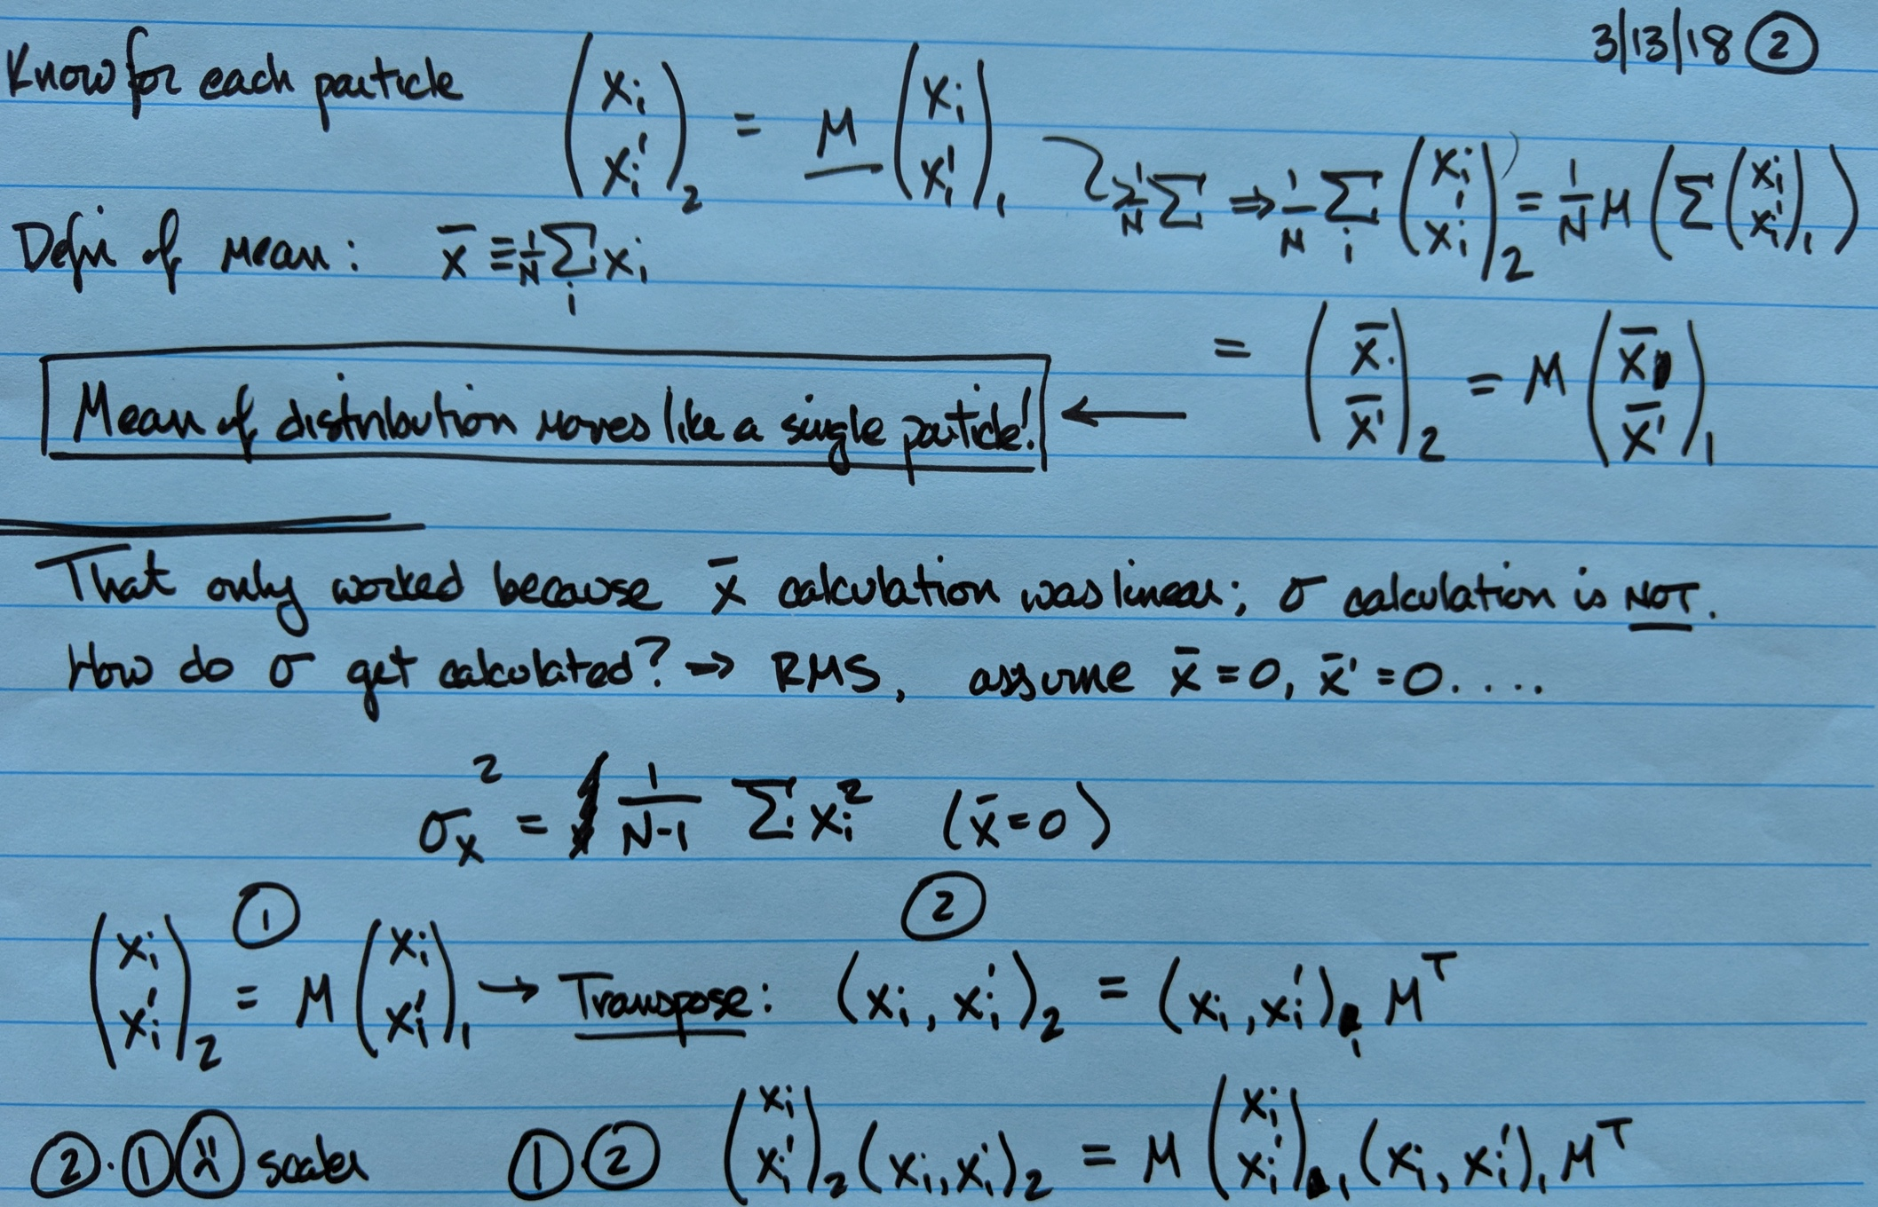

Slide 7
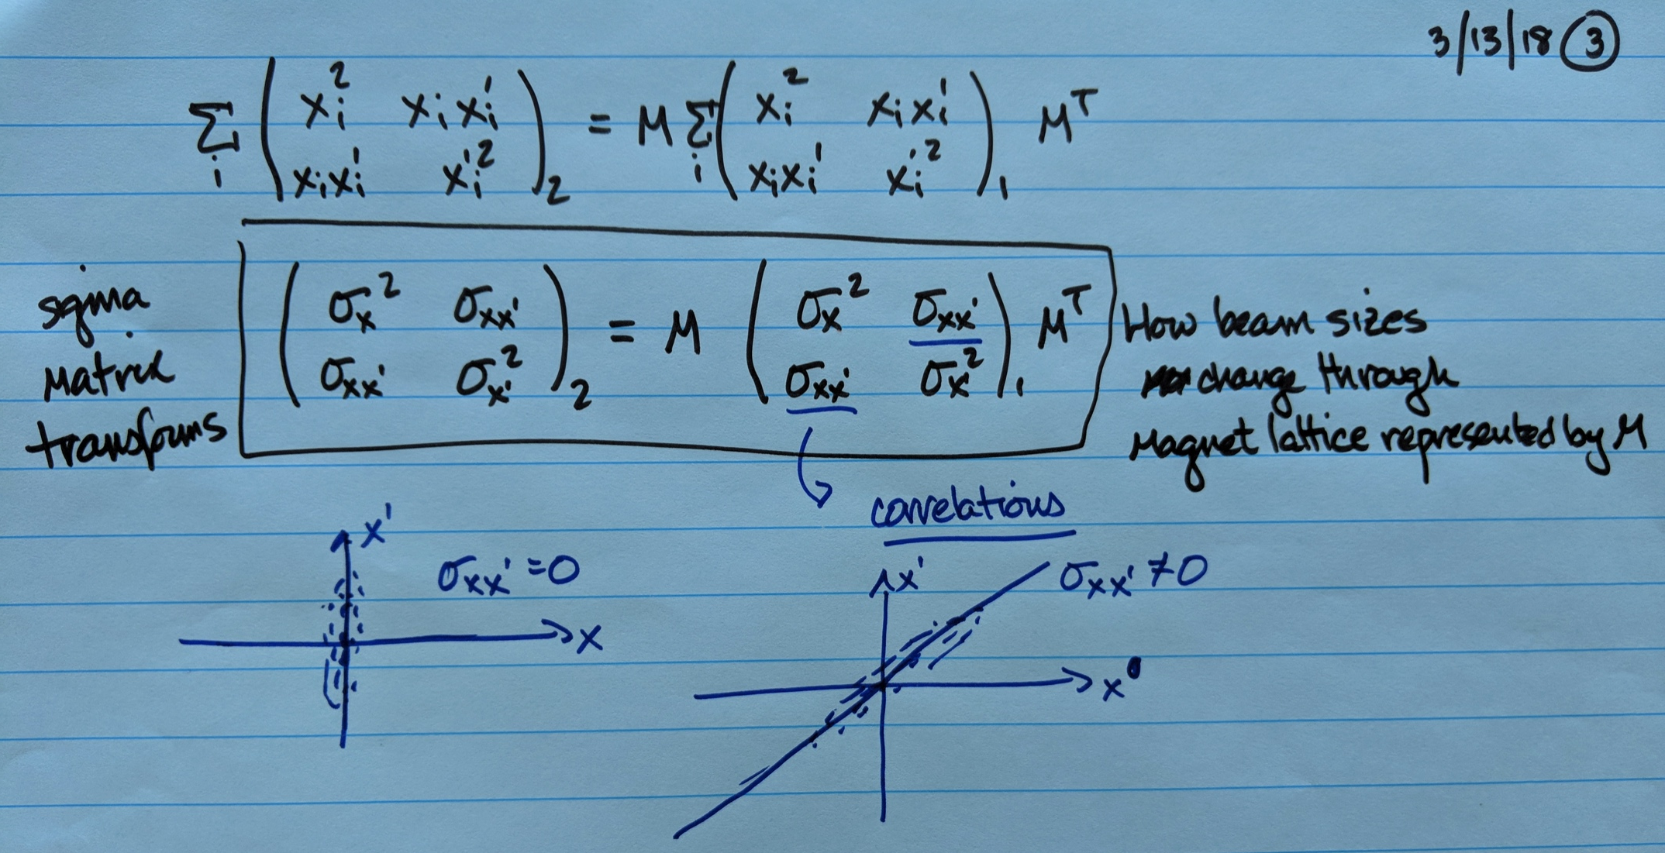

Slide 8
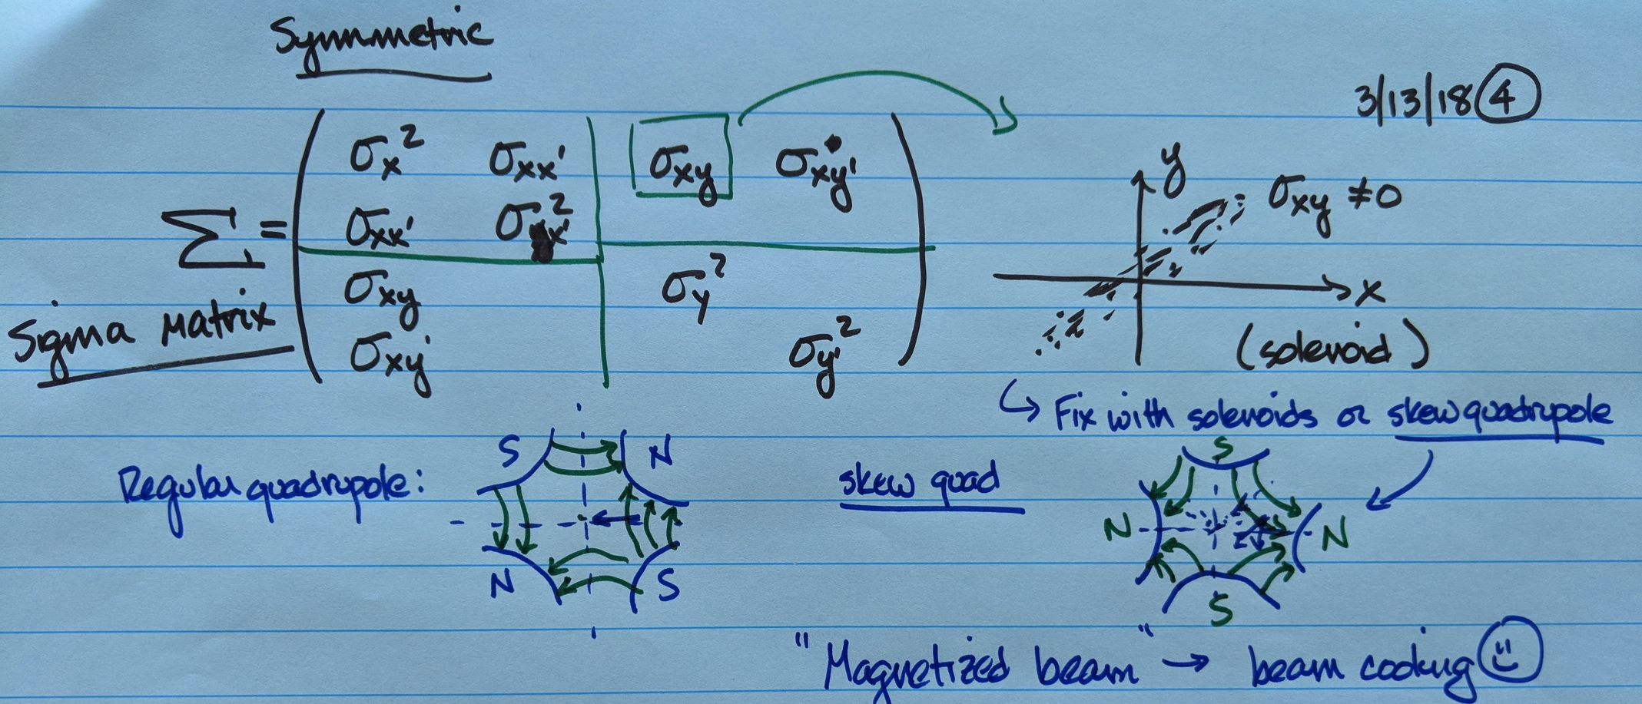

Slide 9
