Slide 1
Introduction to Accelerator Physics
Spring 2018
Observables and Instrumentation
Todd Satogata (Jefferson Lab and ODU) / satogata@jlab.org
http://www.toddsatogata.net/2018-ODU-AP
Enter your presentation preference on the Doodle poll on the class website!
Happy Birthday to Ruth Bader Ginsburg, will.i.am, and Zhores Alferov (2000 Nobel)!
Happy Ides of March, and RIP to Stephen Hawking.

Slide 2
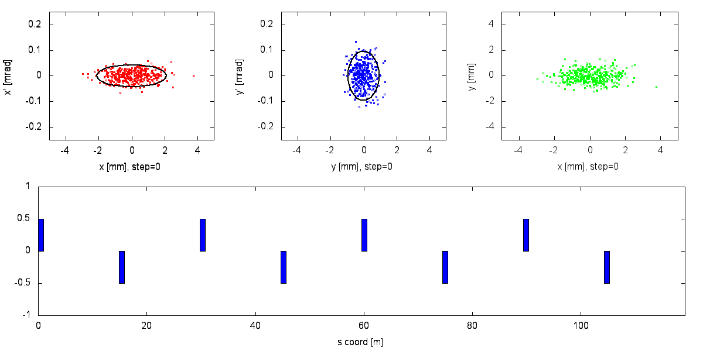
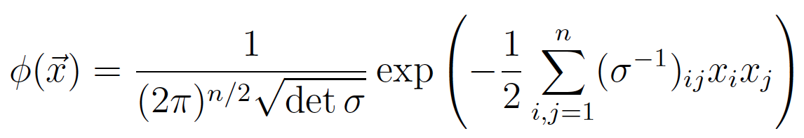

One dimensional Gaussian:
N-dimensional Gaussian:

Slide 3
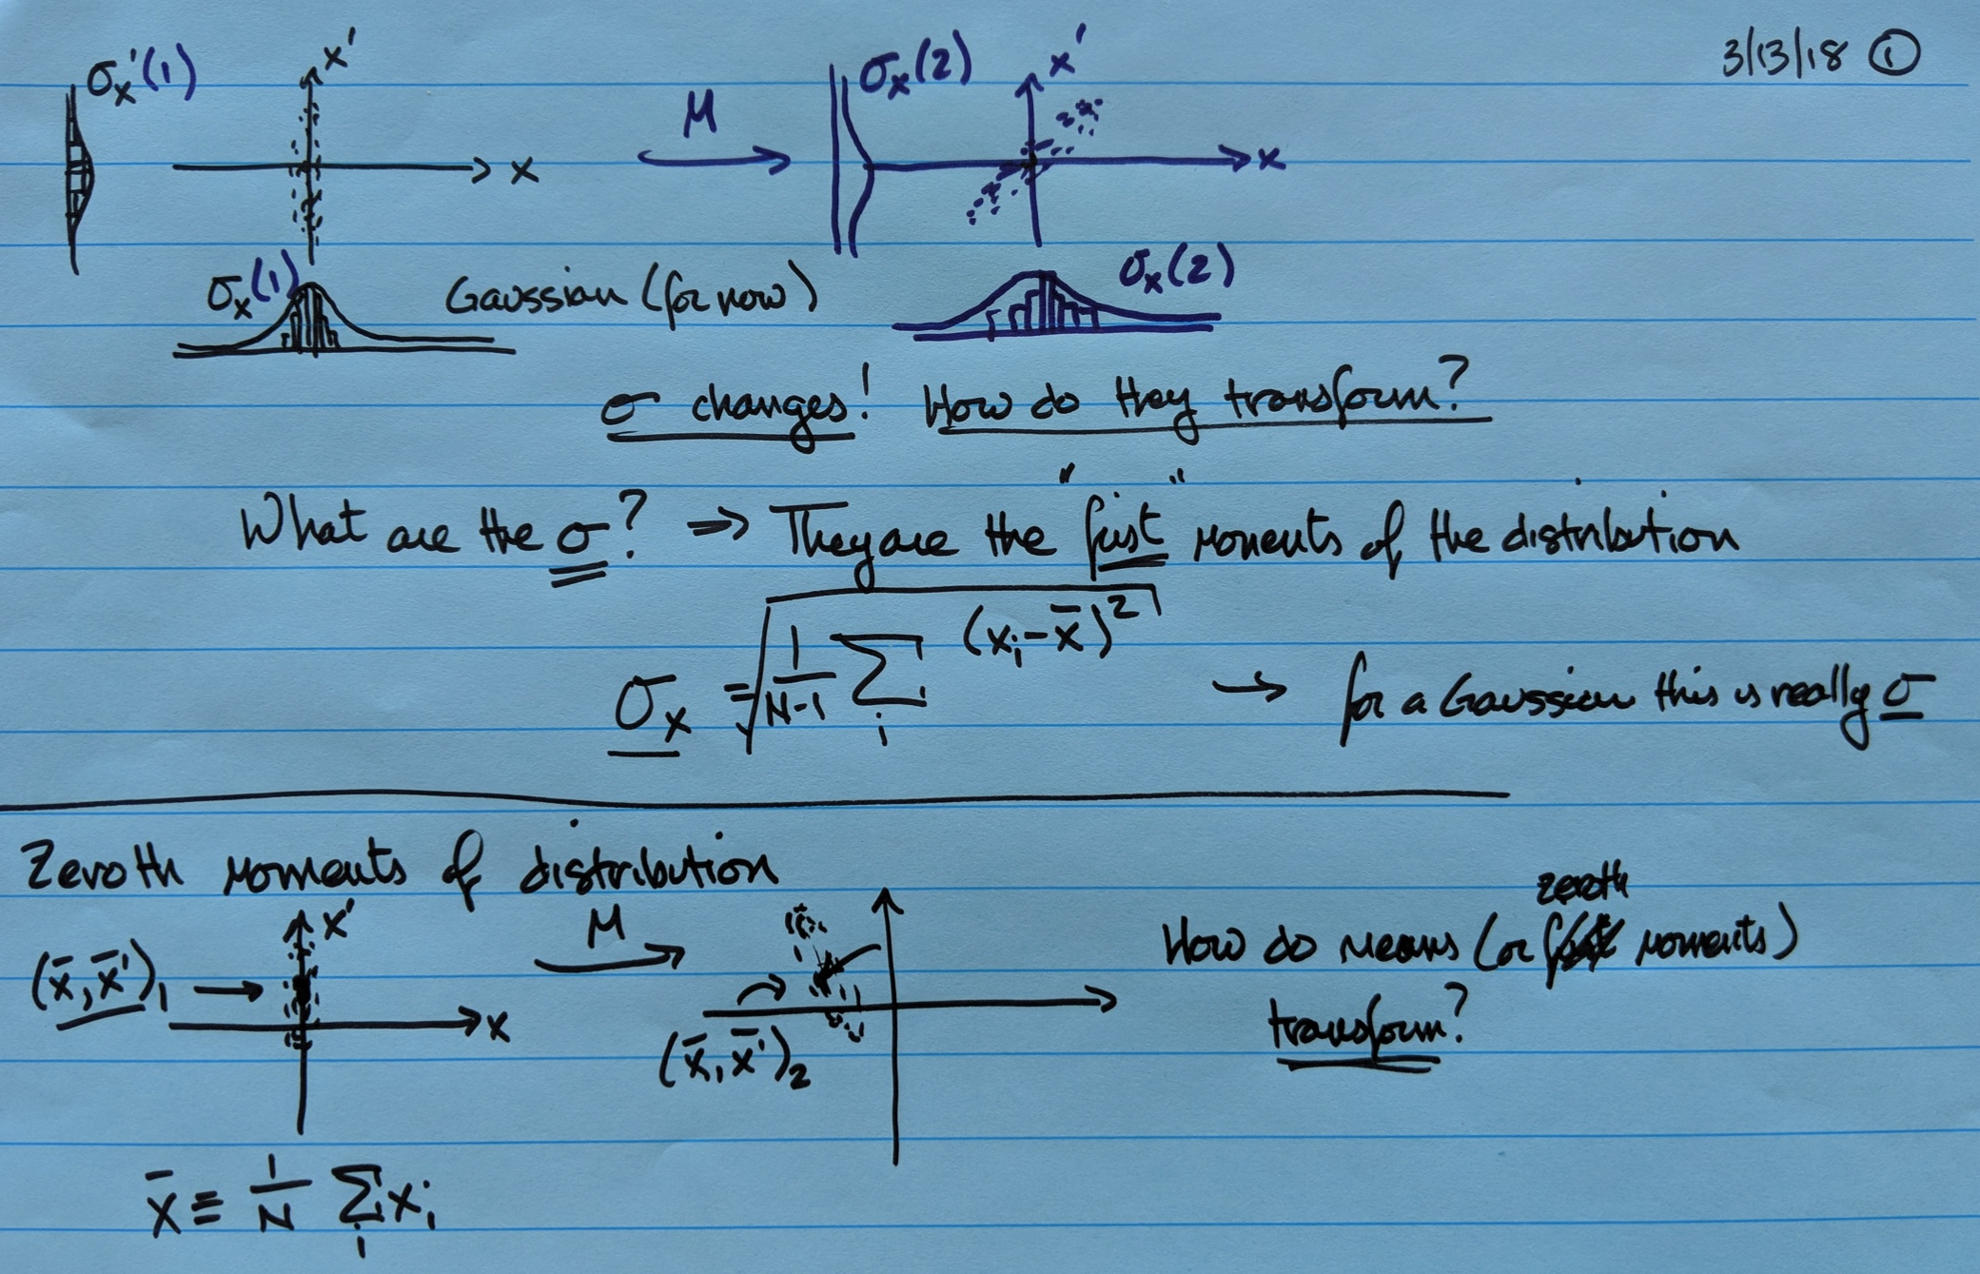

Slide 4
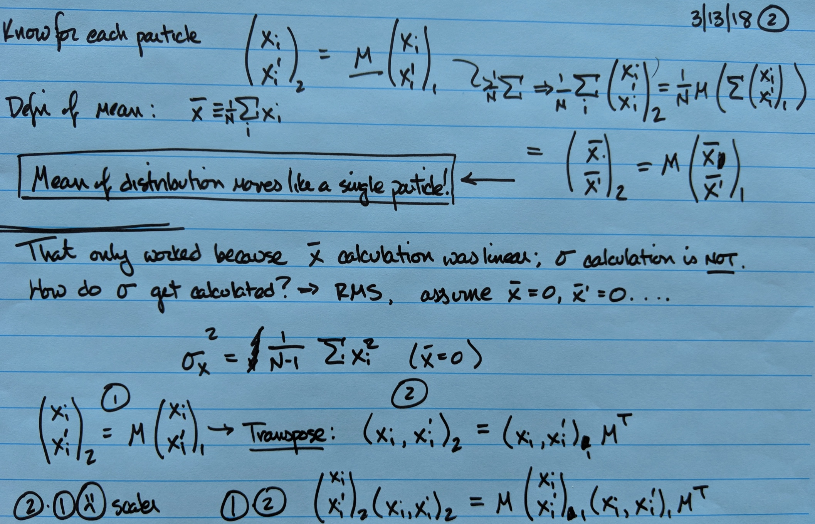

Slide 5
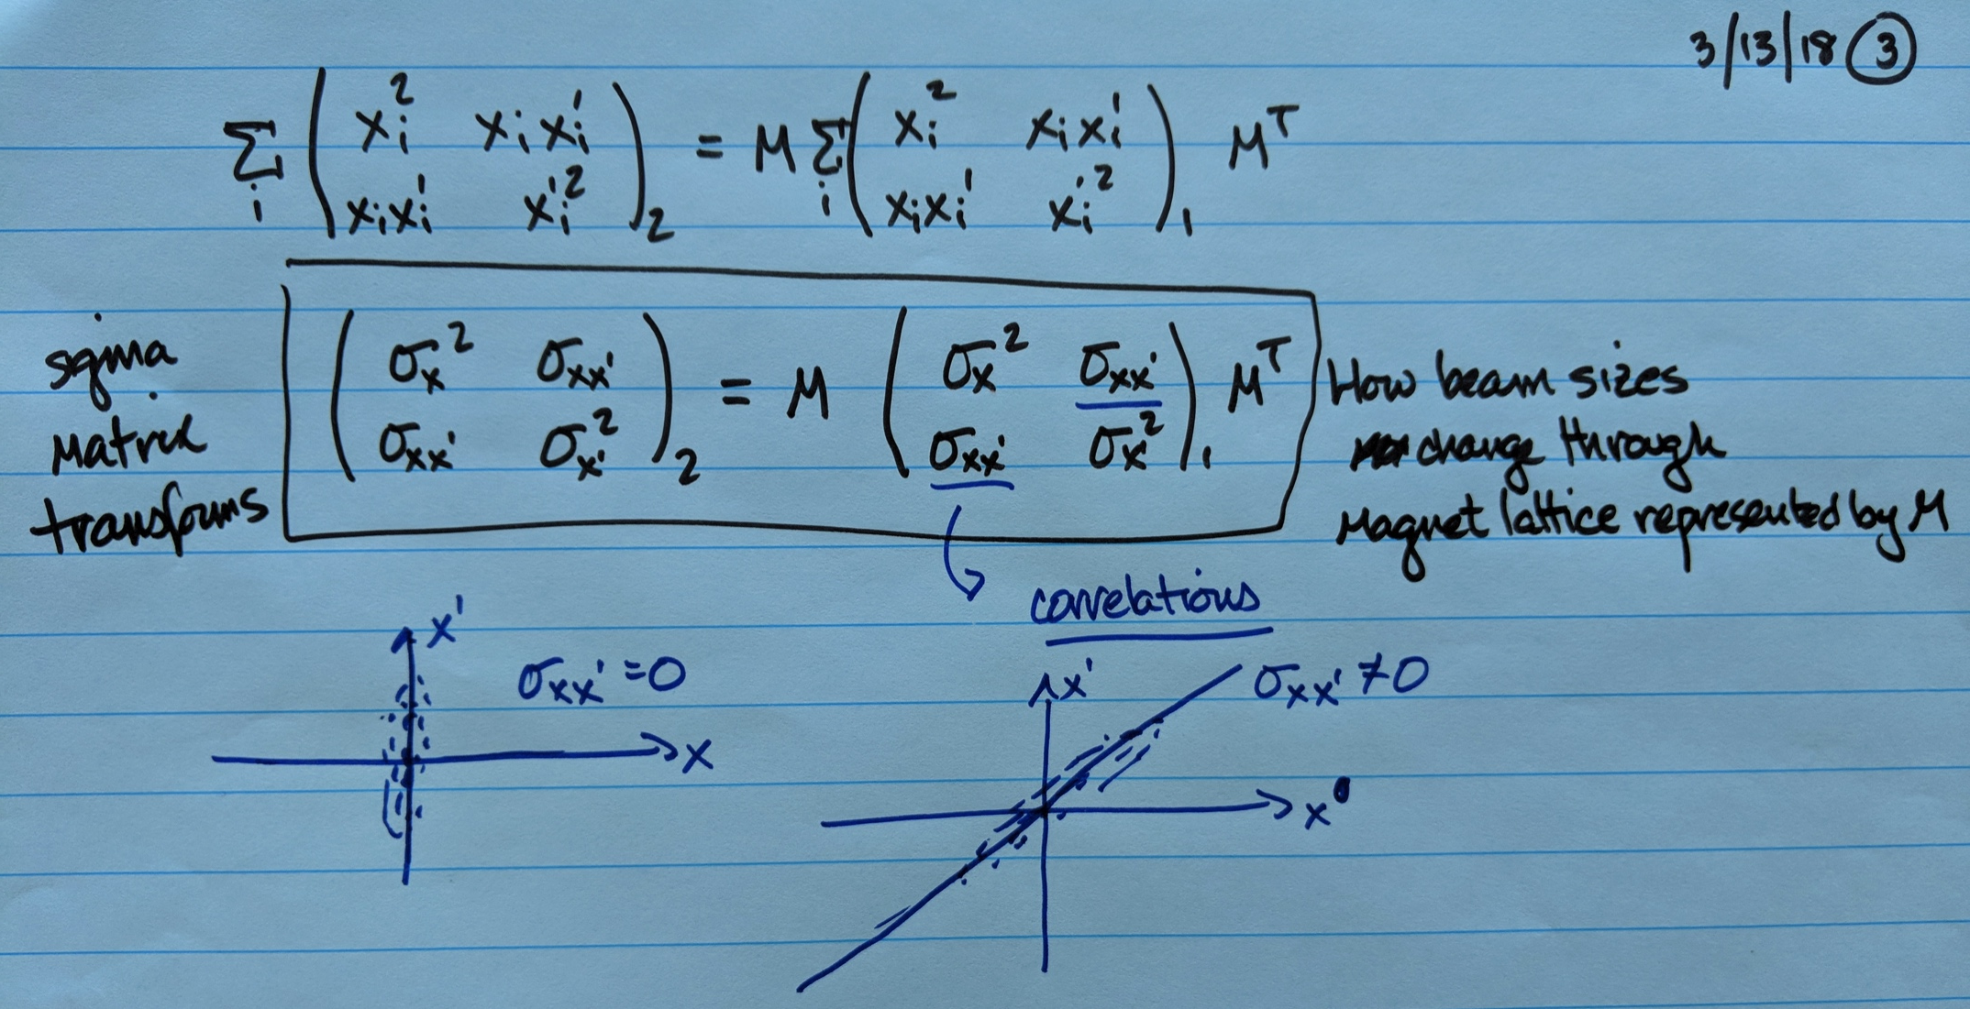

Slide 6
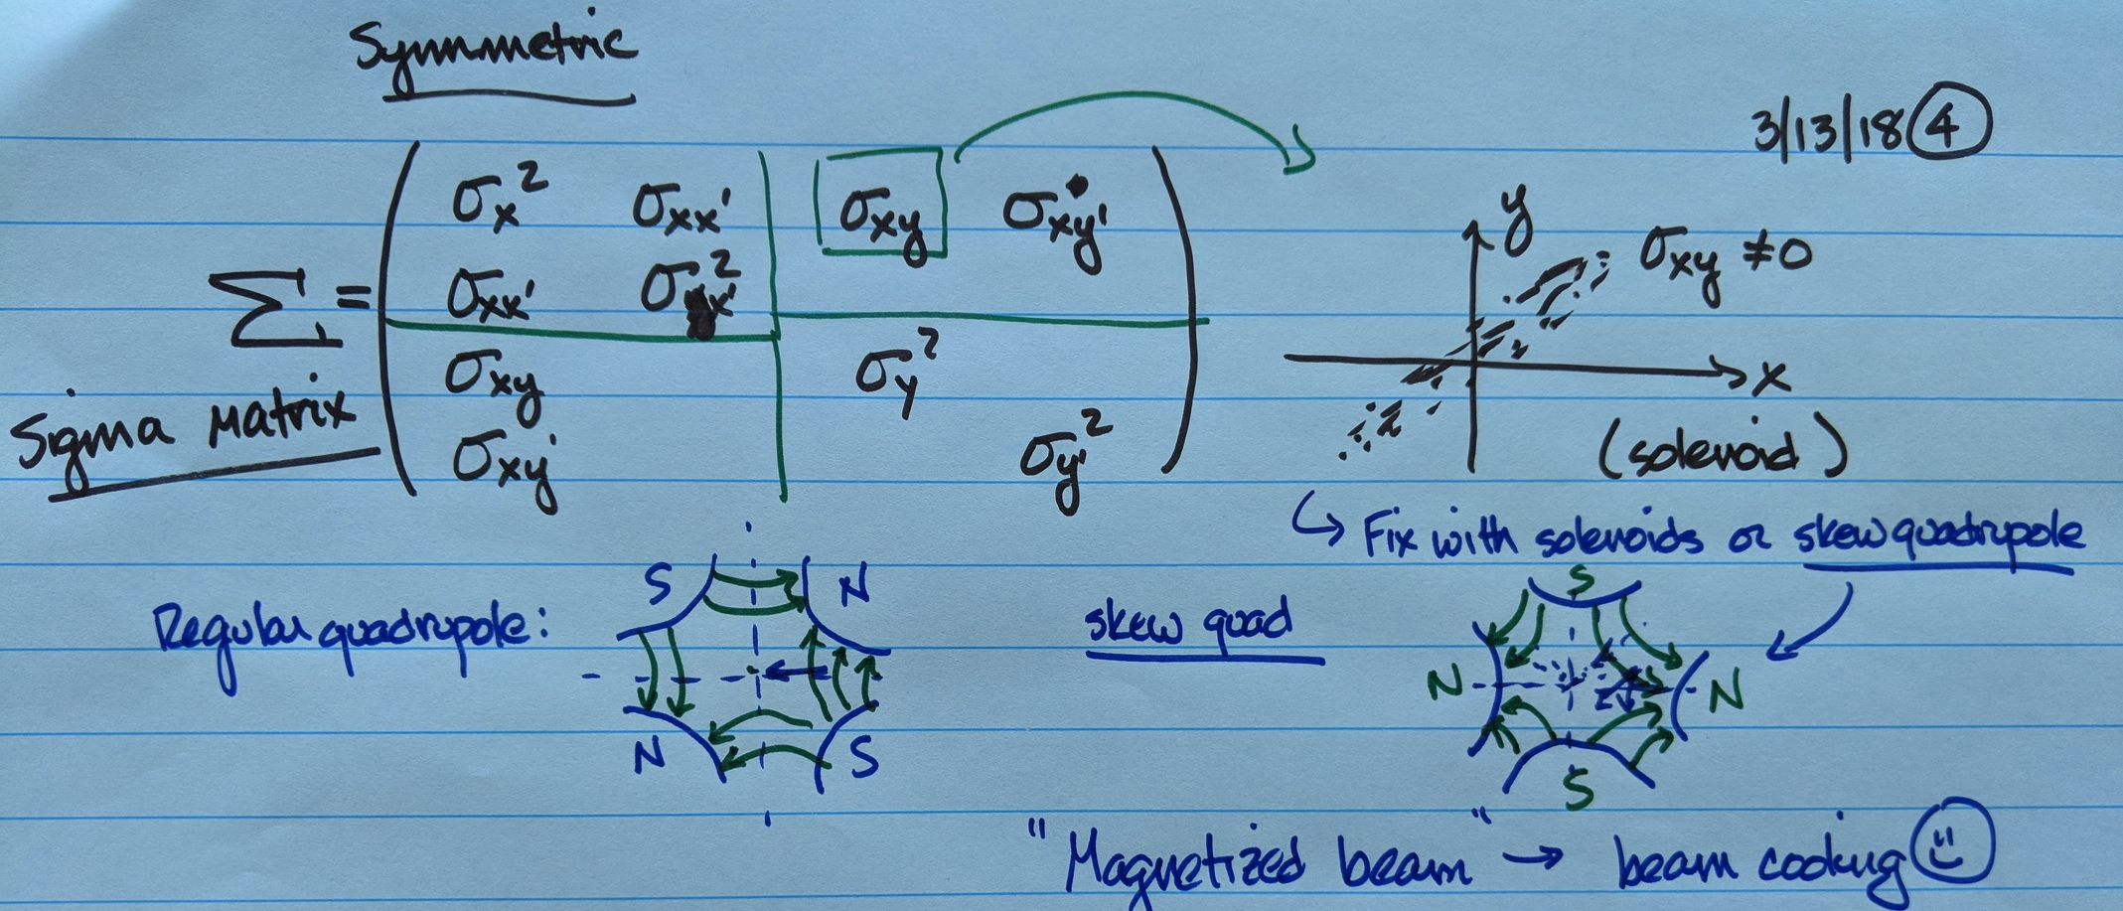

Slide 7
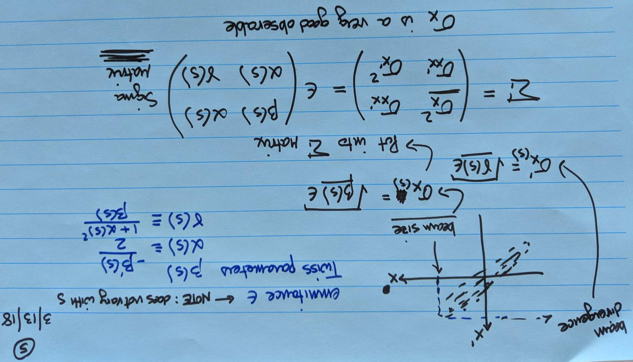

Slide 8
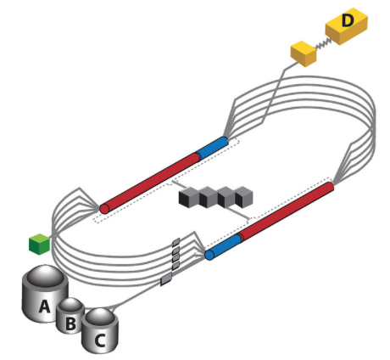
Measuring Beam Properties
We want to characterize and correct the distribution of particles in our beam at many locations within our accelerator
  Current / charge
  Centroid: steer the beam
    Measure: beam position monitors
    Correct: dipole (corrector) magnets
  Beam size: focus the beam
    Measure: wire scanners,
    phosphor “flags”,
    sync light monitors
    Correct: quadrupoles
  Beam losses
    Measure: loss monitors
    Correct: anything!
CEBAF at Jefferson Lab

Slide 9
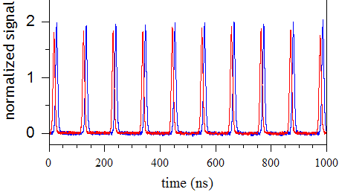
Transverse vs Longitudinal
We have talked a lot about transverse distributions
Beams also have a time structure or longitudinal distribution
This is usually (but not always) a repetitive structure
How long
is a ns?
Protons in RHIC: 107.7 ns spacing, 8.3 ns FWHM “Gaussian” proton bunches
Total charge should be proportional to the integral of this signal.
Reference

Slide 10
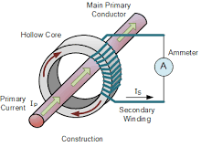
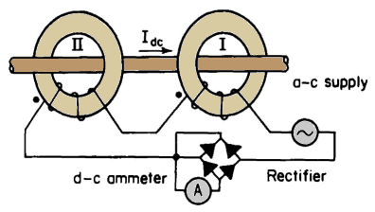
Measuring High-Frequency Current
This beam is a high frequency current
We could run it through the center of conductive, inductive loops and measure V(t)
  Challenging with very fine time structure
  DCCTs: very accurate average (low frequency) current
DC Current Transformer
Sense difference in balanced windings

Slide 11
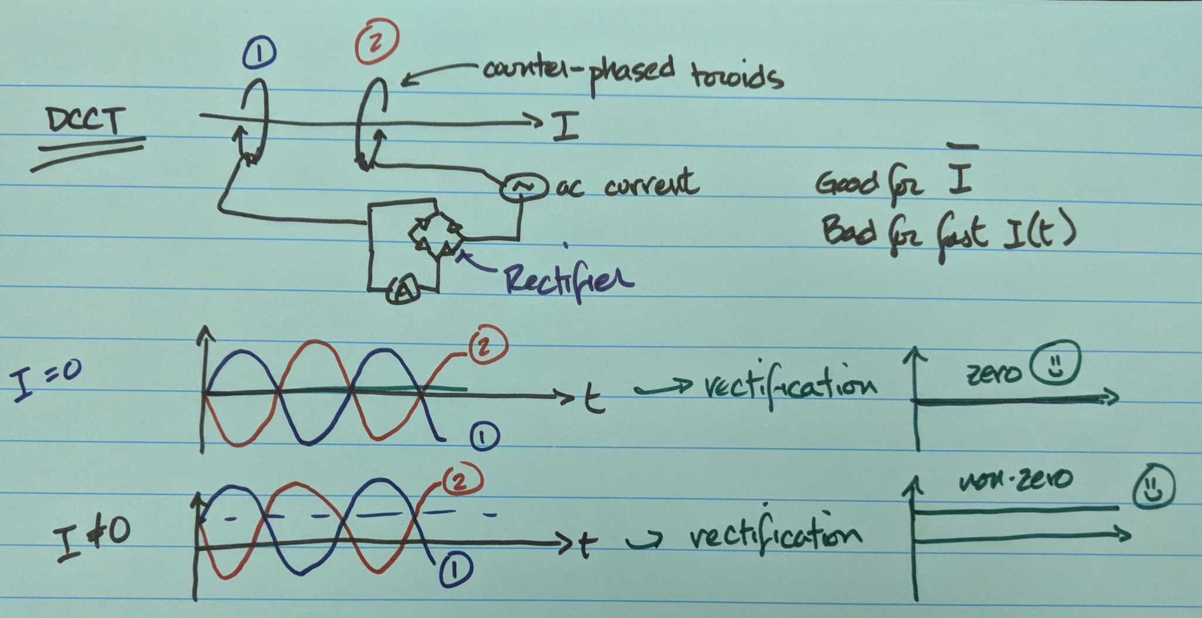

Slide 12
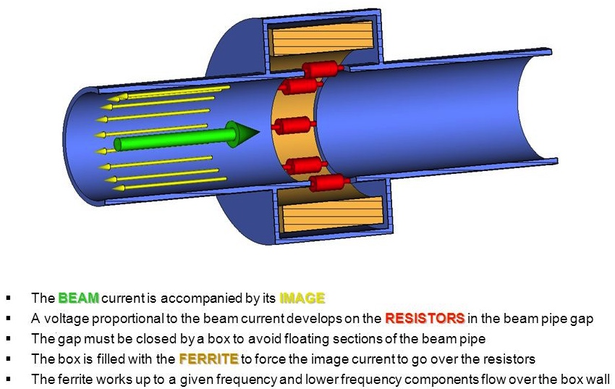
Wall Current Monitor
Can work up to 10+ GHz (sub-ns temporal resolution)
Can in principle also get some distribution information
M. Gasior (CERN)

Slide 13
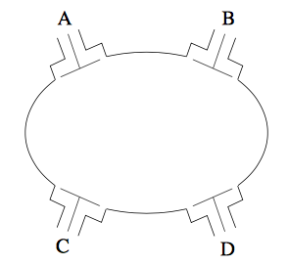
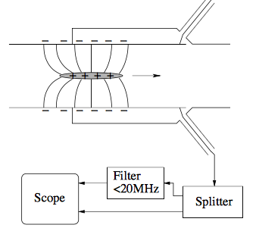
Beam Positions (Chapter 14)
Dedicated instruments to measure beam centroid
beam
direction
beam direction
out of page
Relativistic “impulse” of field
as charged bunch passes by

Slide 14
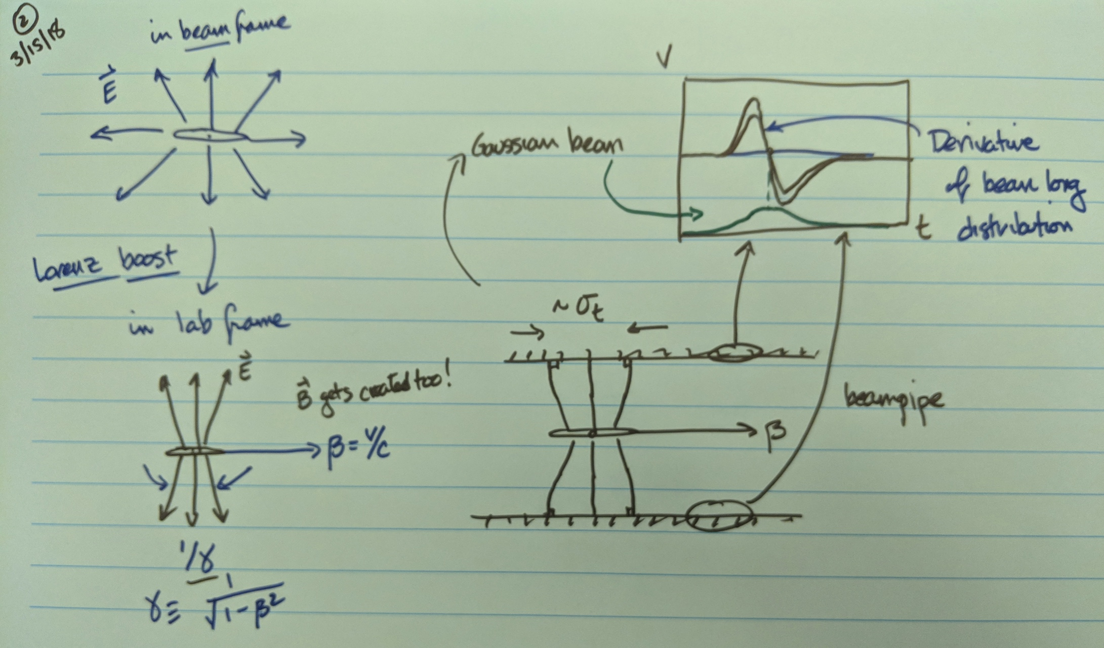

Slide 15
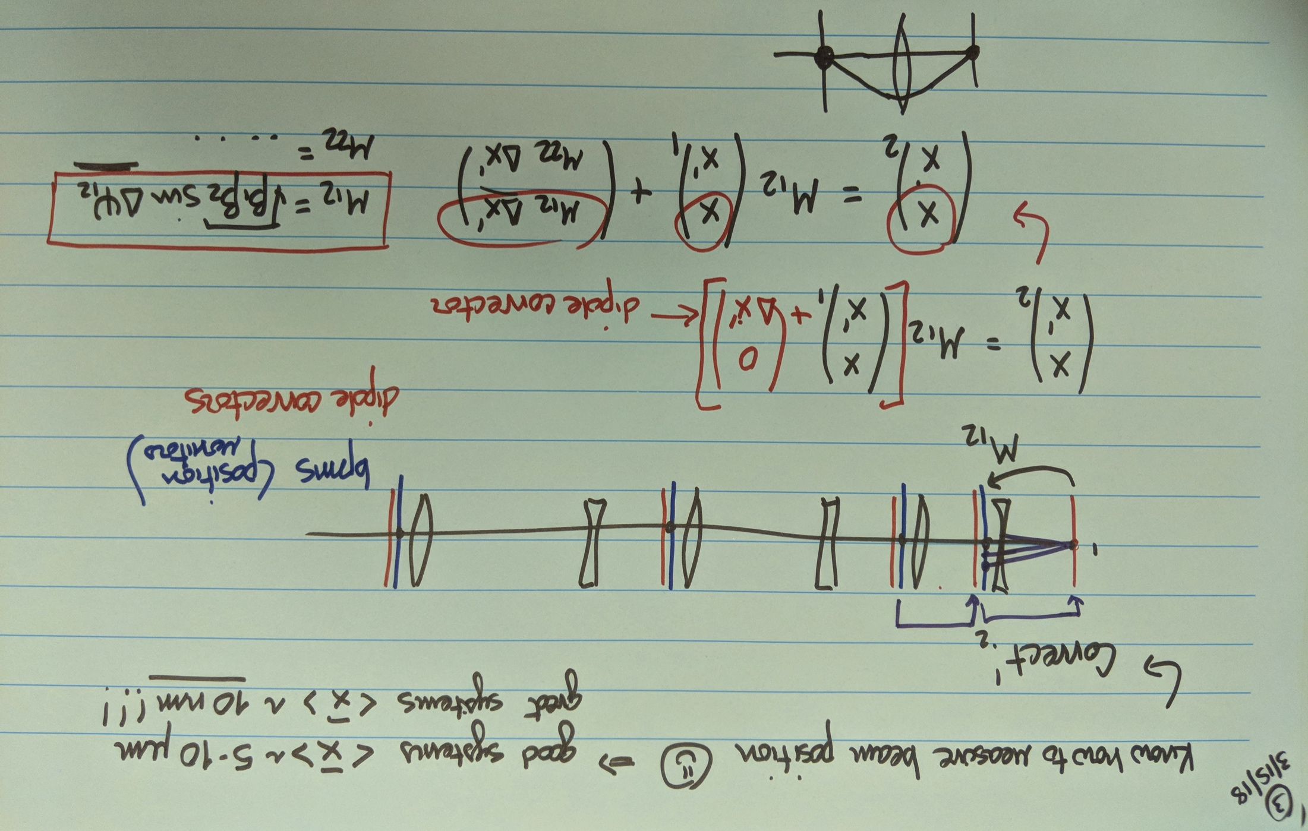

Slide 16
