Slide 1
Introduction to Accelerator Physics
Spring 2018
Chapter 5: Strong Focusing
Todd Satogata (Jefferson Lab and ODU) / satogata@jlab.org
http://www.toddsatogata.net/2018-ODU-AP
~~~~~ February 8 ~~~~~
Happy Birthday to Cecily Strong, James Dean, John Williams, and Daniel Bernoulli!
Happy Boy Scouts Day, Opera Day, and Laugh and Get Rich Day!

Slide 2


Particle Motion through a Drift Space

Slide 3
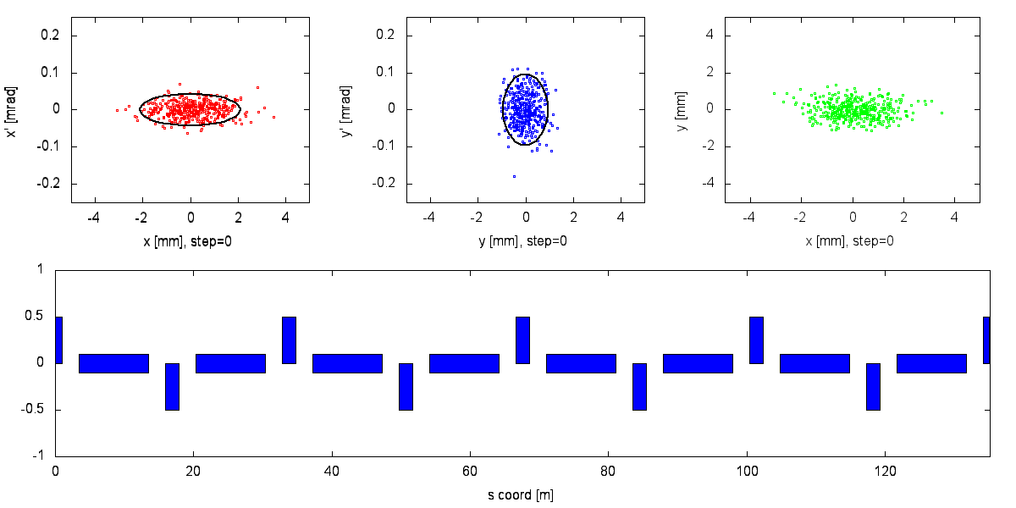
Particle Motion In An Idealized Transport Line

Slide 4
Overview
Doublets and simple focusing
5.1: Transfer matrix approach and linear stability
5.2: Analytical approach
5.3: Emittances (revisit later in semester)
5.4: Adiabatic Invariants
5.5: Dispersion
5.6: Momentum compaction
Solutions to some problems

Slide 5
Strong Focusing
String magnets together and look at optical systems
Real transport systems are generally made of long repeated periods of magnet groups
  Keep beam together while getting from here to there
Fundamental problems
  Quadrupoles (linear focusing) defocus in opposite plane
  Focusing in both planes with weak focusing is too weak
How do we build a focusing system out of magnets and drifts that we know about?
  Easiest analysis: string together transport matrices

Slide 6
Magnet Transport Matrix Review
Drift
Thick quadrupole
Thin quadrupole
f=(kl)⁻¹>>length l
Sector dipole of bend angle θ and radius ρ

Slide 7
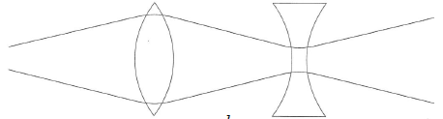
Matrix Example: Strong Focusing
Consider a doublet of thin quadrupoles separated by drift L
  There is net focusing given by this alternating gradient system
  A fundamental point of optics, and of accelerator strong focusing
Thin quadrupole
matrices

Slide 8
Strong Focusing: Another View
  For this to be focusing, x’ must have opposite sign of x where these are coordinates of transformation of incoming paraxial ray
  Equal strength doublet is net focusing under condition that each lens’ focal length is greater than distance between them

Slide 9
Transport Matrix Stability Criteria
For long systems (rings) we want stable as
  If 2x2 M has eigenvectors and eigenvalues :
  M is also unimodular (det M=1) so with complex
  For to remain bounded, must be real
  We can always transform M into diagonal form with the eigenvalues on the diagonal (since det M=1); this does not change the trace of the matrix
  The stability requirement for these types of matrices is then

Slide 10
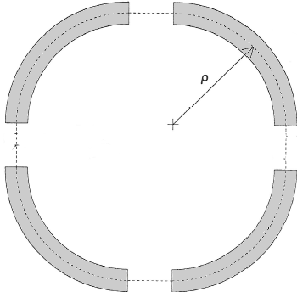
More Math: Hill’s Equation
Let’s go back to our quadrupole equations of motion for
  What happens when we let the focusing K vary with s?
  Also assume K is periodic in s with some periodicity C
  This periodicity can be one revolution around the
  accelerator or as small as one repeated “cell”
  of the layout
  The simple harmonic oscillator equation with a
  periodically varying spring constant K(s) is
  known as Hill’s Equation

Slide 11
Hill’s Equation Solution Ansatz
Solution is a quasi-periodic harmonic oscillator
  where w(s) is periodic in C but the phase Ψ(s) is not!!
  Substitute this educated guess (“ansatz”) to find
  For and to be independent of , coefficients of the sin and cos terms must vanish identically

Slide 12
Courant-Snyder Parameters
Notice that in both equations so we can scale this out and define a new set of functions, Courant-Snyder Parameters or Twiss Parameters

Slide 13
Towards The Matrix Solution
What is the matrix for this Hill’s Equation solution?
Take a derivative with respect to s to get
Now we can solve for A and B in terms of initial conditions
And take advantage of the periodicity of to find

Slide 14
Hill’s Equation Matrix Solution
We can write this down in a matrix form where
is the betatron phase advance through one period C

Slide 15
Interesting Observations
is independent of s: this is the betatron phase advance of this periodic system
Determinant of matrix M is still 1!
Looks like a rotation and some scaling
M can be written down in a beautiful and deep way
  remember

Slide 16
Convenient Calculations
If we know the transport matrix M, we can find the lattice parameters (periodic in C)

Slide 17
General Non-Periodic Transport Matrix
We can parameterize a general non-periodic transport matrix from s₁ to s₂ using lattice parameters and
This does not have a pretty form like the periodic matrix
  However both can be expressed as
  where the C and S terms are cosine-like and sine-like; the second row is the s-derivative of the first row!
  A common use of this matrix is the m₁₂ term:
Effect of angle kick
on downstream position

Slide 18
(Deriving the Non-Periodic Transport Matrix)
  Calculate A, B in terms of initial conditions and
  Substitute (A,B) and put into matrix form:

Slide 19
Non-Periodic Transport Matrix
C-M 5.52, a very general form from all that math:
  This is how one can parameterize uncoupled x or y transport from one location s₀ to another location s where the Twiss parameters of those locations and their relative phase advance is known
    Such as from a table from a modeling code like madx
  Most modeling codes can also output matrix elements between specific locations at starts or ends of magnets
    This still follows the (C S ; C’ S’) matrix form!

Slide 20
Review

Slide 21
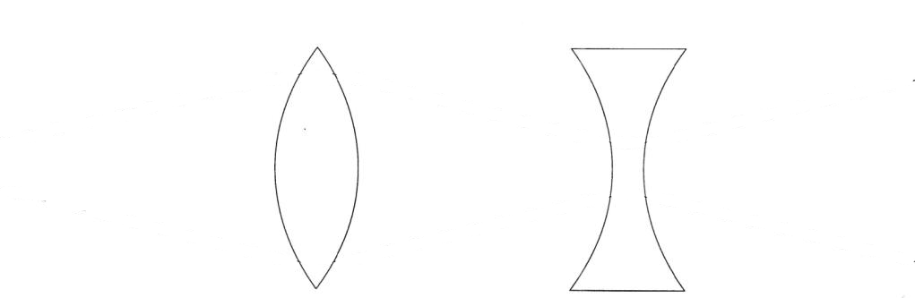
Lattice Optics: FODO Lives!
cell
Most accelerator lattices are designed in modular ways
  Design and operational clarity, separation of functions
One of the most common modules is a FODO module
  Alternating focusing and defocusing “strong” quadrupoles
  Spaces between are combinations of drifts and dipoles
  Strong quadrupoles dominate the focusing
  Periodicity is one FODO “cell” so we’ll investigate that motion
  Horizontal beam size largest at centers of focusing quads
  Vertical beam size largest at centers of defocusing quads

Slide 22
Periodic Example: FODO Cell Phase Advance
cell
Select periodicity between centers of focusing quads
  A natural periodicity if we want to calculate maximum β(s)
  only has real solutions (stability) if

Slide 23
Periodic Example: FODO Cell Beta Max/Min
cell
What is the maximum beta function, ?
  A natural periodicity if we want to calculate maximum β(s)
  Follow a similar strategy reversing F/D quadrupoles to find the minimum β(s) within a FODO cell (center of D quad)

Slide 24
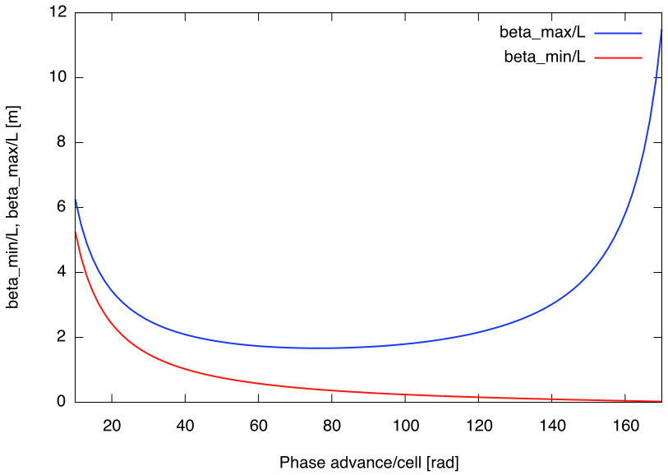
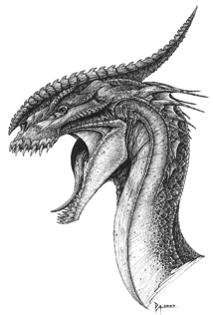
FODO Betatron Functions vs Phase Advance
Here there be dragons
Generally want /L small
Strong focusing
Smaller magnets
Less expensive accelerator
[deg]

Slide 25
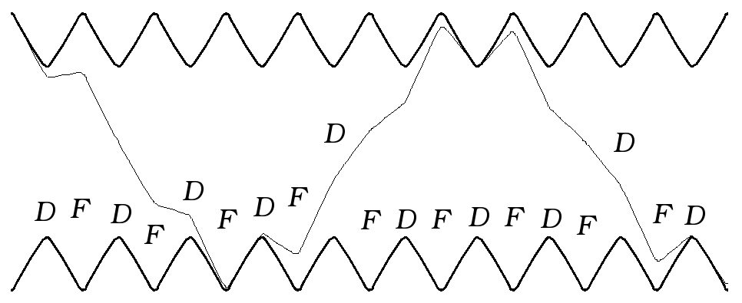
FODO Beta Function, Betatron Motion
Betatron motion
trajectory
design trajectory
This is a picture of a FODO lattice, showing contours of since the particle motion goes like
  This also shows a particle oscillating through the lattice
  Note that provides an “envelope” for particle oscillations
    is sometimes called the envelope function for the lattice
  Min beta is at defocusing quads, max beta is at focusing quads
  6.5 periodic FODO cells per betatron oscillation

Slide 26
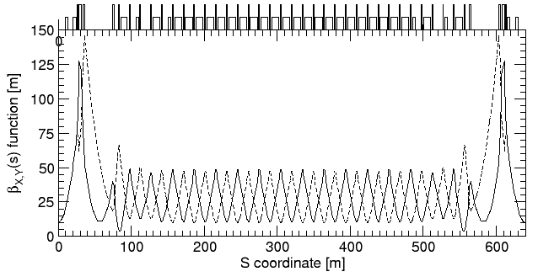
Example: RHIC FODO Lattice
quadrupoles
dipoles
low-beta insertion
low-beta insertion
Horizontal
Vertical
matching
FODO
1/6 of one of two RHIC synchrotron rings, injection lattice
  FODO cell length is about L=30 m
  Phase advance per FODO cell is about
☺

Slide 27
Propagating Lattice Parameters
If I have and I have the transport matrix that transports particles from , how do I find the new lattice parameters ?
Homework ☺

Slide 28
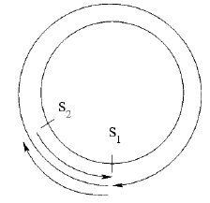
Propagating Lattice Parameters
If I have and I have the transport matrix that transports particles from , how do I find the new lattice parameters ?
  The J(s) matrices at s₁, s₂ are related by
  Then expand, using det M=1
  Your homework is to then show…
Notes:
M(s1)=Ic+Js
M(s2)= M(s1->s2)M(s1)M(s2->s1)=M(s1->s2)M(s1)M(s1->s2)^-1
Lots of things commute

Slide 29
========== What’s the Ellipse? ==========
Area of an ellipse that envelops a given percentage of the beam particles in phase space is related to the emittance
  We can express this in terms of our lattice functions!

Slide 30
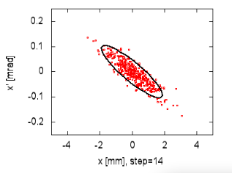
Invariants and Ellipses
We assumed A was constant, an invariant of the motion
  A can be expressed in terms of initial coordinates to find
  This is known as the Courant-Snyder invariant: for all s,
  Similar to total energy of a simple harmonic oscillator
  looks like an elliptical area in phase space
  Our matrices look like scaled rotations (ellipses) in phase space
s=s₀
s=s₀+C
s=s₀+2C
s=s₀+3C

Slide 31
Emittance
The area of the ellipse inscribed by any given particle in phase space as it travels through our accelerator is called the emittance : it is “constant” and given by
  Emittance is often quoted as the area of the ellipse that would contain a certain fraction of all (Gaussian) beam particles
  e.g. RMS emittance contains 39% of 2D beam particles
  Related to RMS beam size
  RMS beam size depends on s!
  RMS emittance convention is fairly standard
  for electron rings, with units of mm-mrad

Slide 32
Adiabatic Damping and Normalized Emittance
But we introduce electric fields when we accelerate
  When we accelerate, invariant emittance is not invariant!
  We are defining areas in phase space
  The definition of x doesn’t change as we accelerate
  But does since changes!
  scales with relativistic beta, gamma:
  This has the effect of compressing x’ phase space by
  Normalized emittance is the invariant in this case
    unnormalized emittance goes down as we accelerate
    This is called adiabatic damping, important in, e.g., linacs

Slide 33
Phase Space Ellipse Geography
y2
y1
CM Fig 5.2
x1
x2
Now we can figure out some things from a phase space ellipse at a given s coordinate:

Slide 34
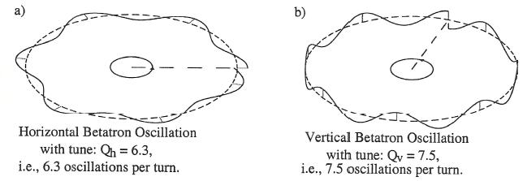
Rings and Tunes
A synchrotron is by definition a periodic focusing system
  It is very likely made up of many smaller periodic regions too
  We can write down a periodic one-turn matrix as before
  We define tune as the total betatron phase advance in one revolution around a ring divided by the total angle

Slide 35
Tunes
There are horizontal and vertical tunes
  turn by turn oscillation frequency
Tunes are a direct indication of the amount of focusing in an accelerator
  Higher tune implies tighter focusing, lower
Tunes are a critical parameter for accelerator performance
  Linear stability depends greatly on phase advance
  Resonant instabilities can occur when
  Often adjusted by changing groups of quadrupoles

Slide 36
6.2: Stability Diagrams
Designers often want or need to change the focusing of the two transverse planes in a FODO structure
  What happens if the focusing/defocusing strengths differ?
  Recalculate the M matrix and use dimensionless quantities
  then take the trace for stability conditions to find
cell

Slide 37
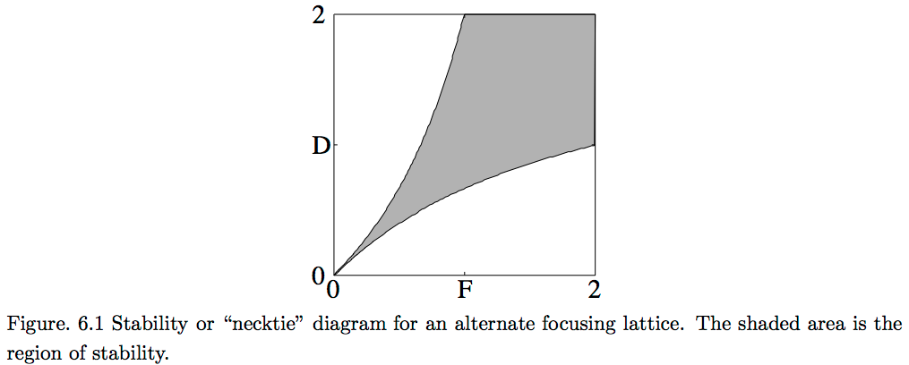
Stability Diagrams II
  For stability, we must have
  Using , stability limits are where
  These translate to a FODO “necktie” stability diagram

