Slide 1
Free Electron Lasers
I.M. Student
Doodledember 17th, 2018

Slide 2
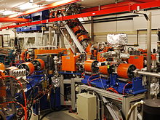
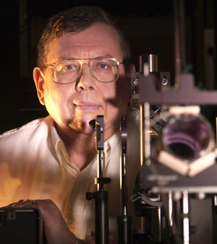
Introduction
What is a Free electron laser (FEL)?
A laser that uses an electron beam as the lasing medium, producing coherent electromagnetic radiation
Invented by John Madey in 1976
Above: Image of FEL
Below: John Madey with FEL

Slide 3
Differences in FELs and Lasers
Lasing medium
Tunability
Power
Cost ☹
Notes:
Electrons vs. gas/solid, microwaves (1 mm to 1 meter) to x-rays (0.01 to 10 nanometers), power over 10,000 watts to just watts

Slide 4
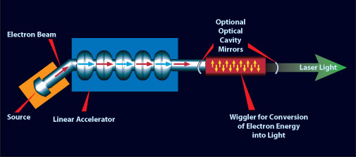
FEL Overview
Creation of electron beam
Beam Acceleration
Wiggler Section

Slide 5
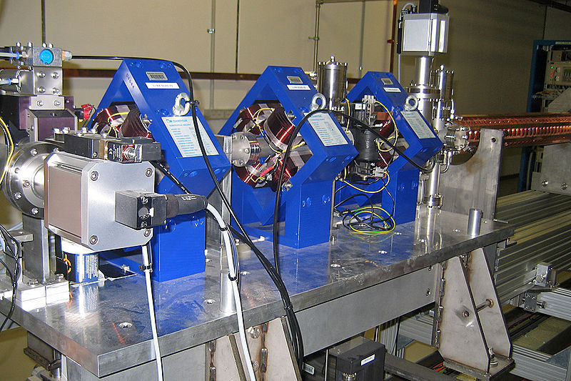
Beam Creation and Acceleration
Electron beam creation
Example: Thermionic emission
Acceleration of the beam
LINAC
Quadrupole magnets around a LINAC

Slide 6
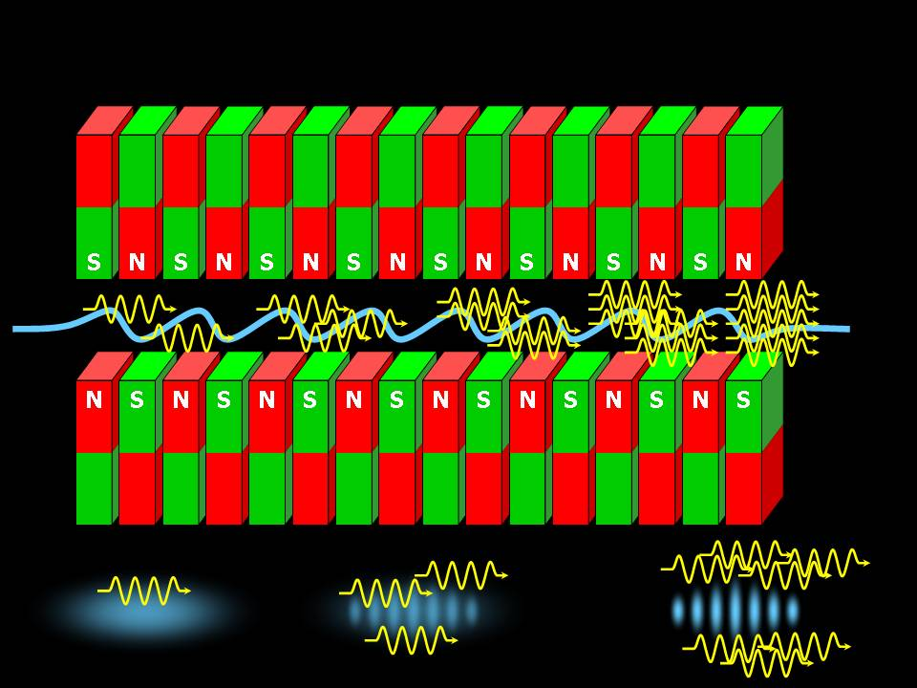
Wiggler Section
The electrons enter the wiggler, causing them to radiate (synchrotron radiation).
The radiation then stimulates the electrons by the ponderomotive force.
Coherent Radiation from Stimulated Emission
Notes:
ponderomotive force- interaction of transverse velocity with transverse EM B-field

Slide 7
Tuning the Wavelength
Wavelength can be tuned in two main ways:
Vary electron beam energy
Vary magnetic field strength by adjusting the distance between the two sets of magnets
Approach 2 is better if possible. If electron beam energy is varied too much, chromatic aberration can become problematic.

Slide 8
Linac Coherent Light Source (LCLS)
Brightest x-ray source in the world
Why X-rays?
X-rays have wavelengths smaller than molecules,
making them ideal for atomic imaging.
Pulses at less than 100 femtoseconds
100 fs = Time for light to travel width of a human hair
Imaging of proteins, plant photosynthesis, an intact virus in its natural state

Slide 9
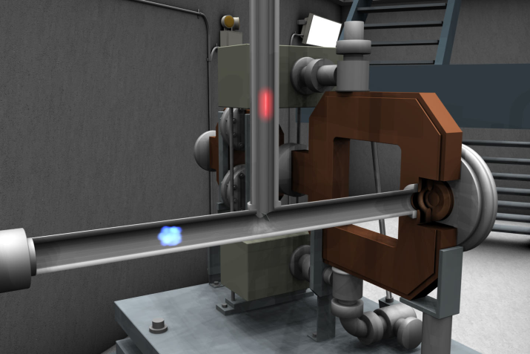
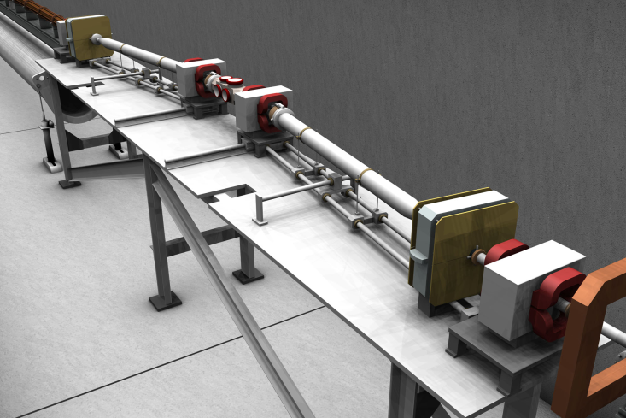
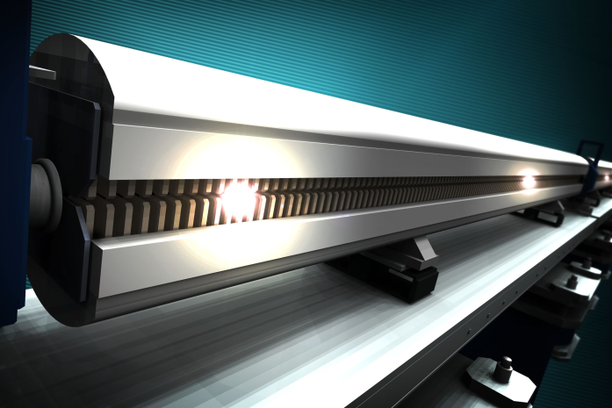
LCLS Pictures
1. Electron bunches are created with pulsed UV laser striking copper plate
2. Focusing quadrupoles during linear acceleration
3. 33 wigglers in all
Each 2 meters long and 1 ton

Slide 10
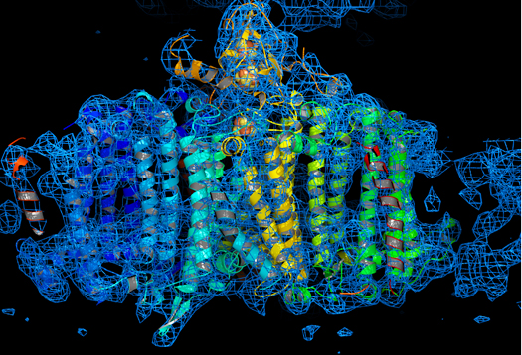
Protein Image from LCLS

Slide 11
References
http://en.wikipedia.org/wiki/Free_electron_laser
http://www.hawaii.edu/news/2011/11/03/madey-prize/
http://www.lightsources.org/cms/?pid=1001328
http://wwwold.jlab.org/div_dept/admin/publications/papers/98/ACC98-02.pdf
http://lcls.slac.stanford.edu/WhatIsLCLS_1.aspx
http://www.futurity.org/science-technology/x-ray-shows-%E2%80%98thrilling%E2%80%99-biology-in-action/

Slide 12
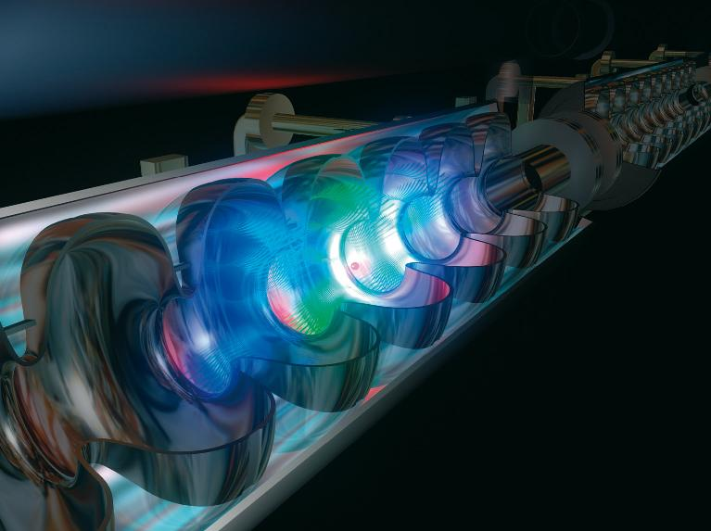
Thank you!

